Slide 1
Basics of SIR Models

Slide 2
Some Terms
Closed v Open populations
  Closed populations have no additions due to births or immigration and no losses due to death or emigration – all dynamics due only to infection
    Unrealistic, but simple and a good place to start
  Open populations can have births, immigration, deaths, emigration
    Either explicitly or implicitly
Equilibrium and Transient
  At equilibrium, the values of all states are constant – individuals may still get sick, recover, etc, but all changes balance each other out
  Dynamics are transient if the states are continuing to change … more nuance later

Slide 3
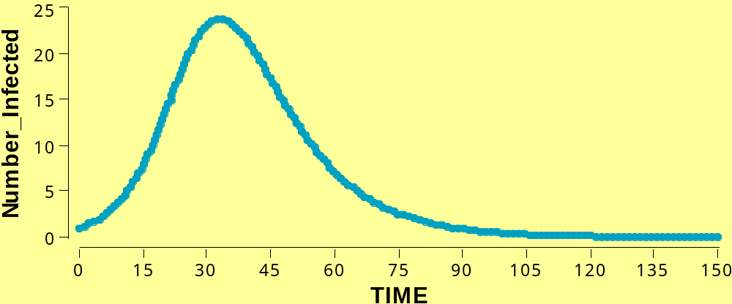
Phases of an Epidemic
1. start
2. early
3. peak
4. end
Susceptible
3
Infectious
1
4
2
Immune
After Medley & Nokes, course notes

Slide 4
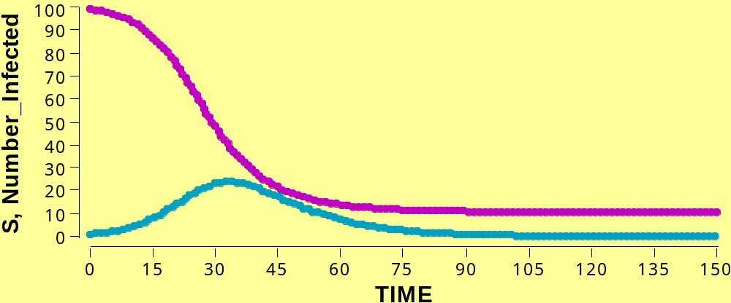
Idealized Epidemic in a Closed Community
S
I

Slide 5
Idealized Epidemic in a Closed Community
Starts with exponential growth
Growth rate slows … why?
When does epidemic stop growing?
When does epidemic stop?
S
I

Slide 6
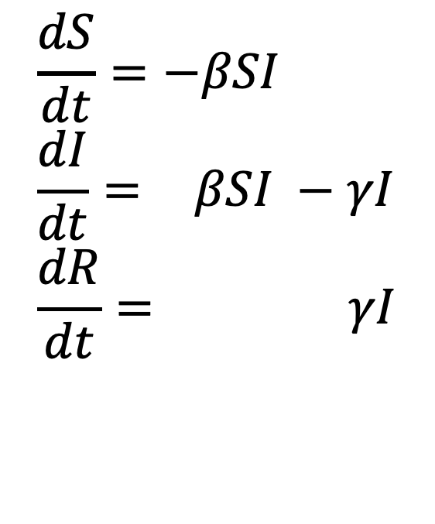
The SIR Model
$$\frac{dS}{dt}=−βSI \\ \frac{dI}{dt}=−βSI −γI \\ \frac{dR}{dt}=−βSI−γI$$
Under what conditions can the infectious compartment grow?
The States
S, I, and R reflect the number of individuals that are currently susceptible, infected (and infectious), and recovered, respectively

Slide 7
Idealized Epidemic in a Closed Community
What do we measure in the world?
Do we measure current Is (total infected),
OR
Do we measure new Is?
S
I

Slide 8
The SIR Model
$$\frac{dS}{dt}=−βSI \\ \frac{dI}{dt}=−βSI −γI \\ \frac{dR}{dt}=−βSI−γI$$
Under what conditions can the infectious compartment grow?
What do we measure in the world?
Do we measure current Is (total infected),
OR
Do we measure new Is?
How could we measure current Is?
How could we measure new Is?

Slide 9
The SIR Model
$$\frac{dS}{dt}=−βSI \\ \frac{dI}{dt}=−βSI −γI \\ \frac{dR}{dt}=−βSI−γI$$
Under what conditions can the infectious compartment grow?
Contact Process
This quantifies the rate at which susceptibles and infecteds interact
  Increases with number (or proportion) of each
  Creates non-linearity

Slide 10
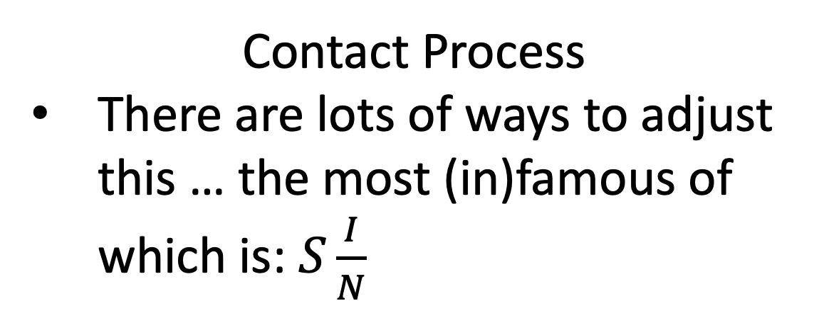
The SIR Model
$$\frac{dS}{dt}=−βSI \\ \frac{dI}{dt}=−βSI −γI \\ \frac{dR}{dt}=−βSI−γI$$
Under what conditions can the infectious compartment grow?
Contact Process
There are lots of ways to adjust this … the most (in)famous of which is: $S\frac{I}{N}$

Slide 11
The SIR Model
$$\frac{dS}{dt}=−βSI \\ \frac{dI}{dt}=−βSI −γI \\ \frac{dR}{dt}=−βSI−γI$$
Under what conditions can the infectious compartment grow?
Contact Process
What other ways might contacts change with the amount of infection?
Hint: think about behavior over the last 2 years

Slide 12
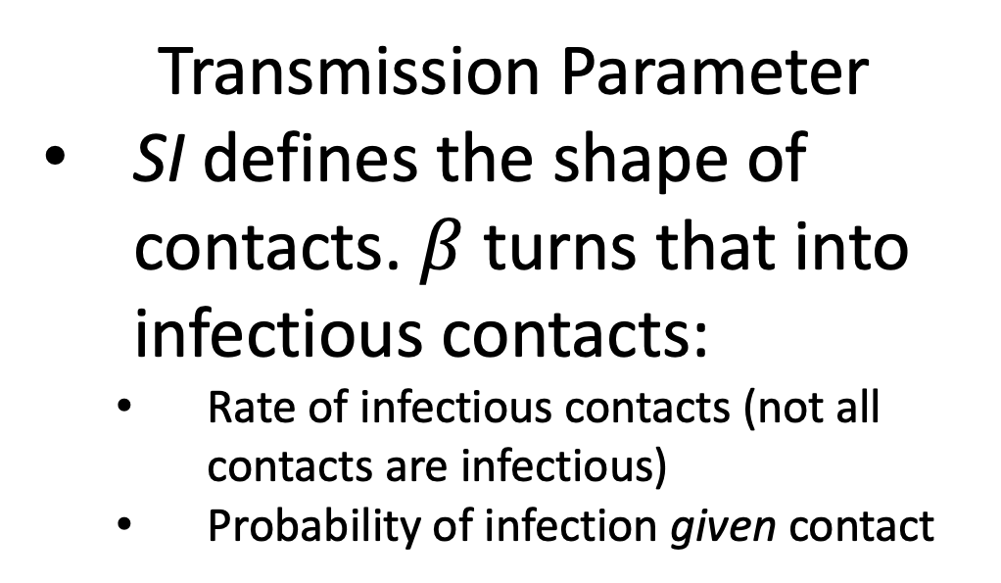
The SIR Model
$$\frac{dS}{dt}=−βSI \\ \frac{dI}{dt}=−βSI −γI \\ \frac{dR}{dt}=−βSI−γI$$
Under what conditions can the infectious compartment grow?
Transmission Parameter
SI defines the shape of contacts. $β$ turns that into infectious contacts:
  Rate of infectious contacts (not all contacts are infectious)
  Probability of infection given contact

Slide 13
The SIR Model
$$\frac{dS}{dt}=−βSI \\ \frac{dI}{dt}=−βSI −γI \\ \frac{dR}{dt}=−βSI−γI$$
Under what conditions can the infectious compartment grow?
Recovery Rate
This is the rate, number per time, of recovery (or removal)
If rate is high, many events happen per unit time and time between events is small

Slide 14
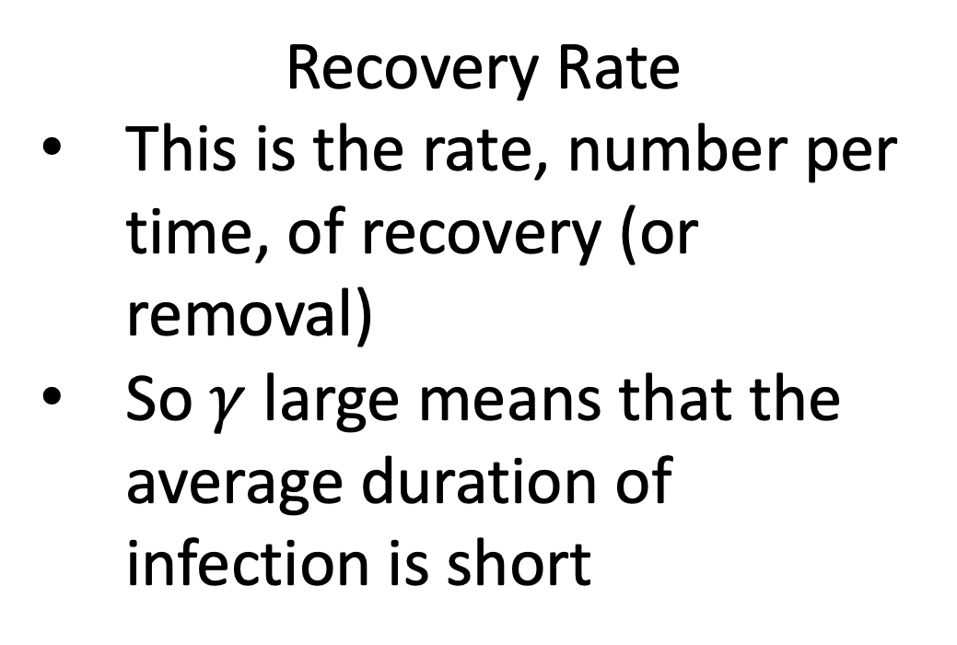
The SIR Model
$$\frac{dS}{dt}=−βSI \\ \frac{dI}{dt}=−βSI −γI \\ \frac{dR}{dt}=−βSI−γI$$
Under what conditions can the infectious compartment grow?
Recovery Rate
This is the rate, number per time, of recovery (or removal)
So $γ$ large means that the average duration of infection is short

Slide 15
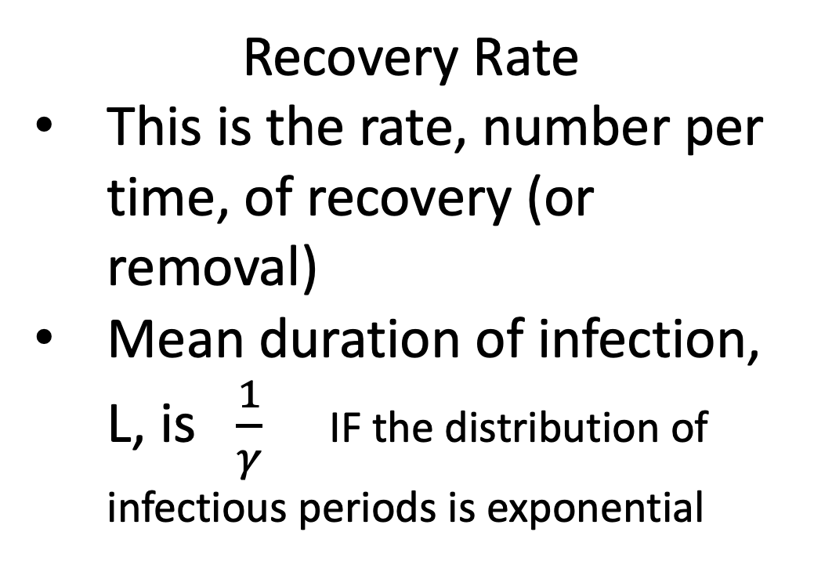
The SIR Model
$$\frac{dS}{dt}=−βSI \\ \frac{dI}{dt}=−βSI −γI \\ \frac{dR}{dt}=−βSI−γI$$
Under what conditions can the infectious compartment grow?
Recovery Rate
This is the rate, number per time, of recovery (or removal)
Mean duration of infection, L, is $\frac{1}{γ}$ IF the distribution of infectious periods is exponential
How realistic is this?
Why do we do this?

Slide 16
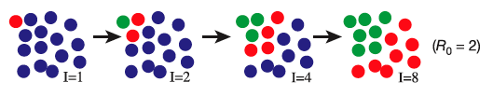
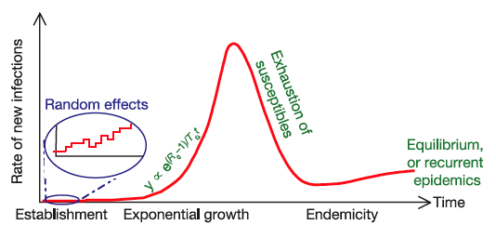
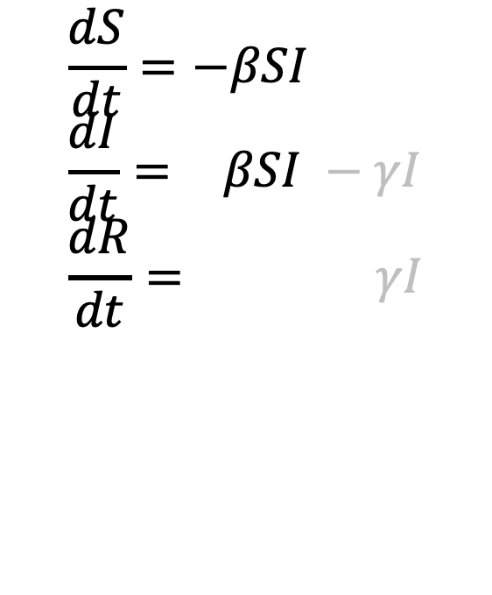
Basic Epidemic Theory
β
S
+
I
I
+
I
Infection
$$\frac{dS}{dt}=−βSI \\ \frac{dI}{dt}=−βSI −γI \\ \frac{dR}{dt}=−βSI−γI$$
γ
I
R
Recovery
At the start, when there are few infections, an epidemic grows (almost) exponentially
figures from Ferguson et al. Nature 2003

Slide 17
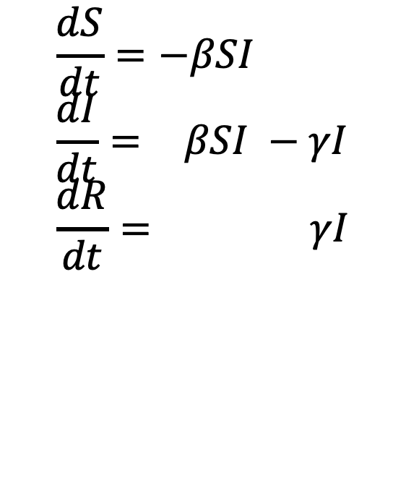
Basic Epidemic Theory
β
S
+
I
I
+
I
Infection
$$\frac{dS}{dt}=−βSI \\ \frac{dI}{dt}=−βSI −γI \\ \frac{dR}{dt}=−βSI−γI$$
γ
I
R
Recovery
As individuals recover and the number susceptible declines that growth slows because Susceptibles are being depleted
When does epidemic stop growing?
figures from Ferguson et al. Nature 2003

Slide 18
Idealized Epidemic in a Closed Community
What is the growth rate of the epidemic here?
S
I

Slide 19
Basic Reproduction Number
$$\frac{dS}{dt}=−βSI \\ \frac{dI}{dt}=−βSI −γI \\ \frac{dR}{dt}=−βSI−γI$$
Under what conditions can the infectious compartment grow?

Slide 20
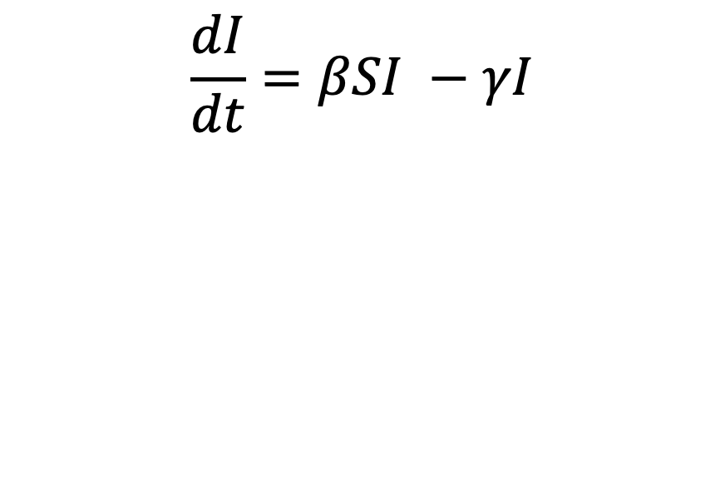
Basic Reproduction Number
$$\frac{dS}{dt}=−βSI \\ \frac{dI}{dt}=−βSI −γI \\ \frac{dR}{dt}=−βSI−γI$$
Under what conditions can the infectious compartment grow?
$$\frac{dI}{dt}=βSI −γI \\ 0= βSI −γI \\ 0= βS −γ \\ βS=γ \\ 1=\frac{βS}{γ}$$

Slide 21
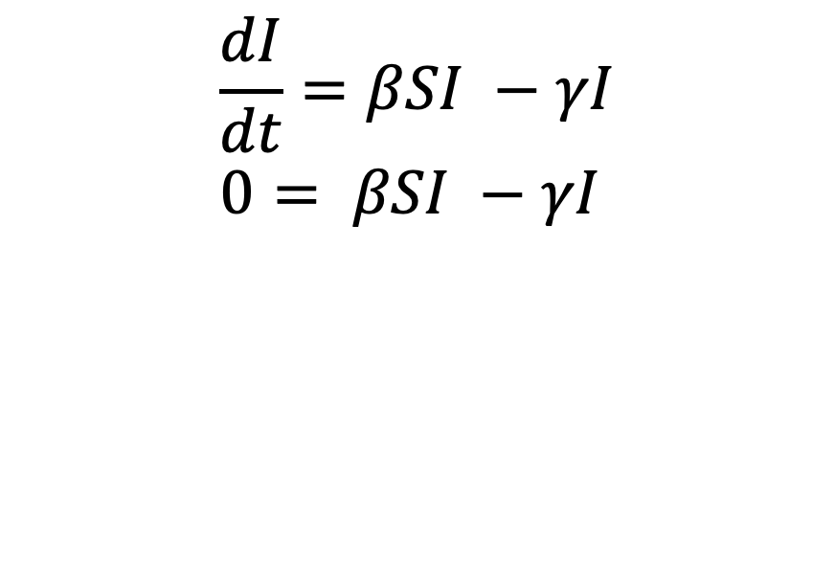
Basic Reproduction Number
$$\frac{dS}{dt}=−βSI \\ \frac{dI}{dt}=−βSI −γI \\ \frac{dR}{dt}=−βSI−γI$$
Under what conditions can the infectious compartment grow?
$$\frac{dI}{dt}=βSI −γI \\ 0= βSI −γI \\ 0= βS −γ \\ βS=γ \\ 1=\frac{βS}{γ}$$

Slide 22
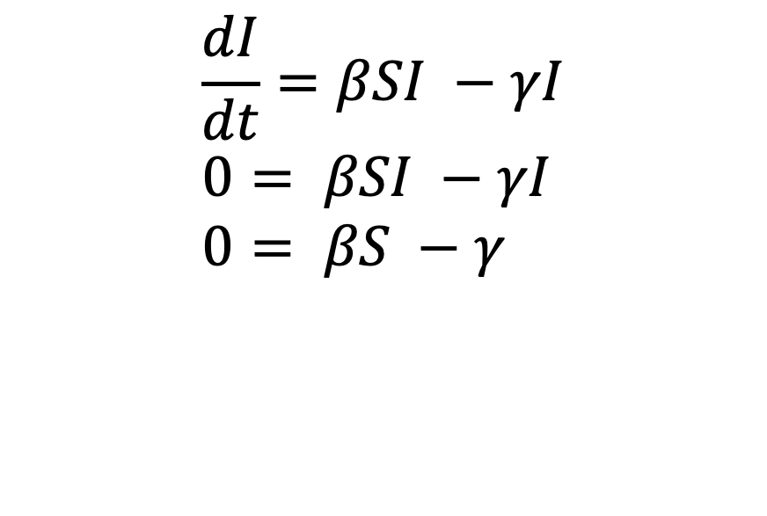
Basic Reproduction Number
$$\frac{dS}{dt}=−βSI \\ \frac{dI}{dt}=−βSI −γI \\ \frac{dR}{dt}=−βSI−γI$$
Under what conditions can the infectious compartment grow?
$$\frac{dI}{dt}=βSI −γI \\ 0= βSI −γI \\ 0= βS −γ \\ βS=γ \\ 1=\frac{βS}{γ}$$

Slide 23
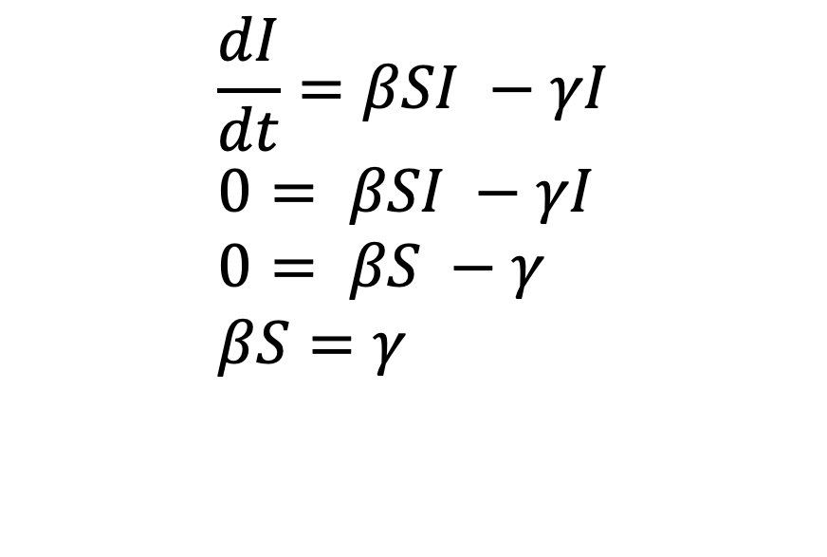
Basic Reproduction Number
$$\frac{dS}{dt}=−βSI \\ \frac{dI}{dt}=−βSI −γI \\ \frac{dR}{dt}=−βSI−γI$$
Under what conditions can the infectious compartment grow?
$$\frac{dI}{dt}=βSI −γI \\ 0= βSI −γI \\ 0= βS −γ \\ βS=γ \\ 1=\frac{βS}{γ}$$

Slide 24
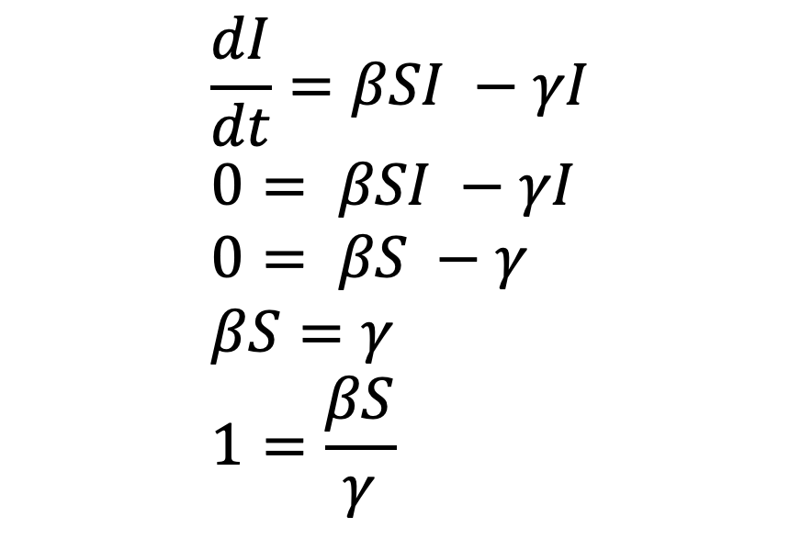
Basic Reproduction Number
$$\frac{dS}{dt}=−βSI \\ \frac{dI}{dt}=−βSI −γI \\ \frac{dR}{dt}=−βSI−γI$$
Under what conditions can the infectious compartment grow?
$$\frac{dI}{dt}=βSI −γI \\ 0= βSI −γI \\ 0= βS −γ \\ βS=γ \\ 1=\frac{βS}{γ}$$
Condition under which I doesn’t change

Slide 25
Basic Reproduction Number
$$\frac{dS}{dt}=−βSI \\ \frac{dI}{dt}=−βSI −γI \\ \frac{dR}{dt}=−βSI−γI$$
Under what conditions can the infectious compartment grow?
$$\frac{dI}{dt}=βSI −γI \\ 0= βSI −γI \\ 0= βS −γ \\ βS=γ \\ 1=\frac{βS}{γ}$$
Condition under which I doesn’t change

Slide 26
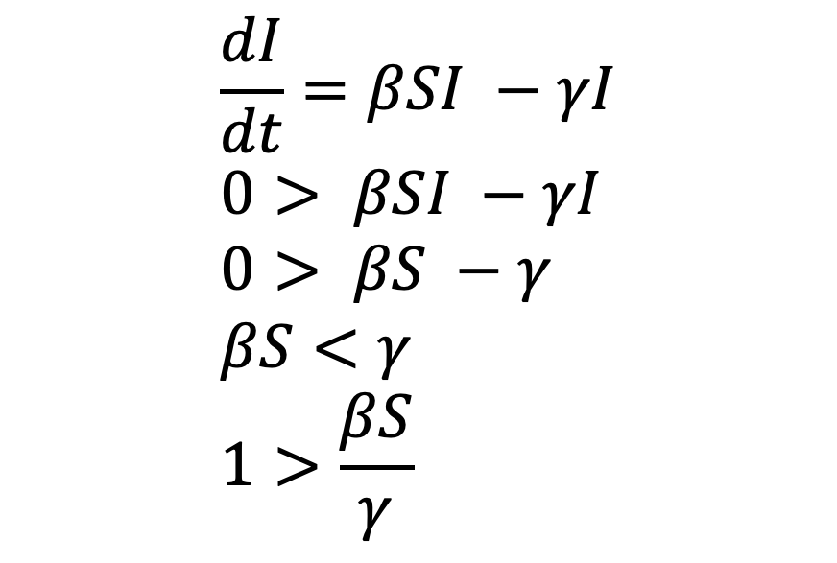
Basic Reproduction Number
$$\frac{dS}{dt}=−βSI \\ \frac{dI}{dt}=−βSI −γI \\ \frac{dR}{dt}=−βSI−γI$$
Under what conditions can the infectious compartment grow?
$$\frac{dI}{dt}=βSI −γI \\ 0> βSI −γI \\ 0> βS −γ \\ βS<γ \\ 1>\frac{βS}{γ}$$
Condition under which I declines … epidemic fades

Slide 27
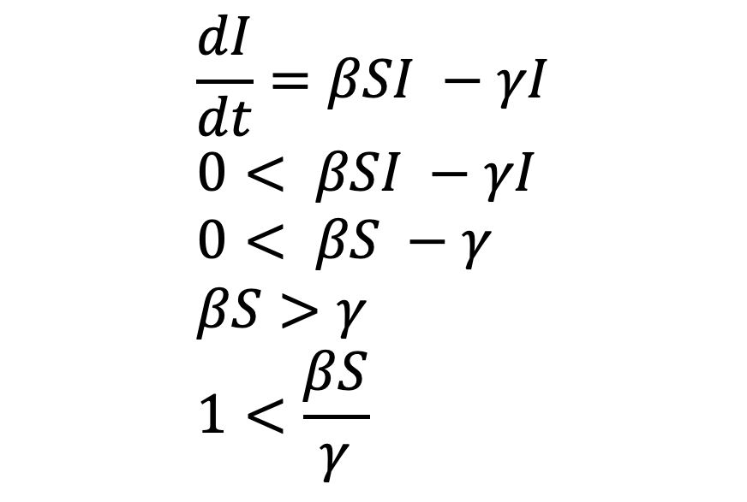
Basic Reproduction Number
$$\frac{dS}{dt}=−βSI \\ \frac{dI}{dt}=−βSI −γI \\ \frac{dR}{dt}=−βSI−γI$$
Under what conditions can the infectious compartment grow?
$$\frac{dI}{dt}=βSI −γI \\ 0< βSI −γI \\ 0< βS −γ \\ βS>γ \\ 1<\frac{βS}{γ}$$
Condition under which I grows … epidemic grows

Slide 28
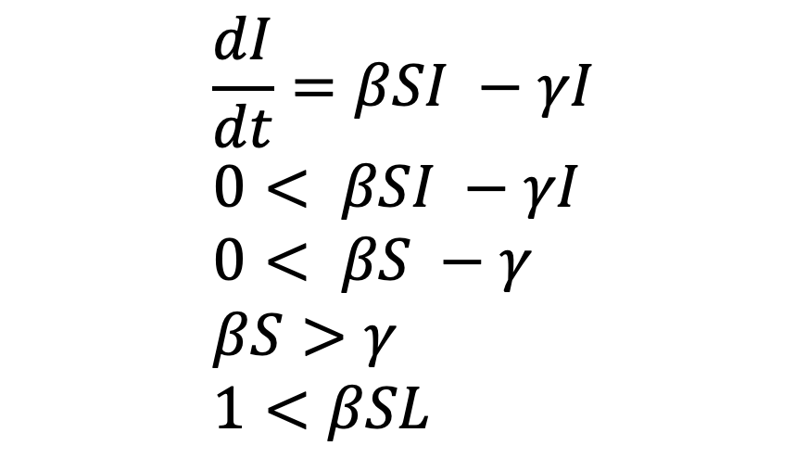
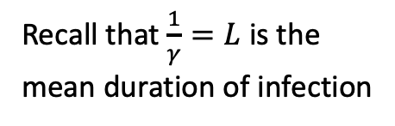
Basic Reproduction Number
$$\frac{dS}{dt}=−βSI \\ \frac{dI}{dt}=−βSI −γI \\ \frac{dR}{dt}=−βSI−γI$$
Under what conditions can the infectious compartment grow?
$$\frac{dI}{dt}=βSI −γI \\ 0< βSI −γI \\ 0< βS −γ \\ βS>γ \\ 1<βSL$$
Recall that $\frac{1}{γ}=L$ is the mean duration of infection

Slide 29
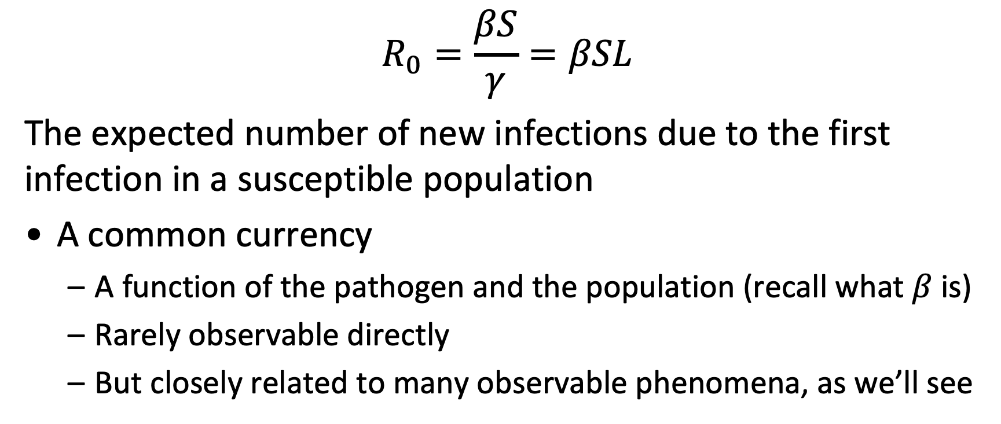
R₀: The Basic Reproduction Number
$$R_{0}=\frac{βS}{γ}=βSL$$
The expected number of new infections due to the first infection in a susceptible population
A common currency
  A function of the pathogen and the population (recall what $β$is)
  Rarely observable directly
  But closely related to many observable phenomena, as we’ll see

Slide 30
Estimated values of R0 for various infections
Measles | England | 1947 | 13-14
 | Nigeria | 1968 | 16-17
 | Kansas | 1920 | 5-6
Pertussis | England | 1944-78 | 16-18
 | Canada | 1912 | 7-8
Chickenpox | USA | 1912 | 7-8
 | USA | 1944 | 10-11

Slide 31
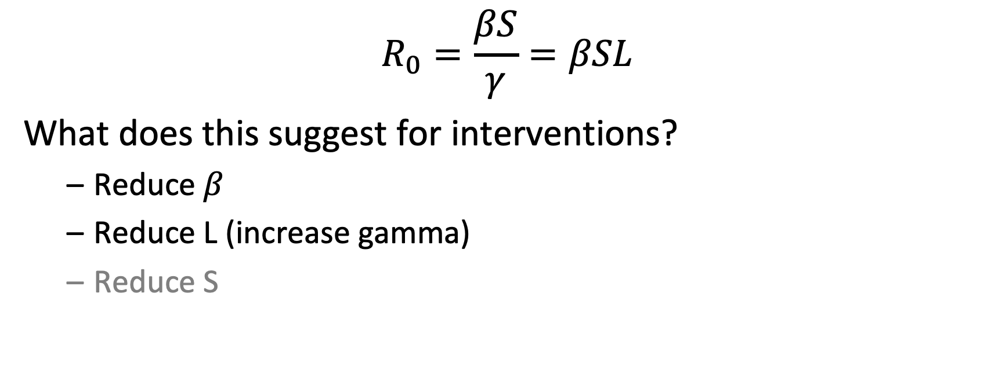
What Does This Mean for Interventions?
$$R_{0}=\frac{βS}{γ}=βSL$$
What does this suggest for interventions?
  Reduce $β$
  Reduce L (increase gamma)
  Reduce S

Slide 32
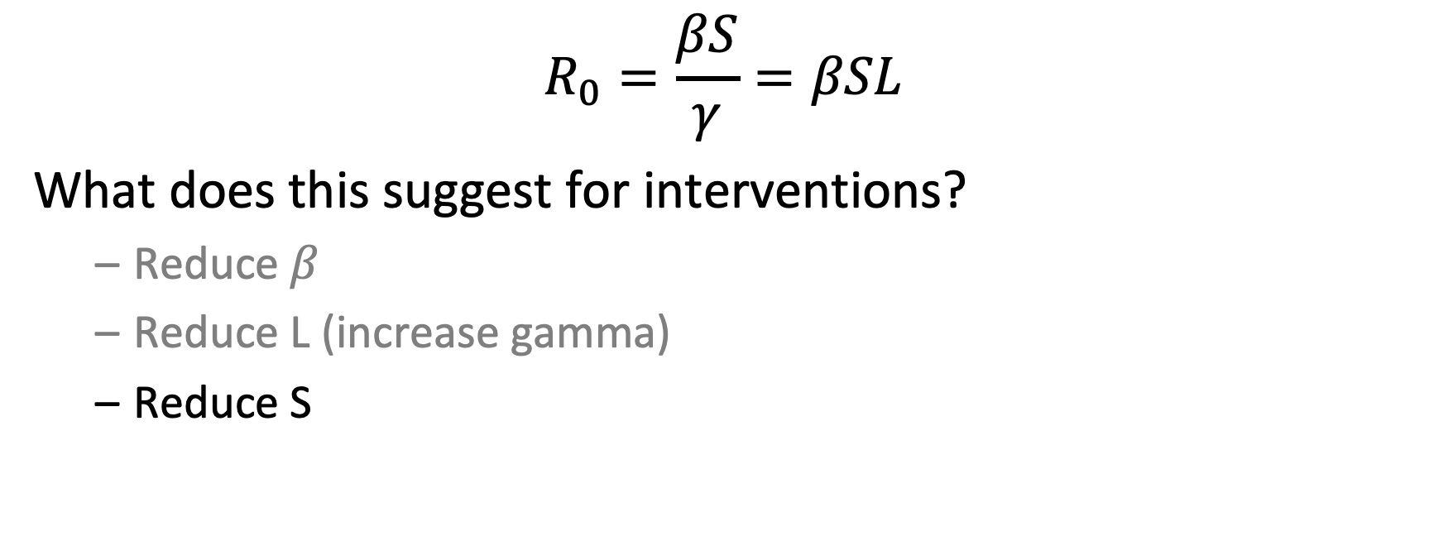
What Does This Mean for Interventions?
$$R_{0}=\frac{βS}{γ}=βSL$$
What does this suggest for interventions?
  Reduce $β$
  Reduce L (increase gamma)
  Reduce S

Slide 33
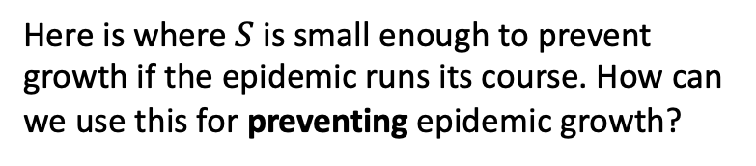
Idealized Epidemic in a Closed Community
Here is where $S$ is small enough to prevent growth if the epidemic runs its course. How can we use this for preventing epidemic growth?
S
I

Slide 34

R_{E} : The Effective Reproduction Number
$$R_{E}=\frac{βpS}{γ}=βpSL$$
What does this suggest for interventions?
  Reduce $β$
  Reduce L (increase gamma)
  Reduce S
p is the fraction susuceptible
1-p is the fraction immune
The expected number of new infections due to each infection in a population with some immunity

Slide 35
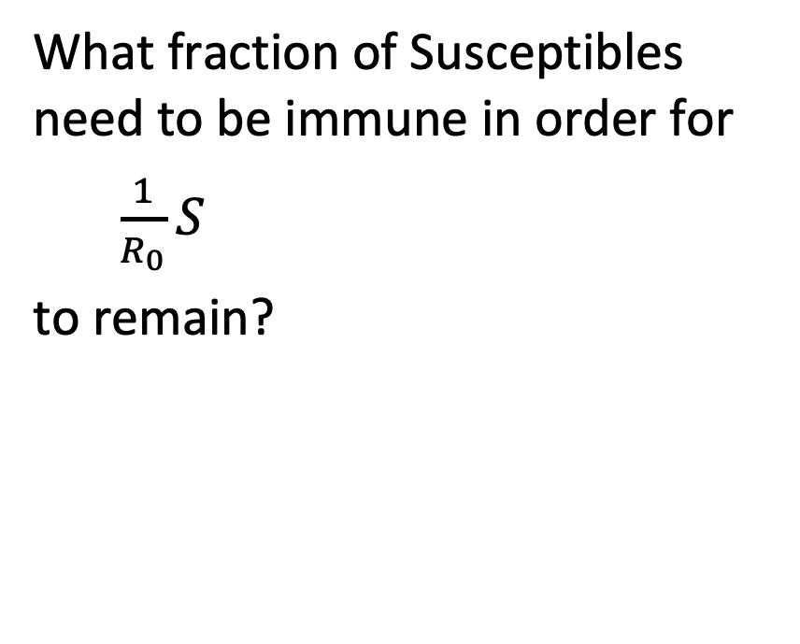
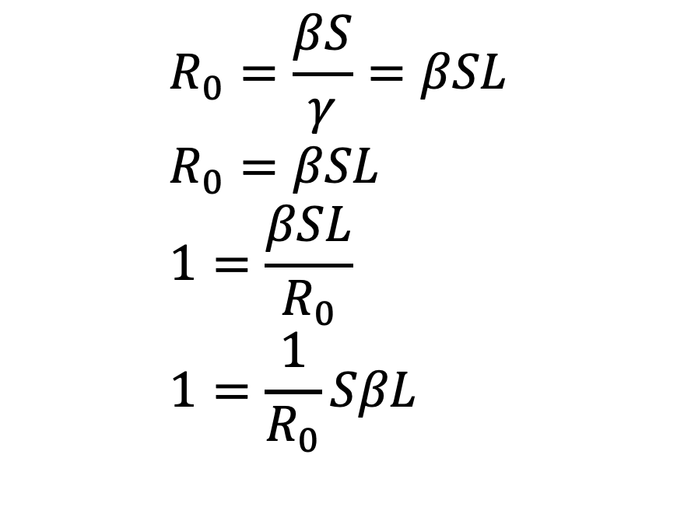
Herd Immunity Threshold
$$R_{0}=\frac{βS}{γ}=βSL \\ R_{0}=βSL \\ 1=\frac{βSL}{R_{0}} \\ 1=\frac{1}{R_{0}}SβL$$
What fraction of Susceptibles need to be immune in order for
$\frac{1}{R_{0}}S$
to remain?

Slide 36
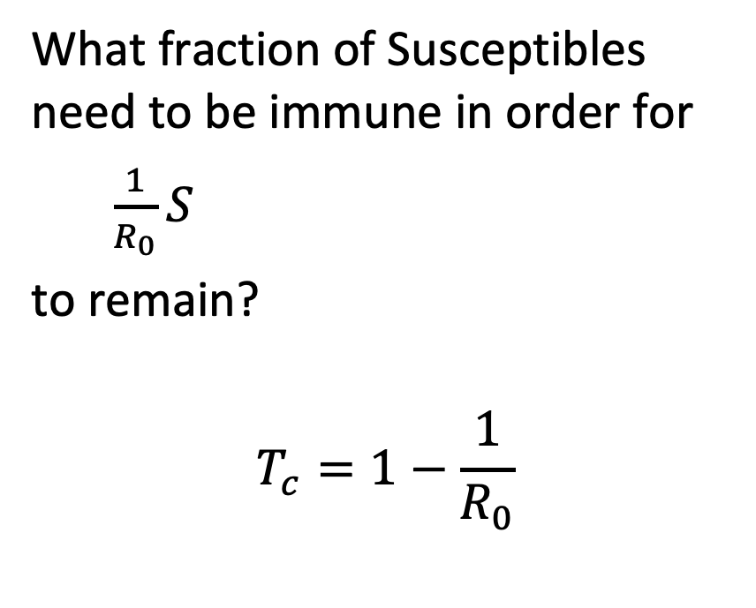
Herd Immunity Threshold
$$R_{0}=\frac{βS}{γ}=βSL \\ R_{0}=βSL \\ 1=\frac{βSL}{R_{0}} \\ 1=\frac{1}{R_{0}}SβL$$
What fraction of Susceptibles need to be immune in order for
$\frac{1}{R_{0}}S$
to remain?
$$T_{c}=1−\frac{1}{R_{0}}$$

Slide 37
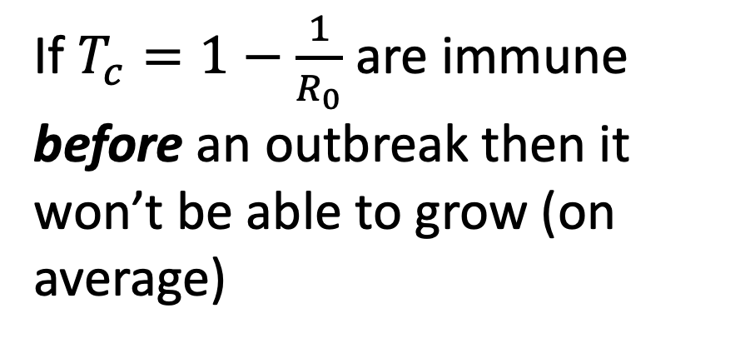
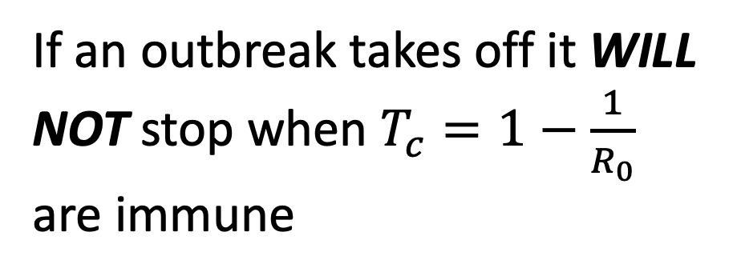
Herd Immunity Threshold
If $T_{c}=1−\frac{1}{R_{0}}$ are immune before an outbreak then it won’t be able to grow (on average)
If an outbreak takes off it WILL NOT stop when $T_{c}=1−\frac{1}{R_{0}}$ are immune

Slide 38
Herd Immunity Threshold
If $T_{c}=1−\frac{1}{R_{0}}$ are immune before an outbreak then it won’t be able to grow (on average)
If an outbreak takes off it WILL NOT stop when $T_{c}=1−\frac{1}{R_{0}}$ are immune
Why not?

Slide 39
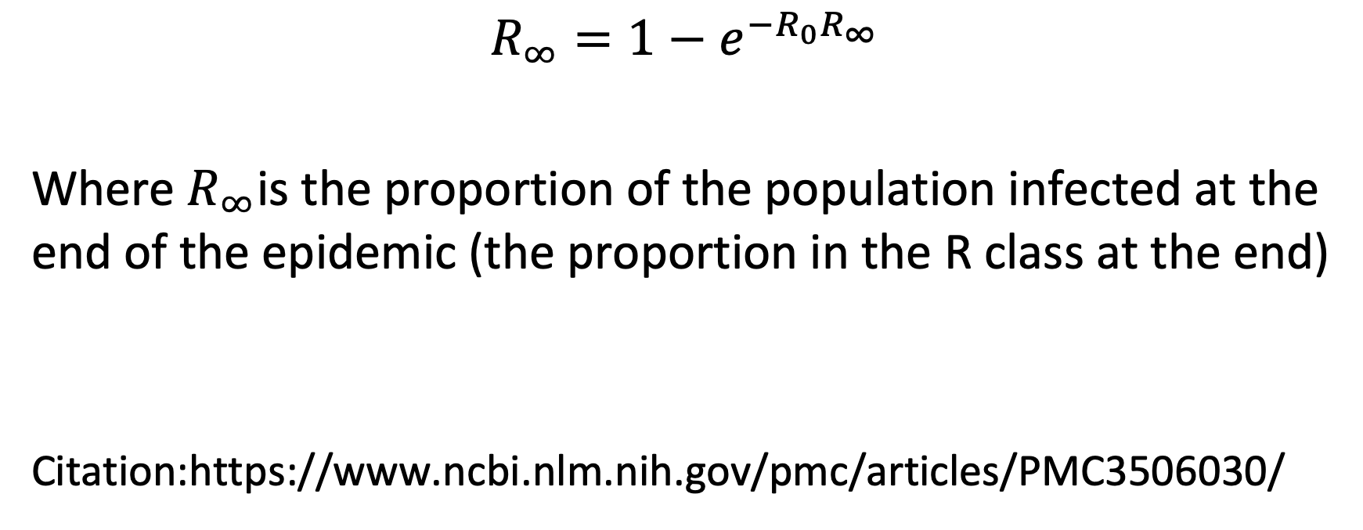
Final Size Calculation
$$R_{∞}=1−e^{−R_{0}R_{∞}}$$
Where $R_{∞}$is the proportion of the population infected at the end of the epidemic (the proportion in the R class at the end)
Citation:https://www.ncbi.nlm.nih.gov/pmc/articles/PMC3506030/

Slide 40
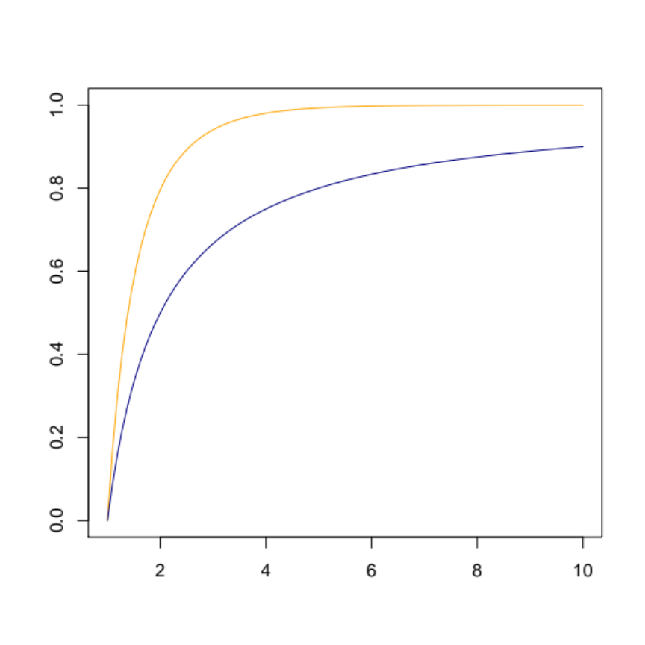
Comparing T_{c} and Final Size
Many more individuals will become infected in an epidemic (on average) than need to be immunized BEFORE an epidemic
Herd Immunity is a relevant concept throughout an epidemic (and helps stop them), the Herd Immunity Threshold is only relevant for preventing, not stopping outbreaks.
overshoot
Final size
Herd immunity threshold
R₀

Slide 41
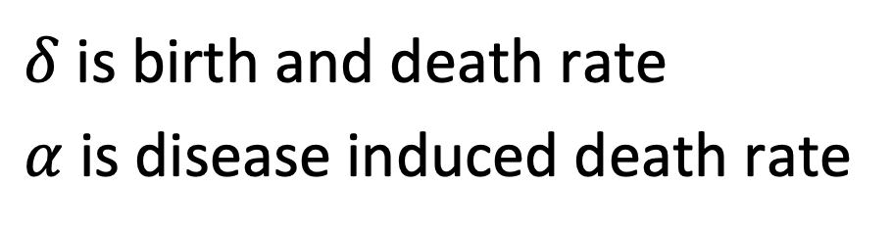
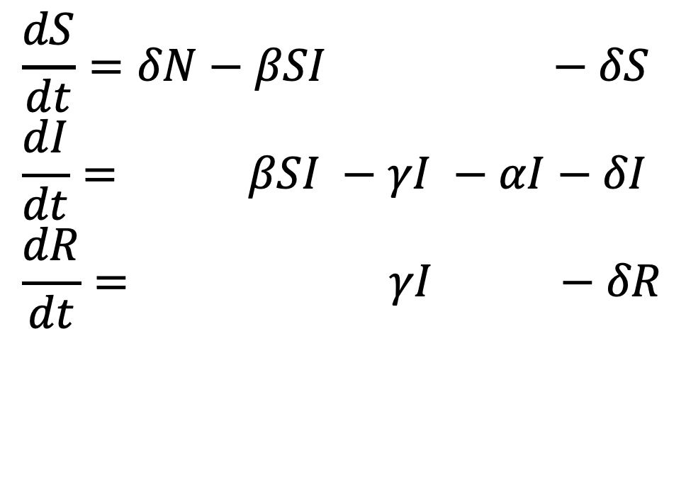
What Happens When Births Are Added?
$$\frac{dS}{dt}=δN−βSI−γI −αI−δS \\ \frac{dI}{dt}=δN−βSI −γI −αI−δI \\ \frac{dR}{dt}=δN−βSI−γI−αR−δR$$
$δ$ is birth and death rate
$α$ is disease induced death rate

Slide 42
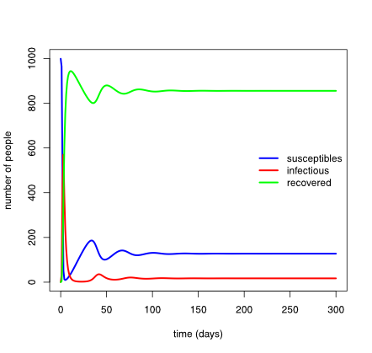
Dynamics Over Time
Note that after initial overshoot, susceptibles build back up until a new outbreak occurs, the second is smaller, and the third smaller than that

Slide 43
Some Terms
Closed v Open populations
  Closed populations have no additions due to births or immigration and no losses due to death or emigration – all dynamics due only to infection
    Unrealistic, but simple and a good place to start
  Open populations can have births, immigration, deaths, emigration
    Either explicitly or implicitly
Equilibrium and Transient
  At equilibrium, the values of all states are constant – individuals may still get sick, recover, etc, but all changes balance each other out
  Dynamics are transient if the states are continuing to change … more nuance later (really)

Slide 44
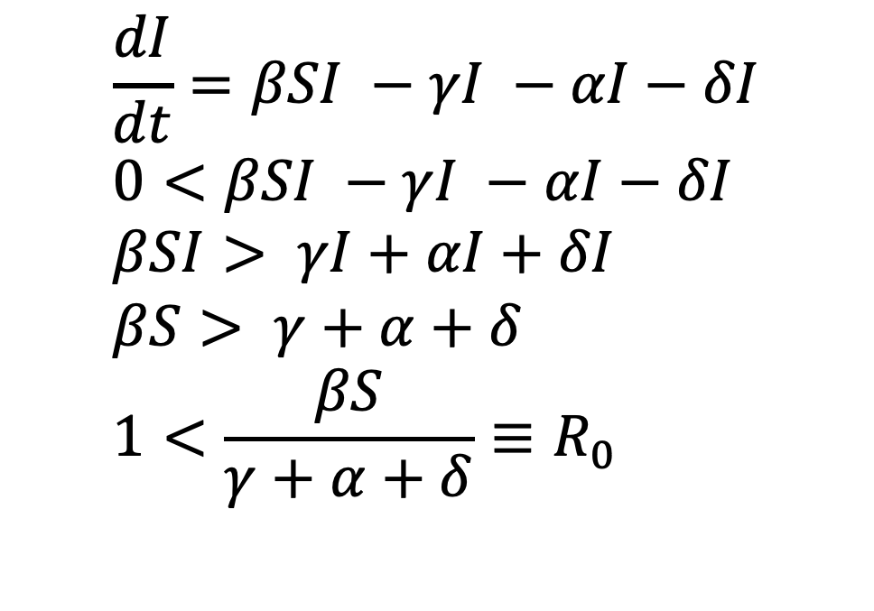
When Does I Stop Growing?
$$\frac{dI}{dt}=βSI −γI −αI−δI \\ 0<βSI −γI −αI−δI \\ βSI> γI+αI+δI \\ βS> γ+α+δ \\ 1<\frac{βS}{γ+α+δ}≡R_{0}$$
$δ$ is birth and death rate
$α$ is disease induced death rate

Slide 45
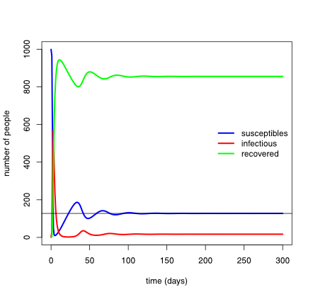
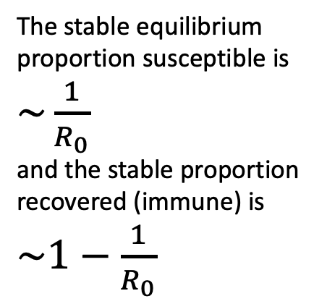
Equilibrium Dynamics
The stable equilibrium proportion susceptible is $\sim \frac{1}{R_{0}}$
and the stable proportion recovered (immune) is $\sim 1−\frac{1}{R_{0}}$

Slide 46
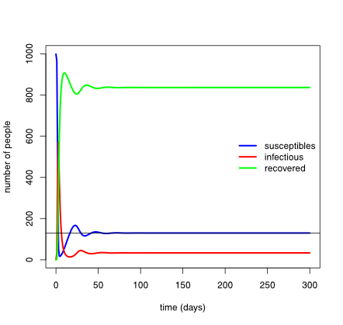
Birth Rate Changes the Speed to Equilibrium
If we increase the birth rate, it takes less time to reach equilibrium under the assumption that the population isn’t growing

Slide 47
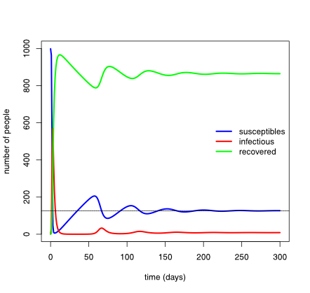
Birth Rate Changes the Speed to Equilibrium
If we decrease the birth rate, it takes longer to reach equilibrium under the assumption that the population isn’t growing

Slide 48
What about growing populations?
Growing populations have more susceptibles added than recovereds being taken away (by death)
  So a greater fraction susceptible, less indirect protection, and more transmission
More of those susceptibles are young, so if young and old have different contact rates, then transmission and dynamics will differ in young vs. old populations …

Slide 49
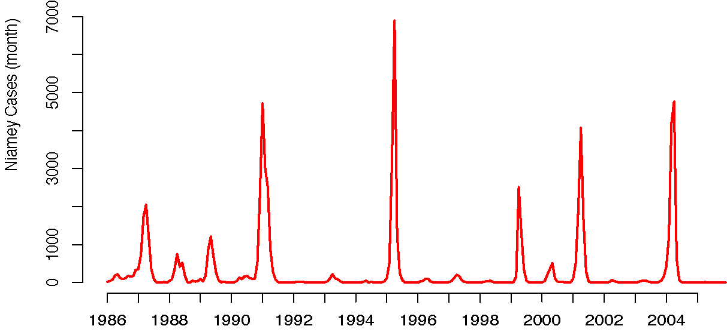
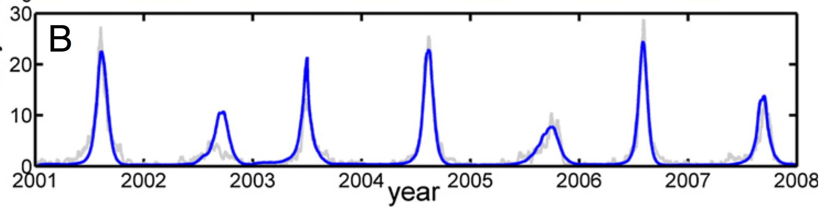
Seasonality and Cycles
Measles in Niamey
Influenza in Jerusalem

Slide 50
Some Terms
Closed v Open populations
  Closed populations have no additions due to births or immigration and no losses due to death or emigration – all dynamics due only to infection
    Unrealistic, but simple and a good place to start
  Open populations can have births, immigration, deaths, emigration
    Either explicitly or implicitly
Equilibrium and Transient
  At equilibrium, the values of all states are constant – individuals may still get sick, recover, etc, but all changes balance each other out
  An attractor is collection of states towards which a system tends – it’s regular and predictable, but not static.
  Dynamics are transient if the states are continuing to change

Slide 51
Seasonality and Cycles
Long term dynamics often exhibit regular fluctuations around the equilibrium levels because of seasonal changes in
  Environmental conditions
  Behavior
  Population movement/aggregation
  Vector seasonality
Examples
Influenza
Lassa fever
Legionellosis
Leptospirosis
Meningococcal meningitis
Polio
Typhoid

Slide 52
Seasonality and Cycles
Long term dynamics often exhibit regular fluctuations around the equilibrium levels because of seasonal changes in
  Environmental conditions
  Behavior
  Population movement/aggregation
  Vector seasonality
Examples
Chickenpox
Measles
Pertussis
Rubella

Slide 53

Seasonality and Cycles
Long term dynamics often exhibit regular fluctuations around the equilibrium levels because of seasonal changes in
  Environmental conditions
  Behavior
  Population movement/aggregation
  Vector seasonality
Examples
Influenza
Lassa fever
Legionellosis
Leptospirosis
Meningococcal meningitis
Polio
Typhoid
Examples
Chickenpox
Measles
Pertussis
Rubella
Modeled as a temporal change in $β$

Slide 54

Seasonality and Cycles
Long term dynamics often exhibit regular fluctuations around the equilibrium levels because of seasonal changes in
  Environmental conditions
  Behavior
  Population movement/aggregation
  Vector seasonality
Examples
Measles
Meningococcal meningitis
Modeled as a temporal change in $β$or S

Slide 55
Seasonality and Cycles
Long term dynamics often exhibit regular fluctuations around the equilibrium levels because of seasonal changes in
  Environmental conditions
  Behavior
  Population movement/aggregation
  Vector seasonality
Examples
Chikungunya
Dengue
Malaria
Trypanosomiasis
West Nile Virus
Yellow Fever
Requires a new compartment for the vector populations

