Slide 1
Age Structure

Slide 2
Connection to previous lecture
  Balance of birth and death rates creates population structure
  Longer life means a greater fraction of population is likely to be immune and can contribute to herd immunity
  Many births and high death rate means that most of the population is in the susceptible class and can contribute to transmission

Slide 3
R0 and Age
Remember relationship between rate of recovery and duration of infection (or time to recovery)
  Average time to an event is the inverse of its rate
Relation between mean age of infection and R₀
  R₀ reflects the rate of infection, mean age is the average time from birth to infection
  Basic calculation requires strong assumption that age-specific force of infection is constant
What does this mean for control?

Slide 4
R0 and Age
Remember relationship between rate of recovery and duration of infection (or time to recovery)
  Average time to an event is the inverse of its rate
Relation between mean age of infection and R₀
  R₀ reflects the rate of infection, mean age is the average time from birth to infection
  Basic calculation requires strong assumption that age-specific force of infection is constant
What does this mean for control?

Slide 5
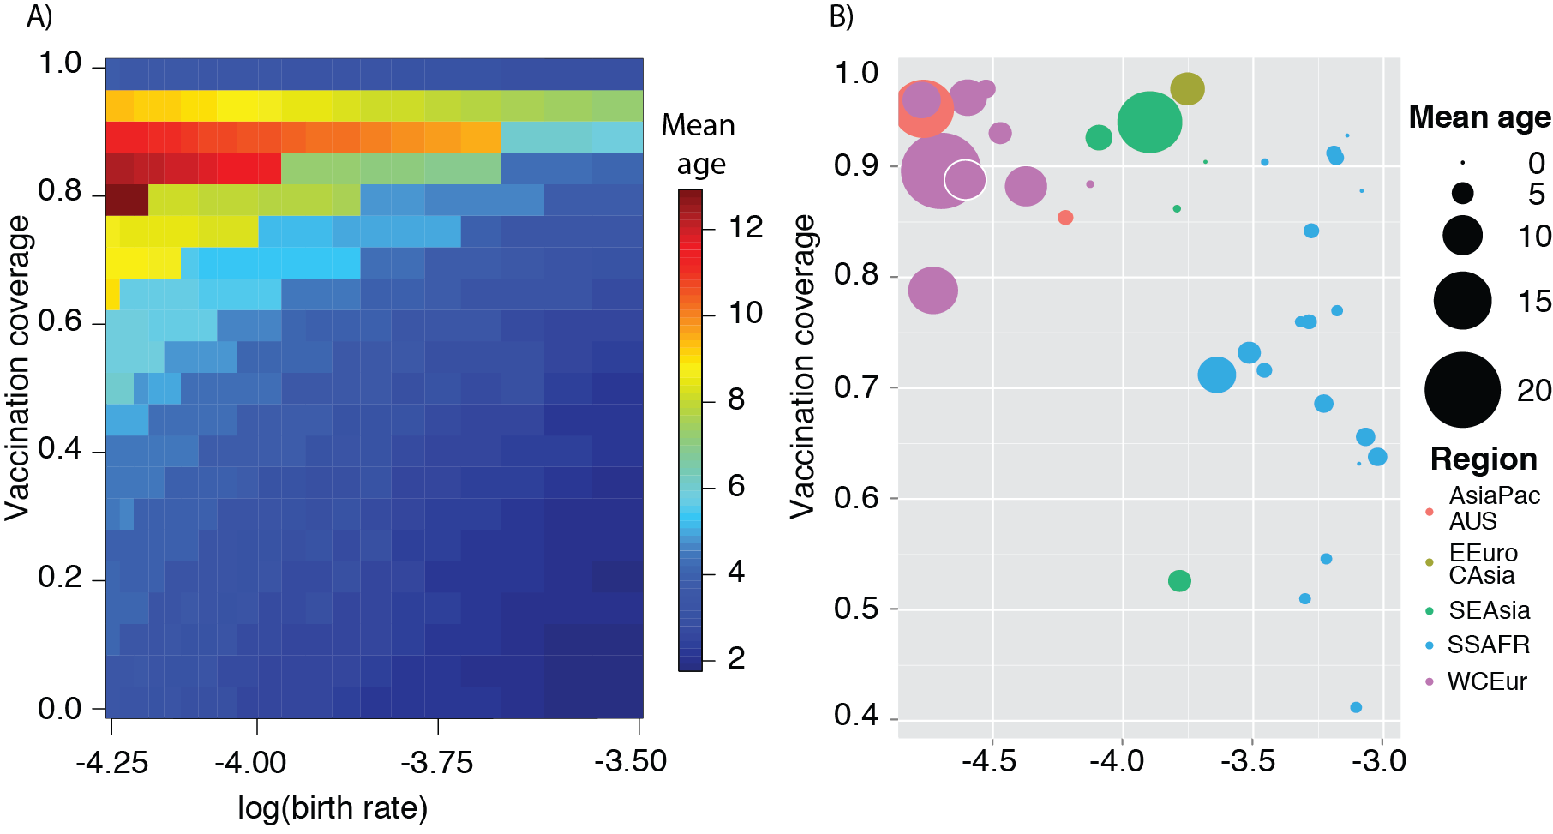
Intuition About Mean Age of Infection
Reduced prevalence of infection results in lower force of infection on each susceptible individual
18 23 30
Births per 1000
Notes:
So I’ve been increasingly interested in the inferences we can make when we look at age specific data
In particular, as prevalence declines – there is lower force of infection on each susceptible

Slide 6
Intuition About Mean Age of Infection
Reduced prevalence of infection results in lower force of infection on each susceptible individual
Longer wait until contact between susceptible and infectious individuals
18 23 30
Births per 1000
Notes:
This means there is a longer wait until contact with an infectious individual

Slide 7
Intuition About Mean Age of Infection
Reduced prevalence of infection results in lower force of infection on each susceptible individual
Longer wait until contact between susceptible and infectious individuals
Lower force of infection implies higher mean age at infection
18 23 30
Births per 1000
Notes:
And thus higher mean age of infection – and absolute value will be mediated by underlying demographic rates

Slide 8
Intuition About Mean Age of Infection
Reduced prevalence of infection results in lower force of infection on each susceptible individual
Longer wait until contact between susceptible and infectious individuals
Lower force of infection implies higher mean age at infection
18 23 30
Births per 1000
Notes:
But the sensitivity of age as an indicator is mediated by underlying demographic rates

Slide 9
Observation About Mean Age of Infection
50 Countries reporting > 100 cases
18 23 30
Births per 1000
11 18 30 50
Births per 1000
Ferrari et al 2013
Notes:
And this is a robust pattern seen in many empirical systems

Slide 10
R0 and Age
Remember relationship between rate of recovery and duration of infection (or time to recovery)
  Average time to an event is the inverse of its rate
Relation between mean age of infection and R₀
  R₀ reflects the rate of infection, mean age is the average time from birth to infection
  Basic calculation requires strong assumption that age-specific force of infection is constant
What does this mean for control?

Slide 11
R0 and Age
Remember relationship between rate of recovery and duration of infection (or time to recovery)
  Average time to an event is the inverse of its rate
Relation between mean age of infection and R₀
  R₀ reflects the rate of infection, mean age is the average time from birth to infection
  Basic calculation requires strong assumption that age-specific force of infection is constant
    What evidence do we have that this is or IS NOT the case?
What does this mean for control?

Slide 12
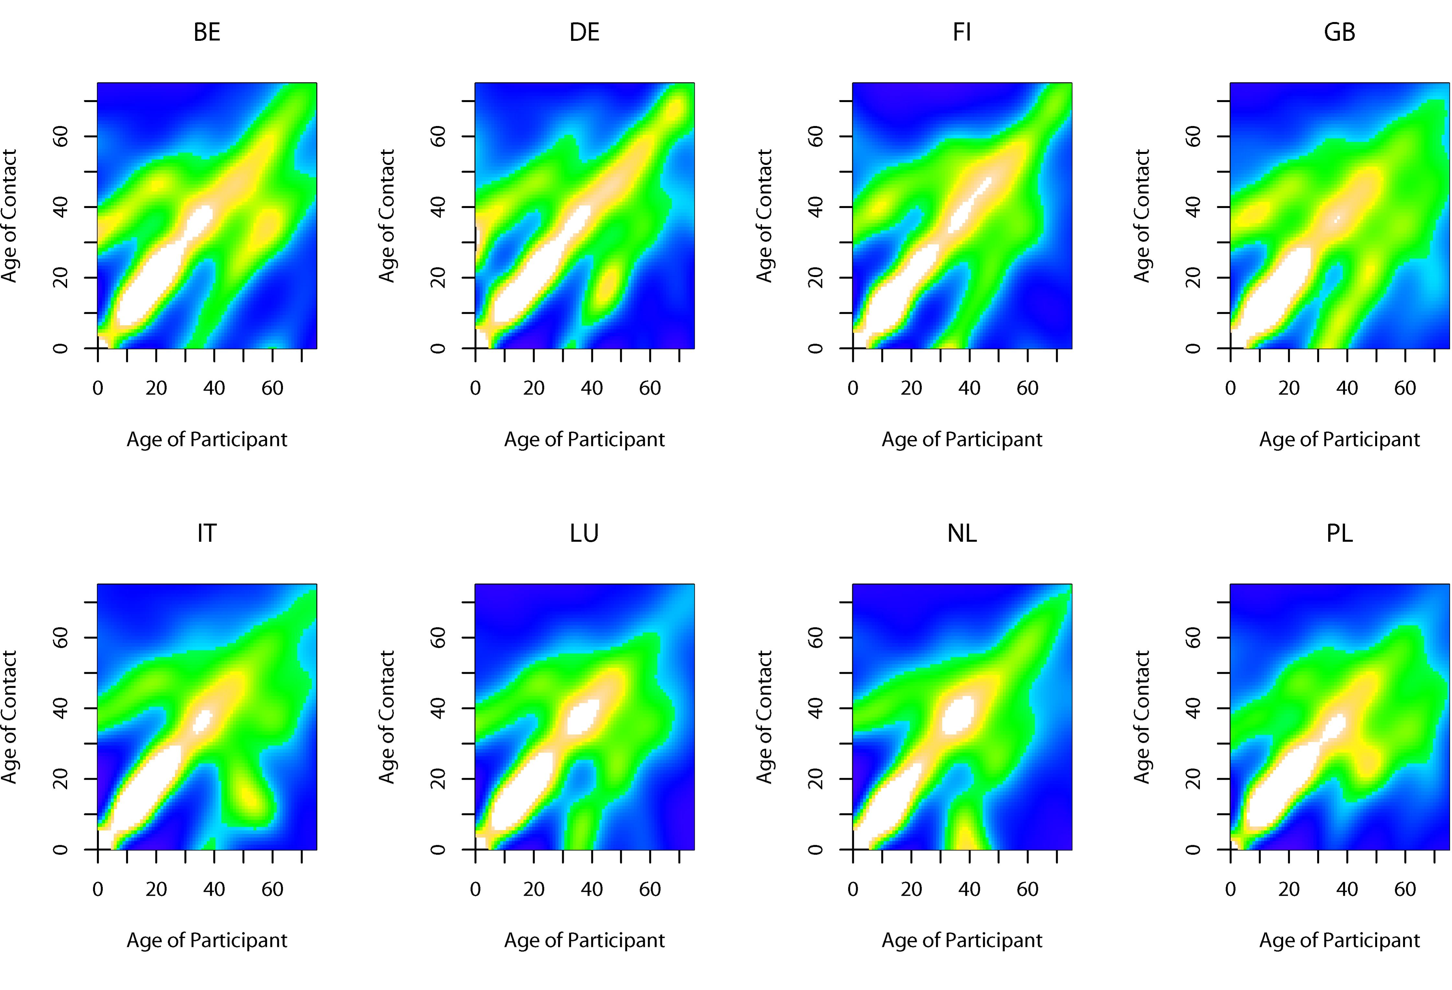
Age-related contact patterns
Mossong et al. PLoS Med 2007

Slide 13
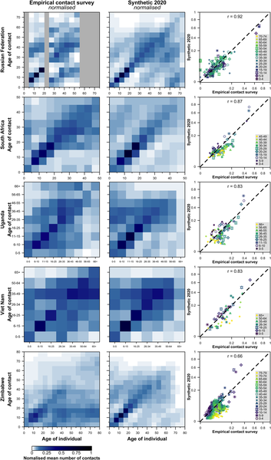
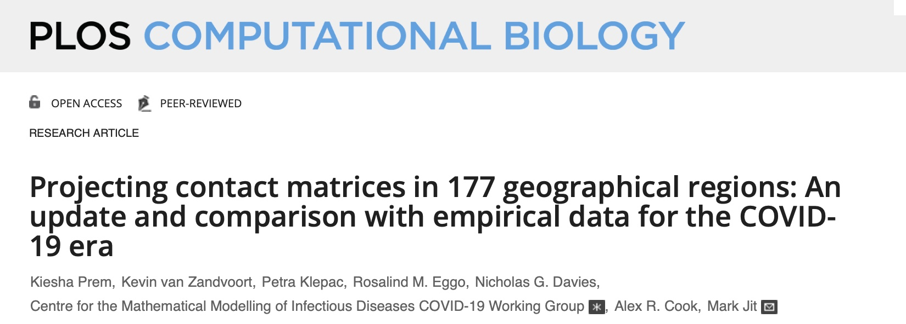
Age-related contact patterns

Slide 14
Age-related contact patterns
How diary studies relate to transmissible contacts is unclear
The applicability of these matrices to different pathogens and modes of transmission is still uncertain

Slide 15
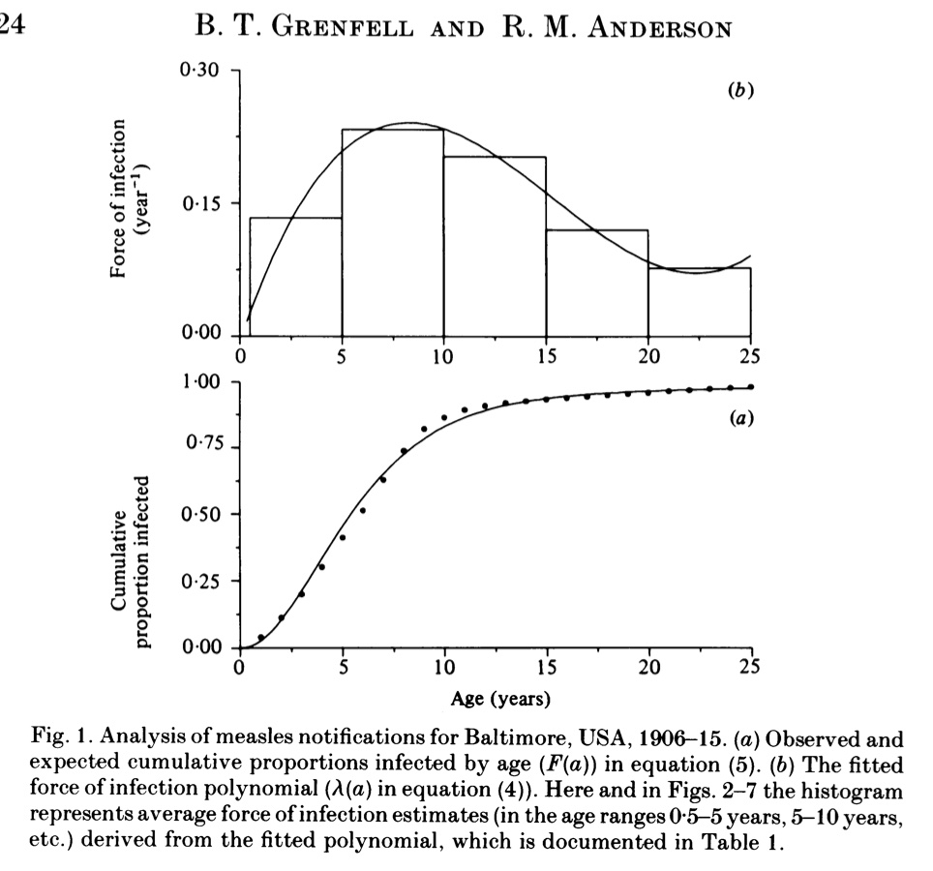
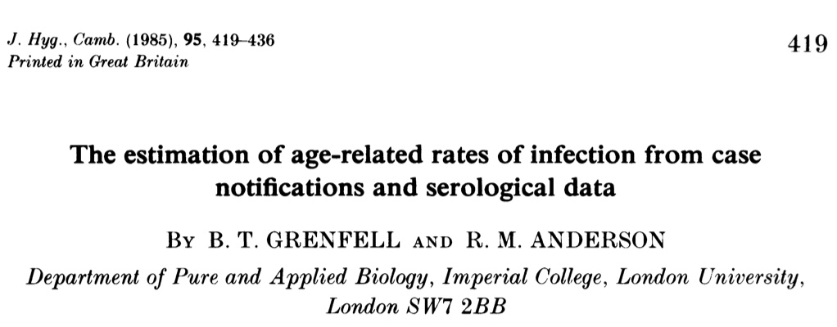
Estimated FOI – Catalytic model
Empirical evidence based on distribution of infection or seroprevalence

Slide 16
Inference from Age Distribution of Cases
Differences in behavior and exposure result in age-specific risk, or force of infection
The likelihood of observing a case at age A is related to the integral of all risk prior to A
Basis of the catalytic model
  Griffiths (1974)
  Grenfell and Anderson (1985)

Slide 17
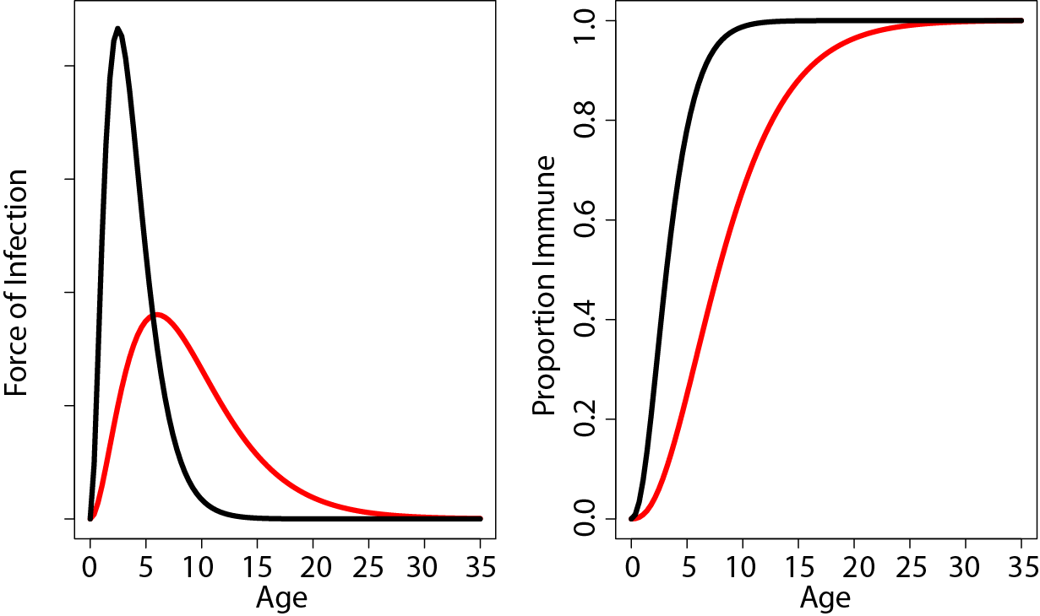
Catalytic Model
The age specific Force of Infection is the rate at which individuals of each age are exposed to infection
The shape of this function reflects the absolute risk (height) and the age ranges over which infection is most likely (breadth of the curve)

Slide 18
Catalytic Model
The age specific Force of Infection is the rate at which individuals of each age are exposed to infection
The shape of this function reflects the absolute risk (height) and the age ranges over which infection is most likely (breadth of the curve)
How does this differ from the WAIFW matrix?
How does this differ from diary studies?

Slide 19
Catalytic Model
The proportion immune (i.e. sero(+)) at each age is the equal to the sum of all age-specific risk prior to that age

Slide 20

Catalytic Model
The proportion immune (i.e. sero(+)) at each age is the equal to the sum of all age-specific risk prior to that age

Slide 21
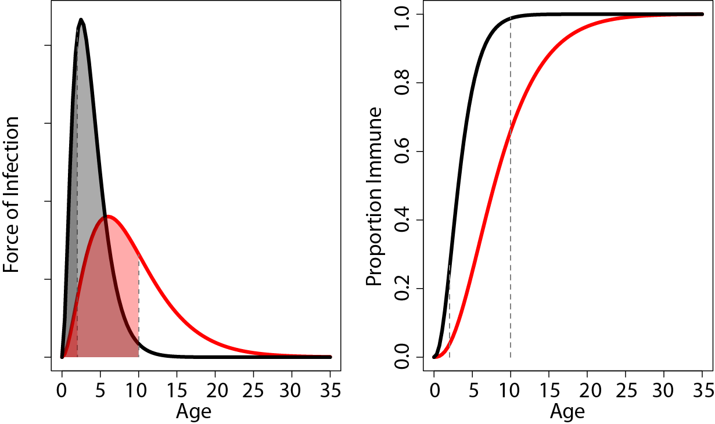
Catalytic Model
The proportion immune (i.e. sero(+)) at each age is the equal to the sum of all age-specific risk prior to that age

Slide 22
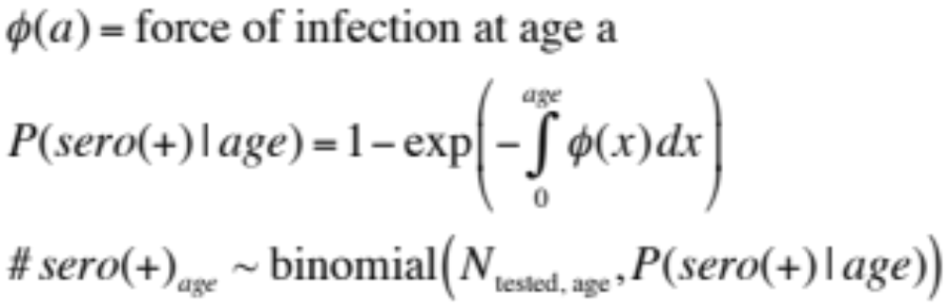
Fitting the Catalytic Model
Serological Data
Case Data
  Expected age distribution of cases is a function of:
    Remaining susceptible by age a
    Force of infection at age a, conditional on remaining susceptible
  Grenfell and Anderson (1985)
    Multinomial likelihood

Slide 23
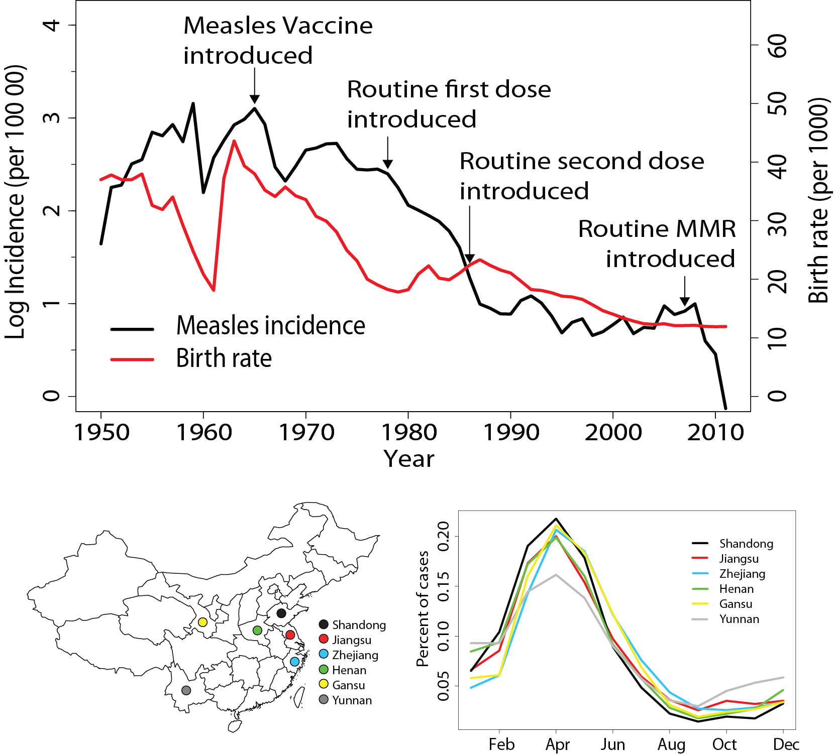
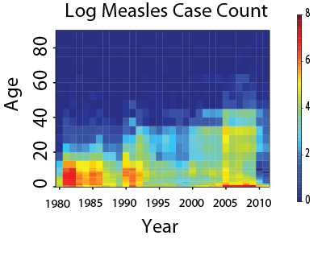
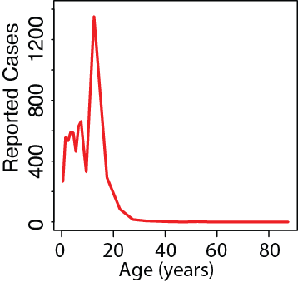
Age Distribution in Jiangsu
Notes:
From cases largely concentrated in children in the 80’s – note hear that age classes are annual up to 10y

Slide 24
Age Distribution in Jiangsu
1y up to age 10y
5y afterwards
Notes:
From cases largely concentrated in children in the 80’s – note hear that age classes are annual up to 10y and 5 year classes afterwards

Slide 25
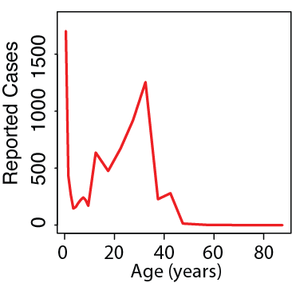
Age Distribution in Jiangsu
Notes:
And then strongly bi-modal in recent years with many adult cases

Slide 26
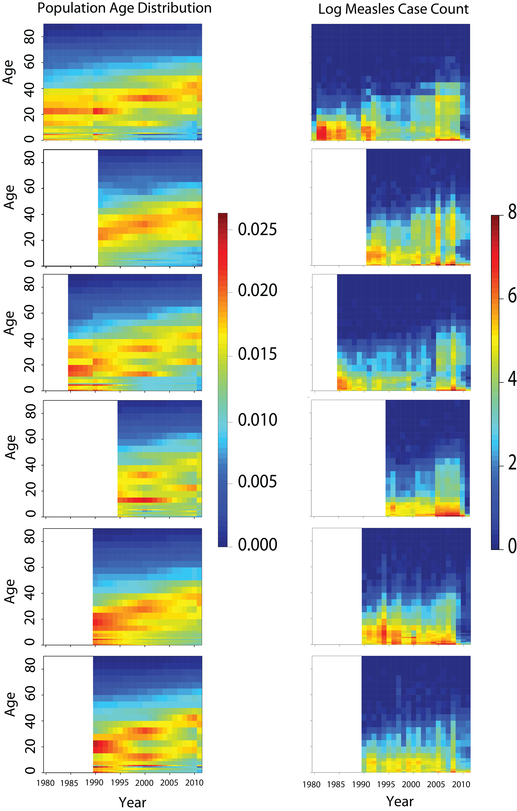
Pattern Consistent Across China
Notes:
And, just to show you that this isn’t an idiosyncrasy of Jiangsu, this patterns is apparent in all 6 provinces we’ve looked at

Slide 27
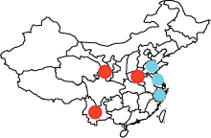
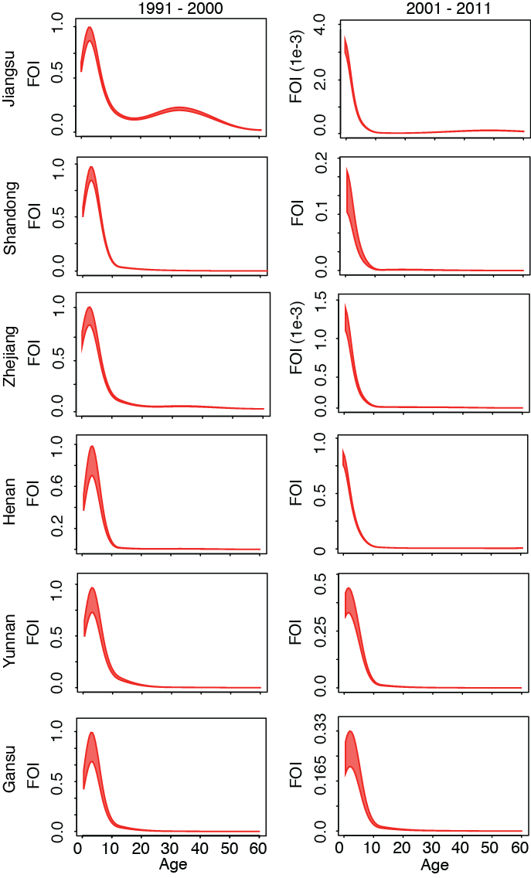
Provincial Variation
Reduction in R_{E} from 90’s to 00’s
97%
90%
95%
24%
68%
73%
Farrington, Kanaan, Gay 2001
Notes:
While it is difficult to relate this to an exact value of R-effective, we can use methods described by Farrington et al to estimate a relative change in RE from the 90s to the 2000’s and we estimate a dramatic decline in the east and a less dramatic decline in the west.

Slide 28
Transmission, Severity, and Control

Slide 29
Most severe in the young:
  Measles, pertussis, diphtheria
Most severe in the elderly
  COVID-19
Most severe in the young AND the elderly
  Influenza
Most severe in intermediate ages
  Zika virus, rubella – severe complications in pregnancy

Slide 30
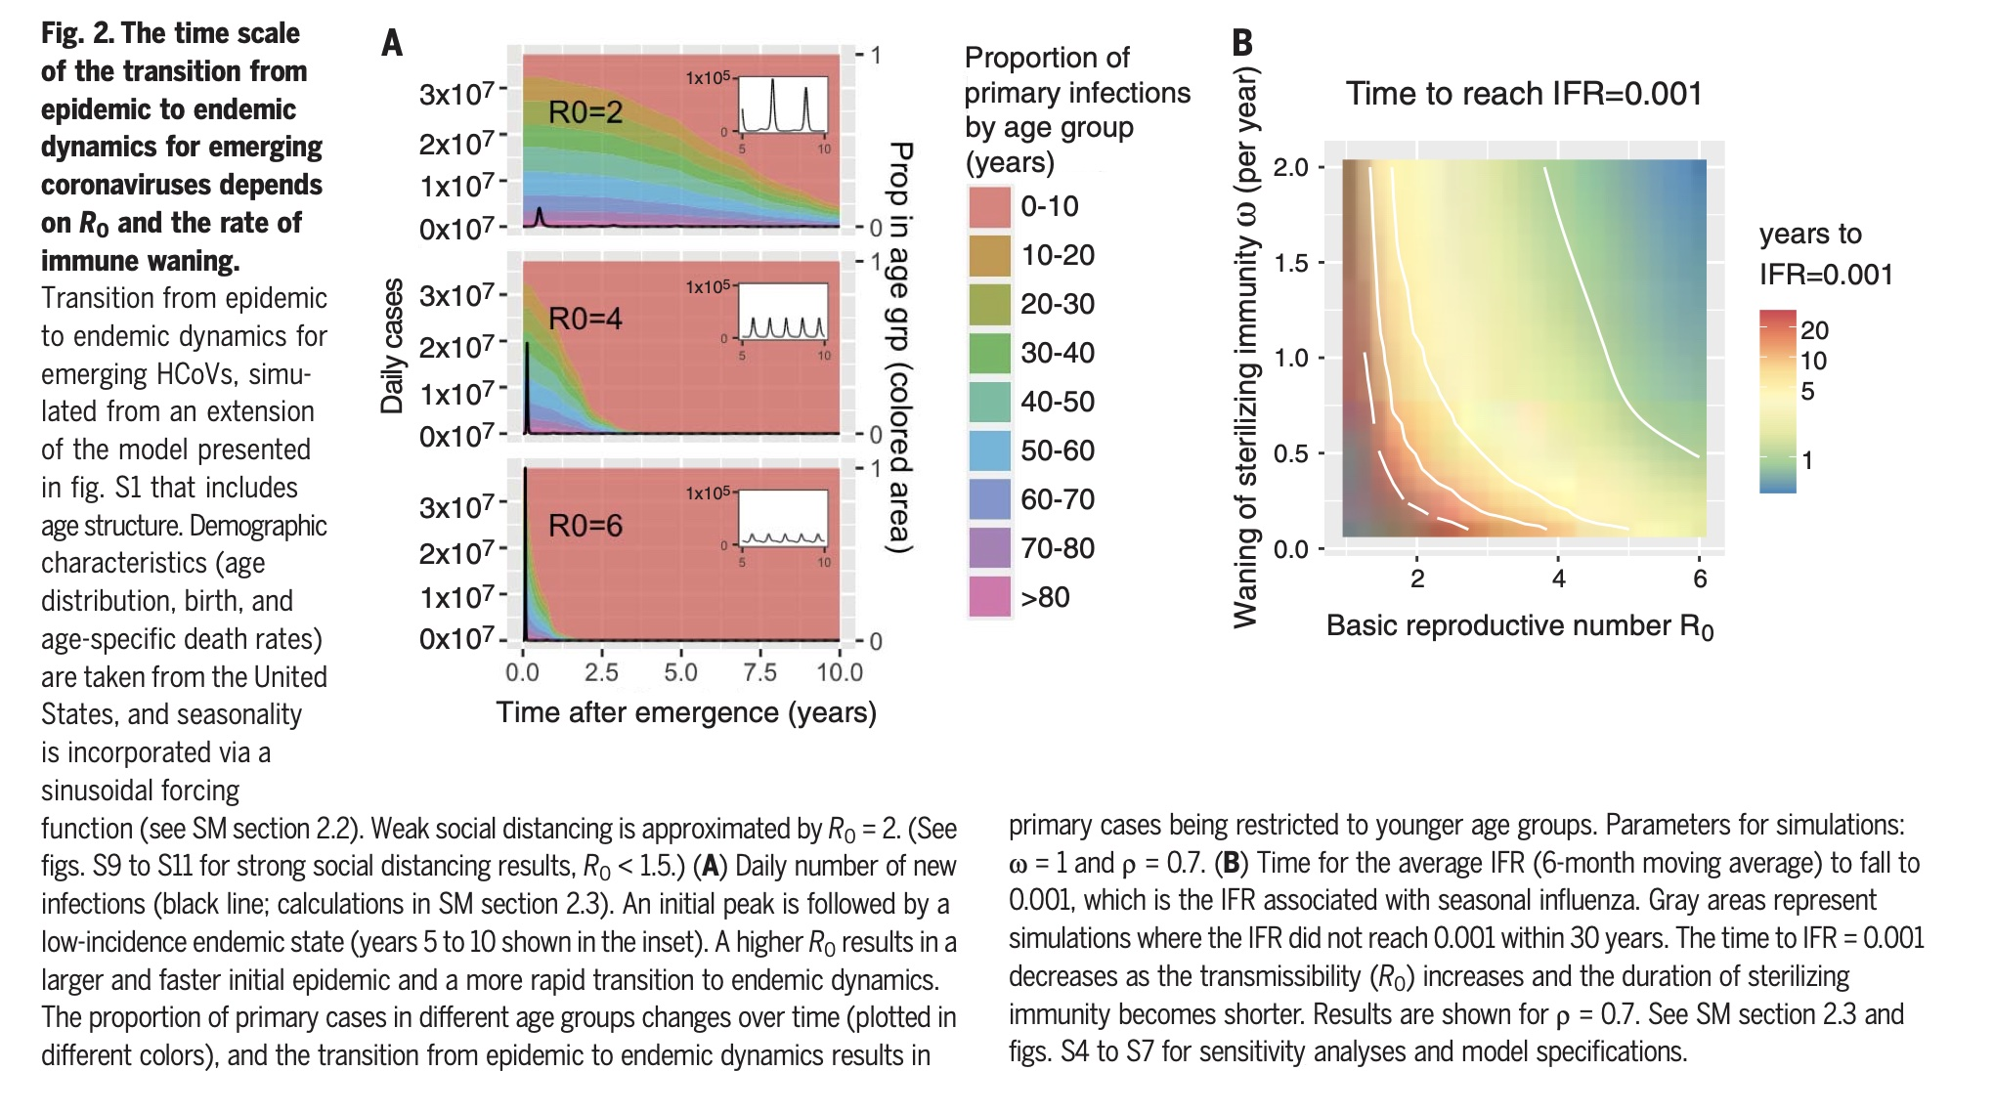
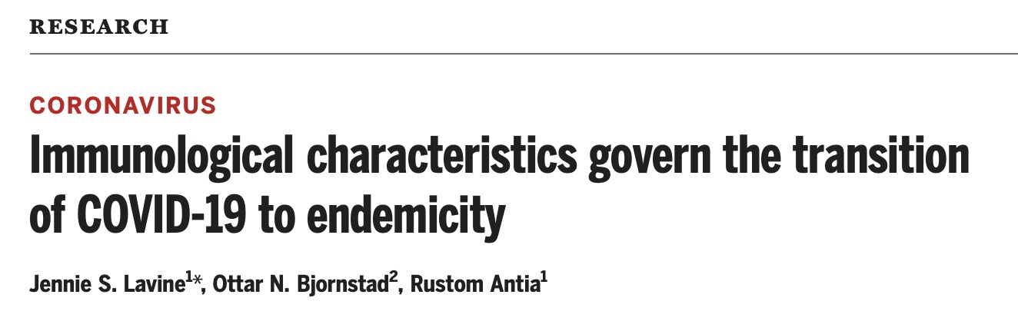
COVID-19 and transition to endemicity
Higher disease severity in older adults observed when entire population is susceptible
What will distribution of immunity look like after endemic equilibrium is reached?
What does this mean for the future of disease severity?

Slide 31
Rubella and CRS
Rubella is a directly transmitted virus with R₀ of 4-8 in endemic regions
Infections in children and adults are mild
Infections during first trimester of pregnancy can lead to serious complications (Congenital Rubella Syndrome, CRS)
  Deafness
  Blindness
  Congenital heart disease

Slide 32
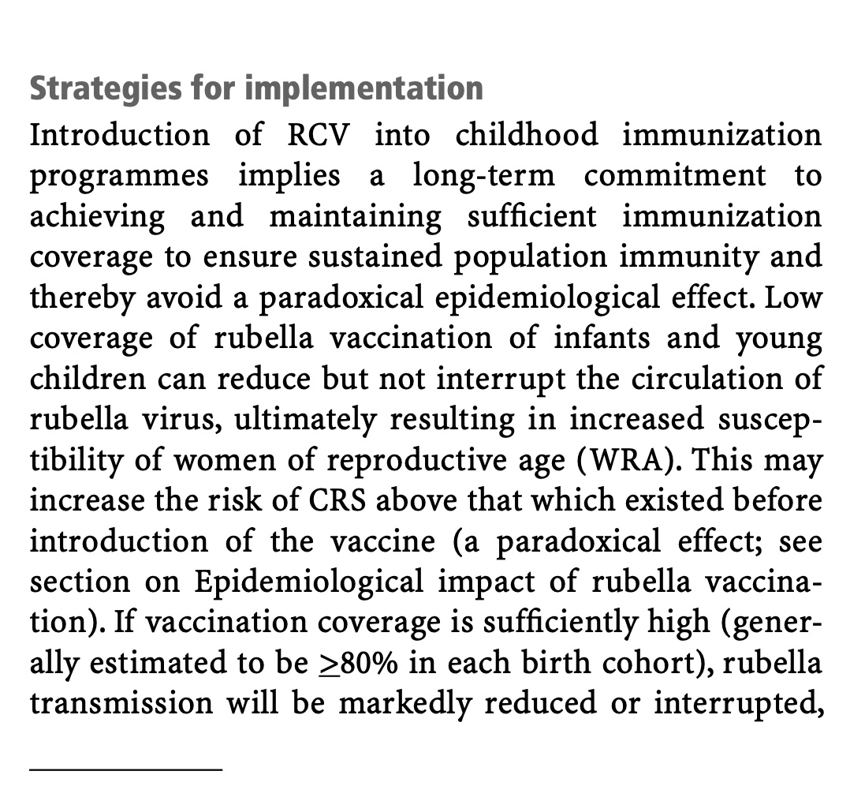
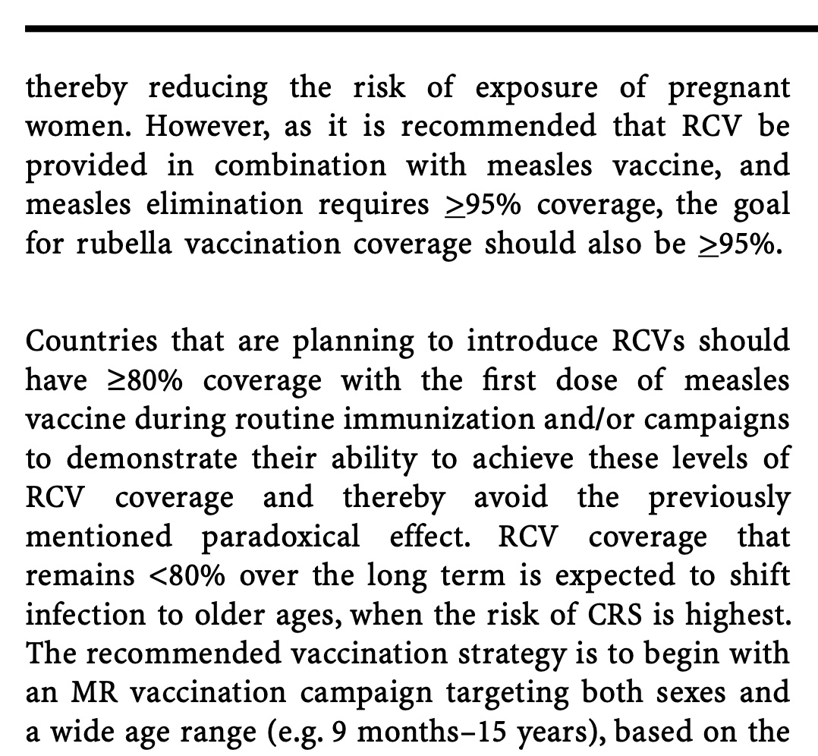
Introduction of Rubella Containing Vaccine

Slide 33
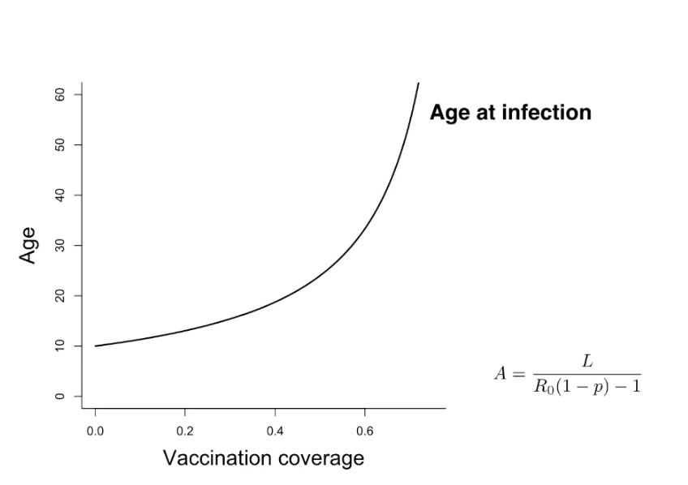
Age Dynamics Following RCV Introduction

Slide 34
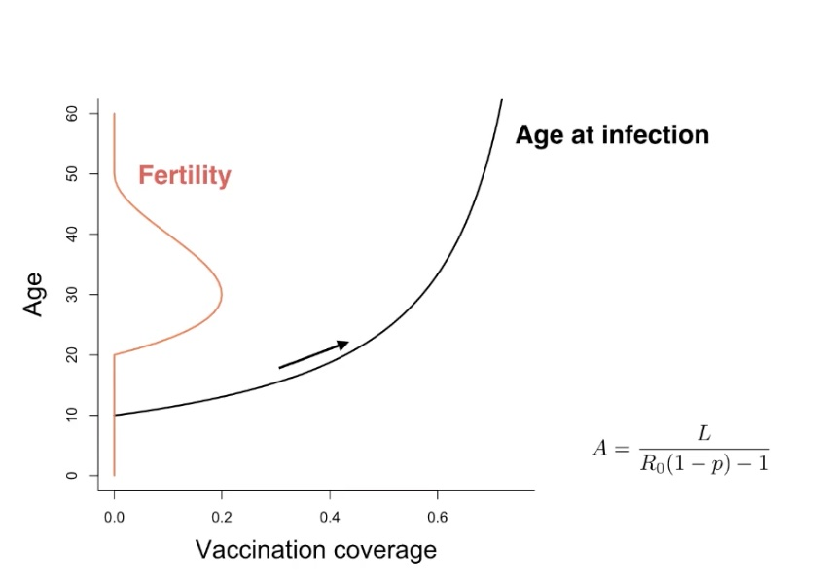

Slide 35
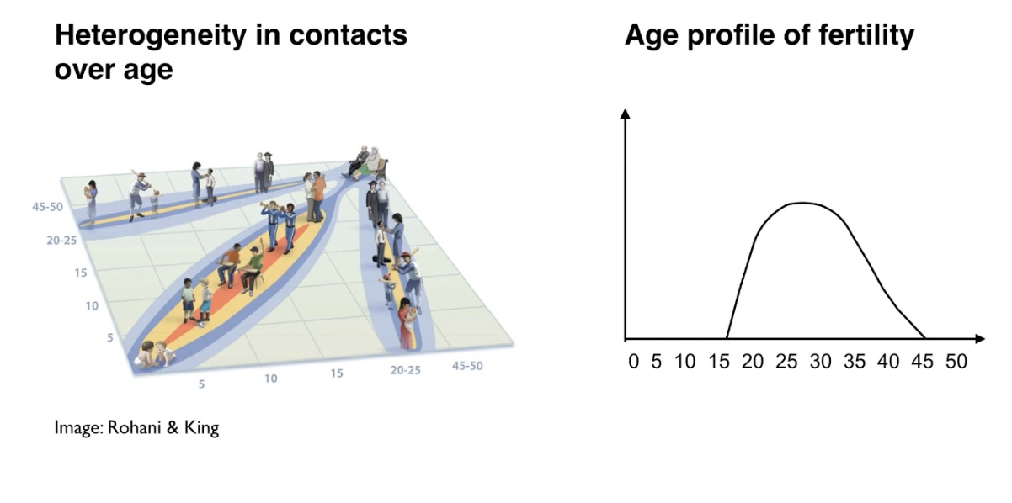

Slide 36
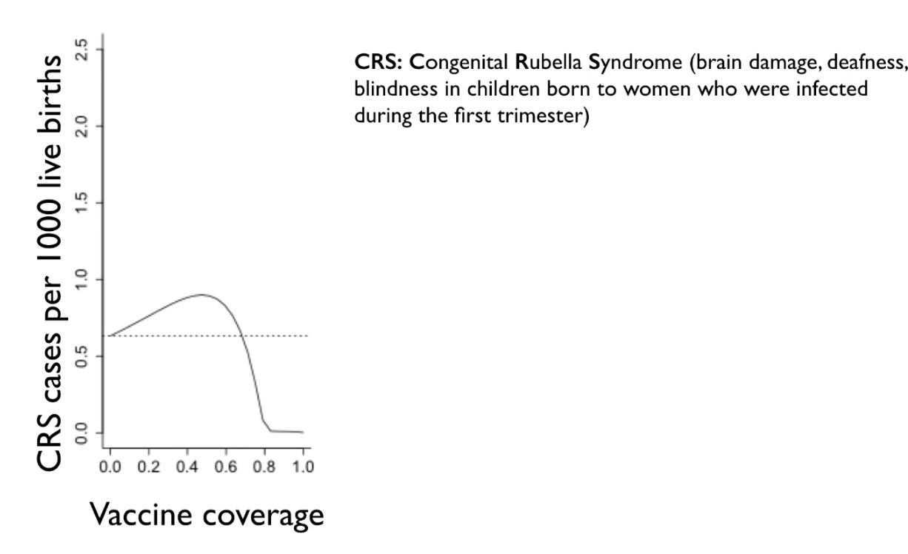

Slide 37
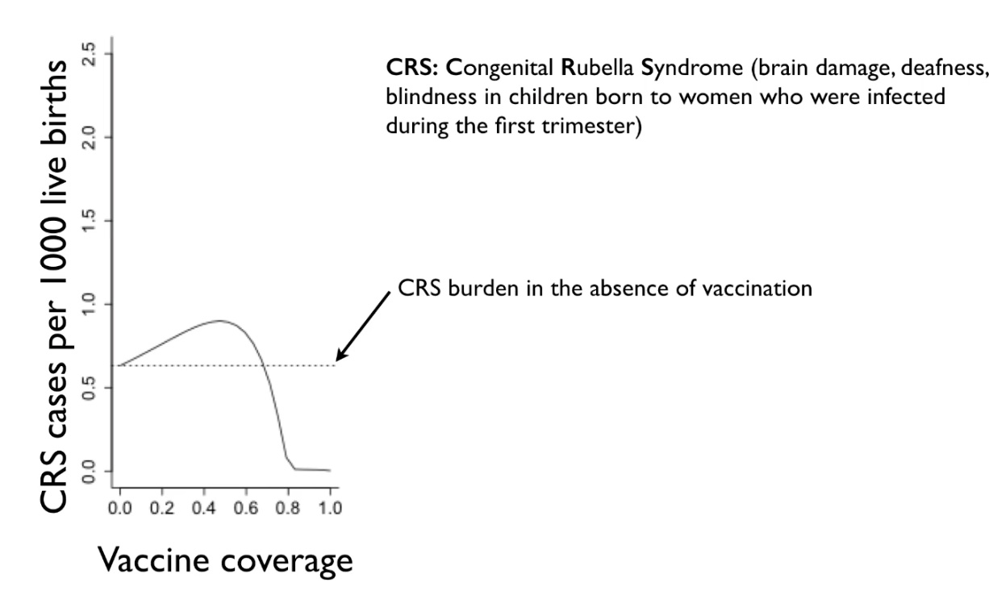

Slide 38
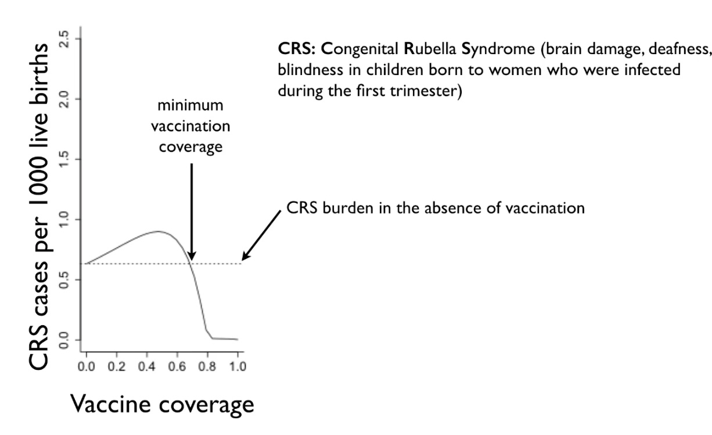

Slide 39
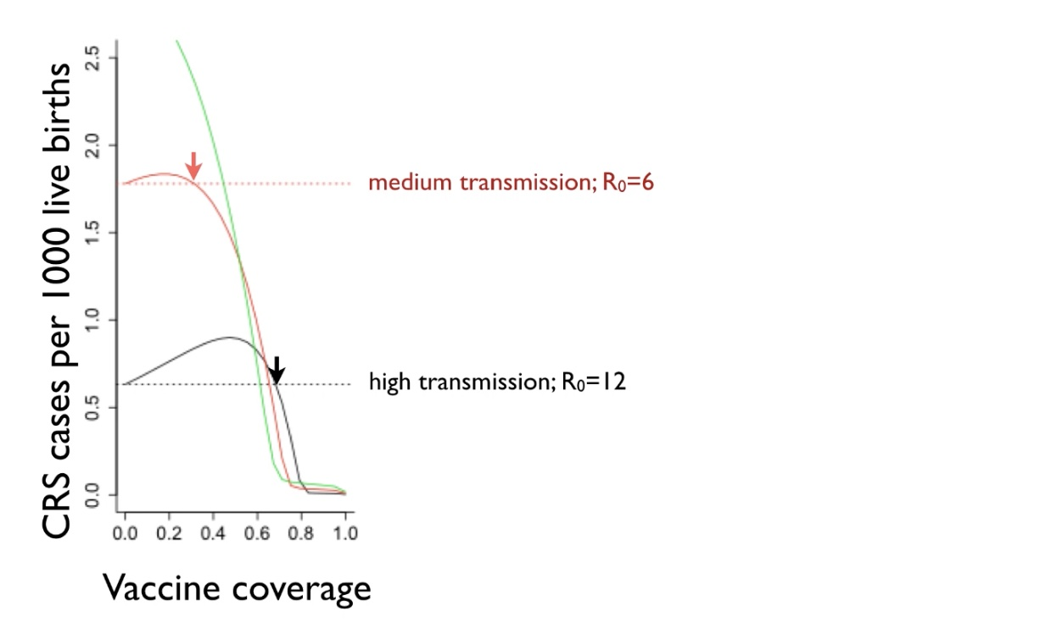

Slide 40
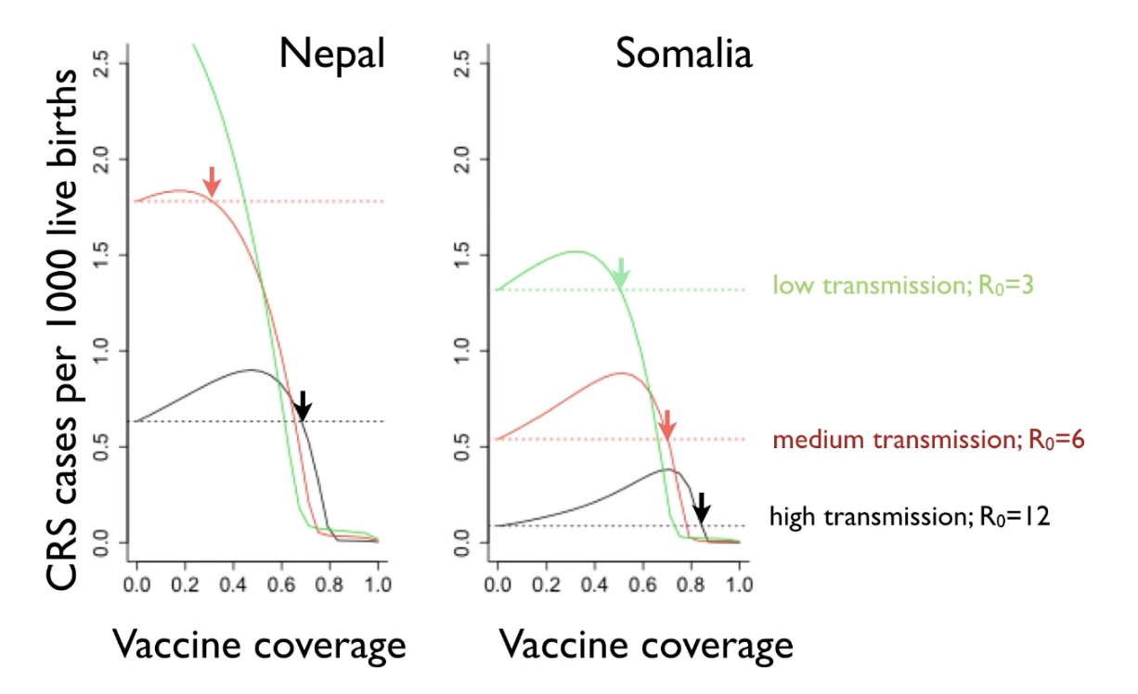

Slide 41
80% Rule for Rubella Vaccine Introduction
A single policy recommendation is convenient, but dynamics suggest that the optimal strategy for introduction is highly dependent on
  Local vaccination coverage
  Local transmission rate
  Local age-specific maternity

