Slide 1
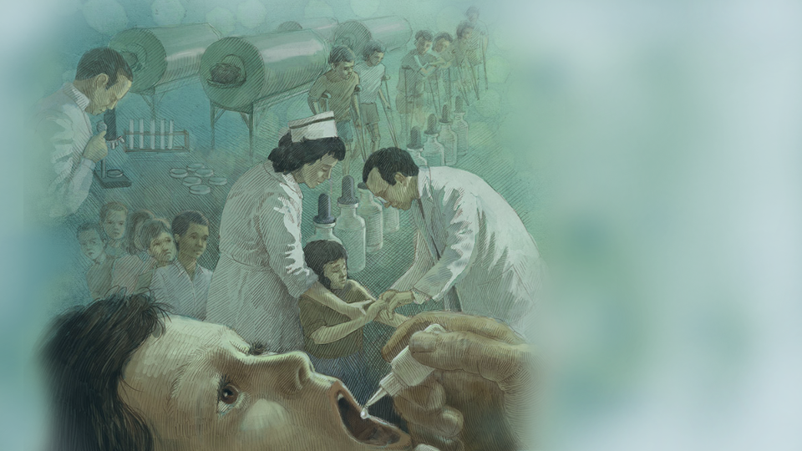
Lecture 3: Vaccination
Micaela E. Martinez
Emory University

Slide 2
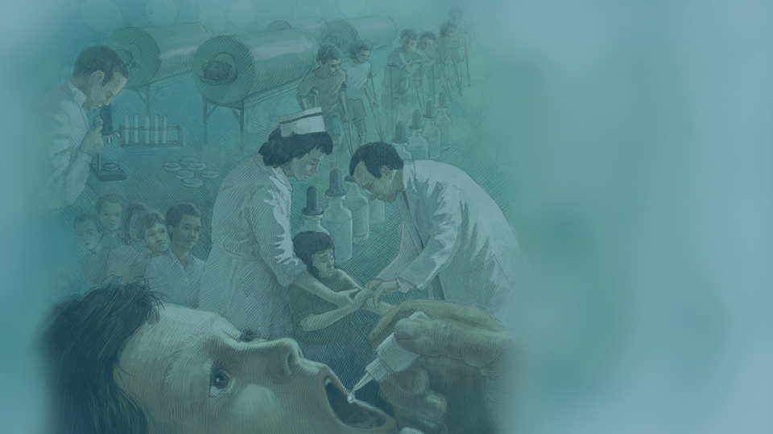
Vaccine Modes of Action
Vaccines have several modes of action, i.e., the way(s) by which they confer protection.
These can include any of the following alone or in combination:
protection from infection
reduction of shedding
protection from disease/pathology

Slide 3
Vaccine Modes of Action
Vaccines that protect from infection are considered “transmission blocking”
Vaccines that reduce shedding by vaccinated individuals who become infected are transmission reducing vaccines
Vaccines that protect from pathology/disease but don’t reduce susceptibility to infection or shedding are not transmission reducing vaccines

Slide 4
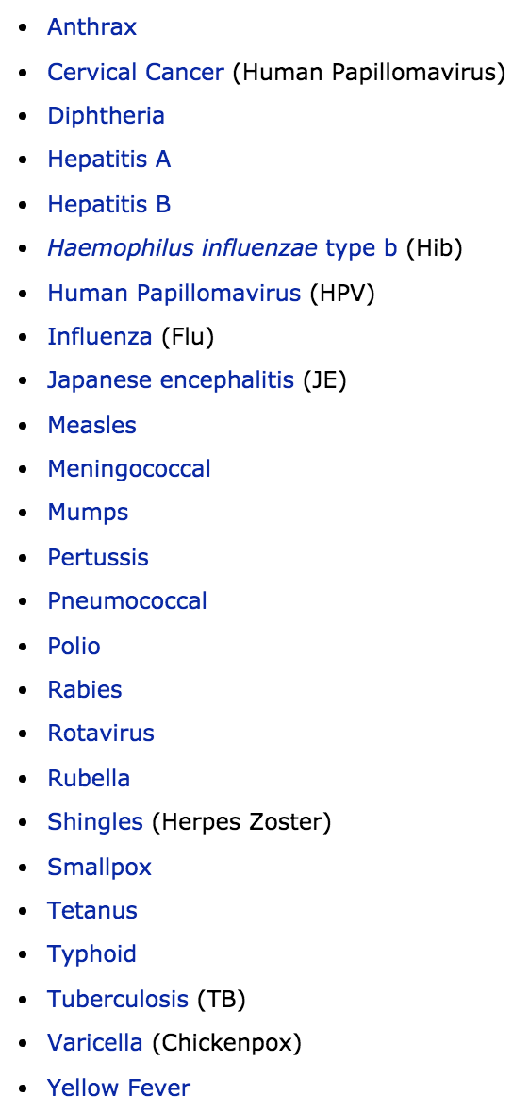
Vaccine Modes of Action
Vaccines we have today differ in their modes of action
For instance, the measles vaccine protects from infection, while the shingles vaccine protects from pathology for an existing latent infection

Slide 5
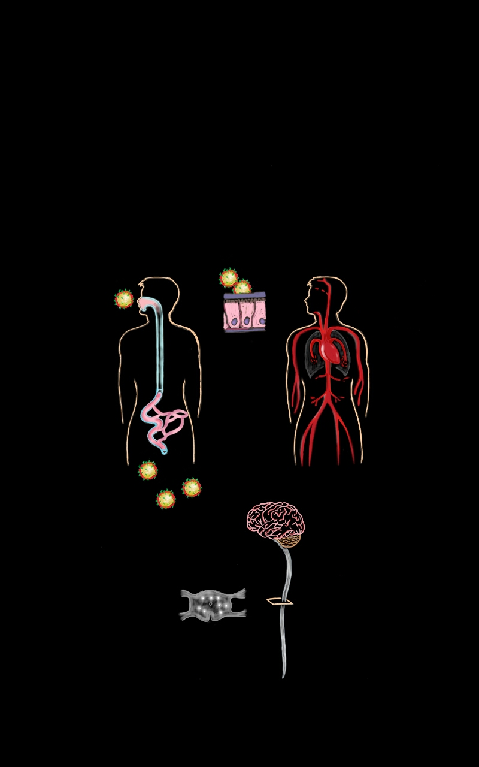
How do vaccines work? [Mode of action]
Consider a fecal-oral transmission enteric pathogen where each infected individual infects 2 others

Slide 6
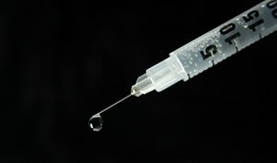
How do vaccines work? [Mode of action]
(1) Reduces susceptibility to infection
(1) Reduces susceptibility
Prevents all downstream infections
Protects vaccinated individual & others in the population (ripple effect)

Slide 7
How do vaccines work? [Mode of action]
(2) Reduces infectiousness
(1) Reduces susceptibility
Protects others in the population (downstream effect)

Slide 8
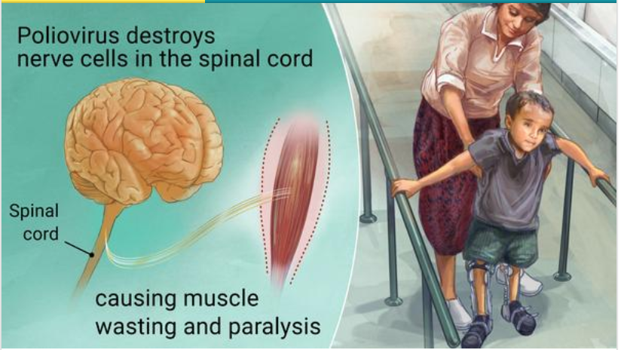
How are the vaccines working?
(3) Reduces symptoms
(1) Reduces susceptibility
(2) Reduces infectiousness
Protects vaccinated individuals from pathology
Martinez et al. (in prep)

Slide 9
Vaccine Modes of Action Assessed as Efficacy
Vaccine efficacy is a measure of how well a vaccine works. Efficacy is defined differently among vaccines and is typically uniquely defined within each clinical trial. Vaccines can have multiple efficacy measures representing various modes of action and levels of protection.

Slide 10
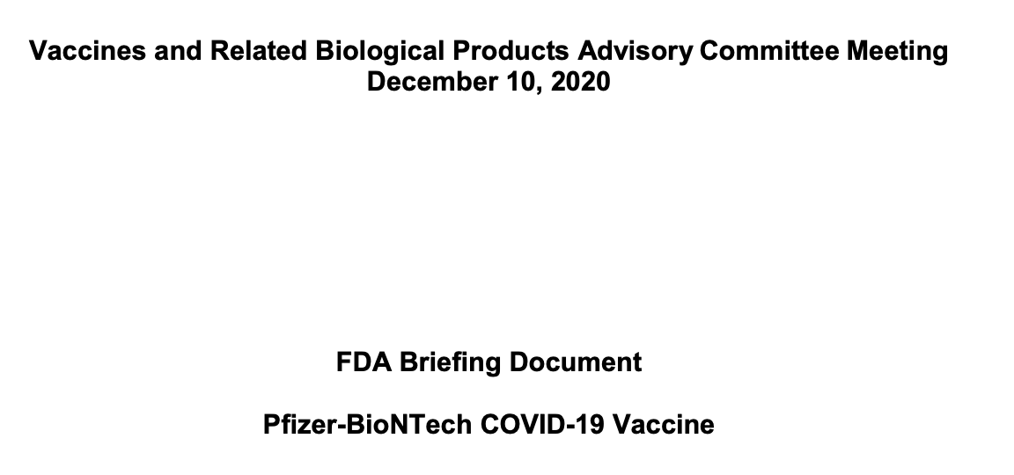
Exploring Efficacy with the COVID-19 Vaccines in the US
Pfizer-BioNTech COVID-19 Vaccine

Slide 11
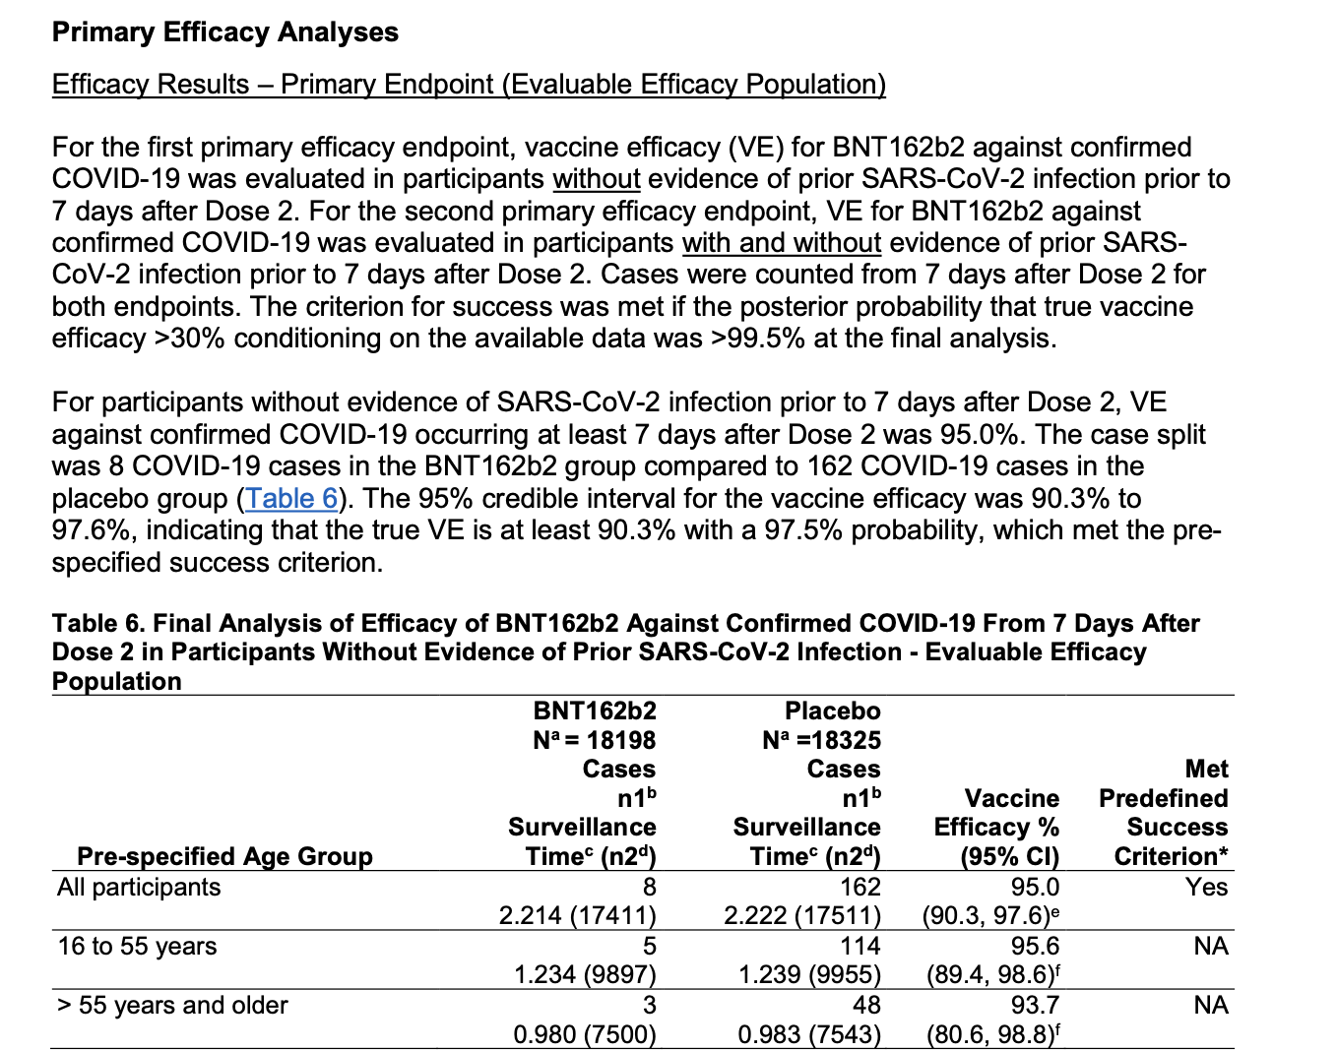
Pfizer-BioNTech COVID-19 Vaccine

Slide 12
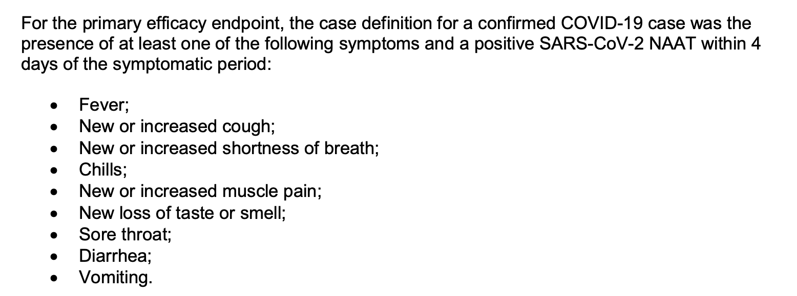
Pfizer-BioNTech COVID-19 Vaccine

Slide 13
Exploring Efficacy with the COVID-19 Vaccines in the US
Primary Efficacy for Pfizer COVID-19 vaccine:
Individuals get 2 doses and have no evidence of SARS-CoV-2 infection prior to 7 days after dose 2 (i.e., they are given enough time for both doses to work)
Cases counted starting 7 days after dose 2
Cases of COVID-19 defined as one or more symptoms and positive PCR test within 4d of symptoms

Slide 14
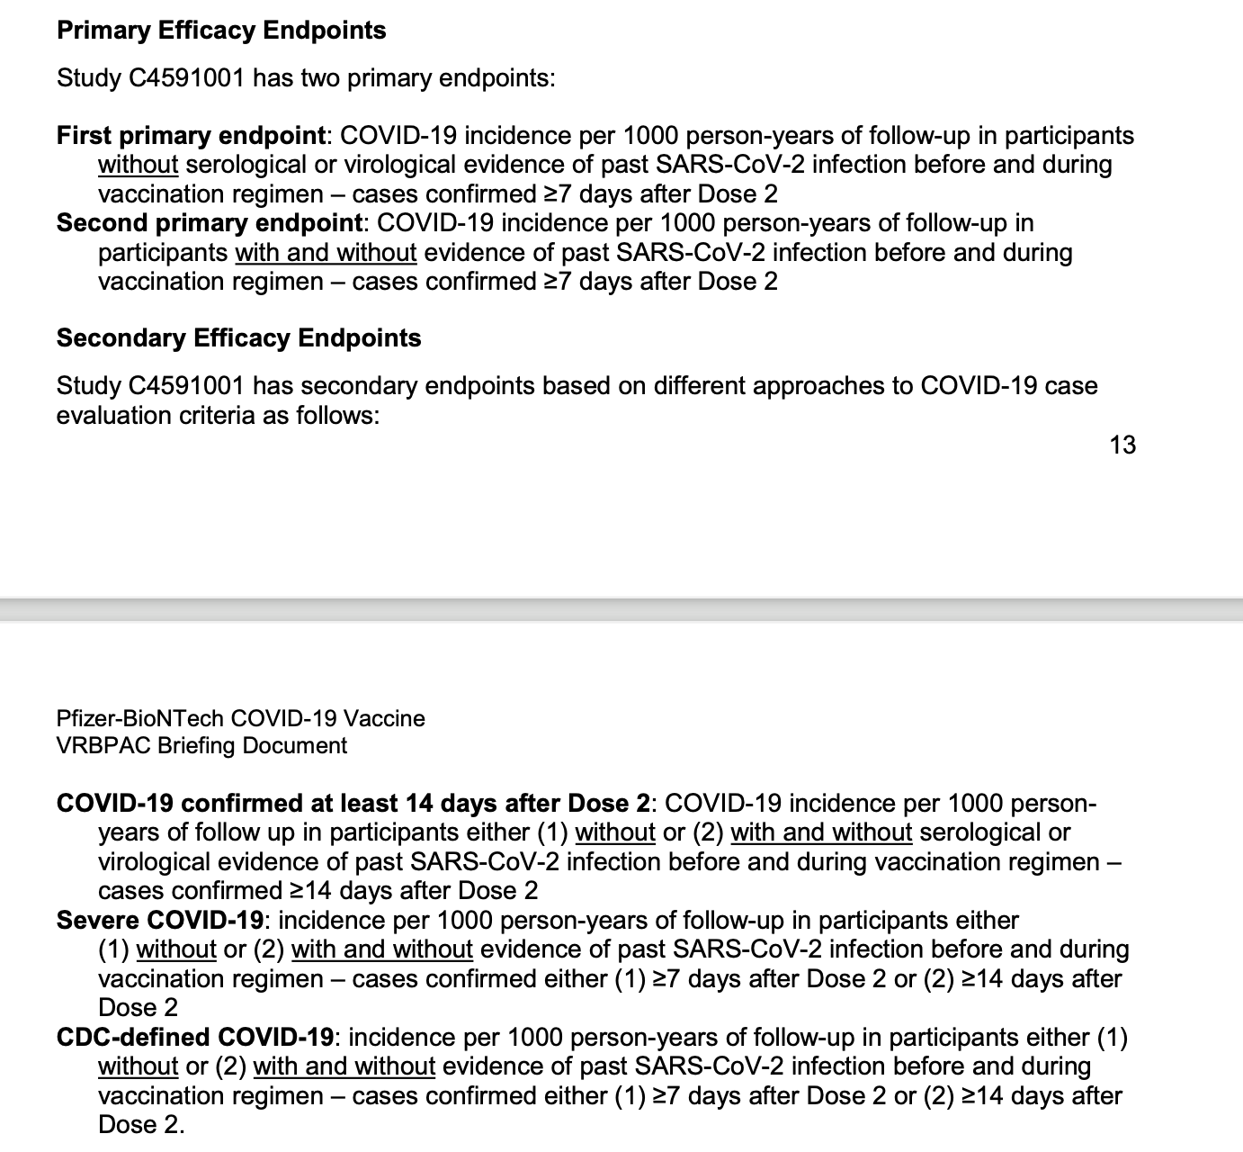
Pfizer-BioNTech COVID-19 Vaccine used six efficacy metrics

Slide 15
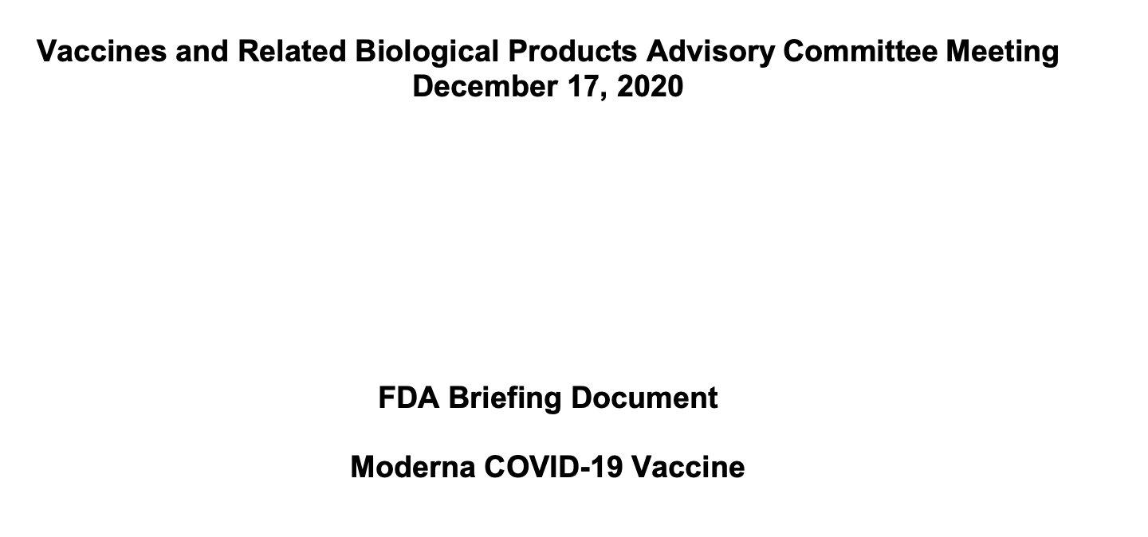
Exploring Efficacy with the COVID-19 Vaccines in the US

Slide 16
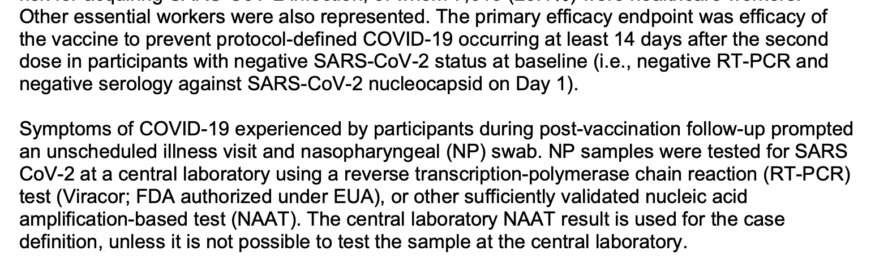
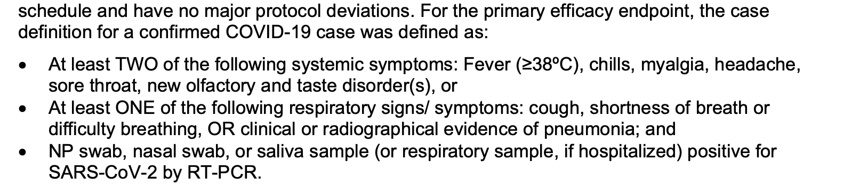
Exploring Efficacy with the COVID-19 Vaccines in the US
Moderna vaccine

Slide 17
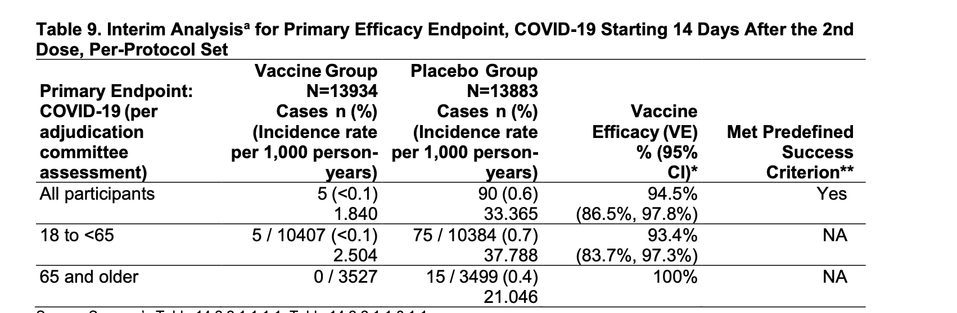
Exploring Efficacy with the COVID-19 Vaccines in the US
Moderna vaccine

Slide 18
Exploring Efficacy with the COVID-19 Vaccines in the US
The primary vaccine efficacy endpoints for the Pfizer and Moderna Emergency Use Authorization in the US were measures of protection from symptomatic infection
Both trials used different definitions of efficacy, but still arrived at similar efficacy measures for their mRNA vaccines
The take away is that efficacy may be uniquely defined by each trial, and for each vaccine, but each efficacy measure can be biologically interpreted by considering which mode(s) of action the efficacy measure addresses

Slide 19
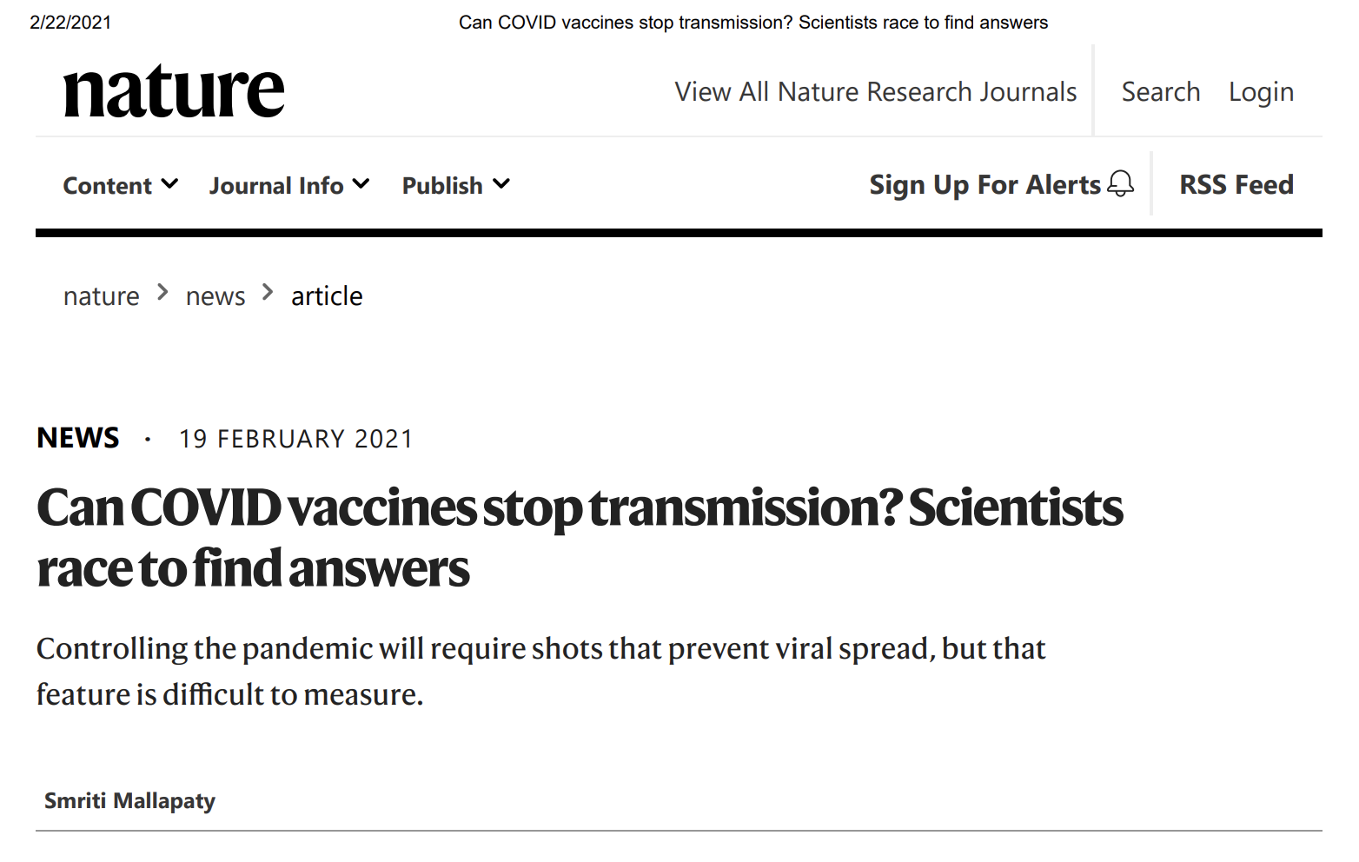
Exploring Efficacy with the COVID-19 Vaccines in the US

Slide 20
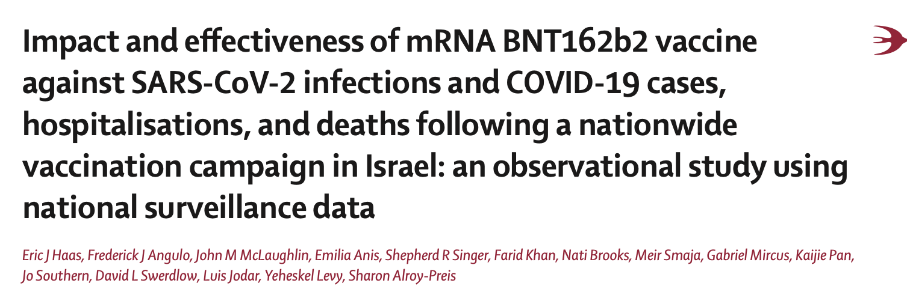
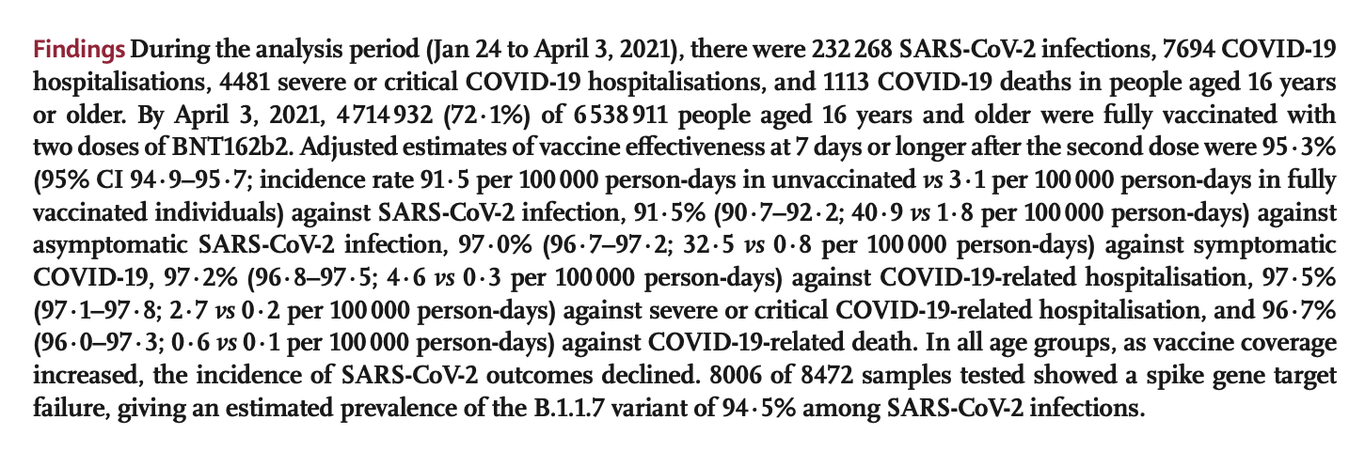
Exploring Efficacy with the COVID-19 Vaccines in the US
Published May 15, 2021

Slide 21
Transmission Blocking Vaccines
Transmission blocking vaccines confer protection from infection and therefore move individuals from the Susceptible class and reduce the susceptible pool.

Slide 22
Types of Vaccine Administration
Routine immunization
Pulsed vaccination/vaccination campaigns
Catch-up campaigns
Initial roll-out of new vaccine, often phased by risk and/or age group

Slide 23
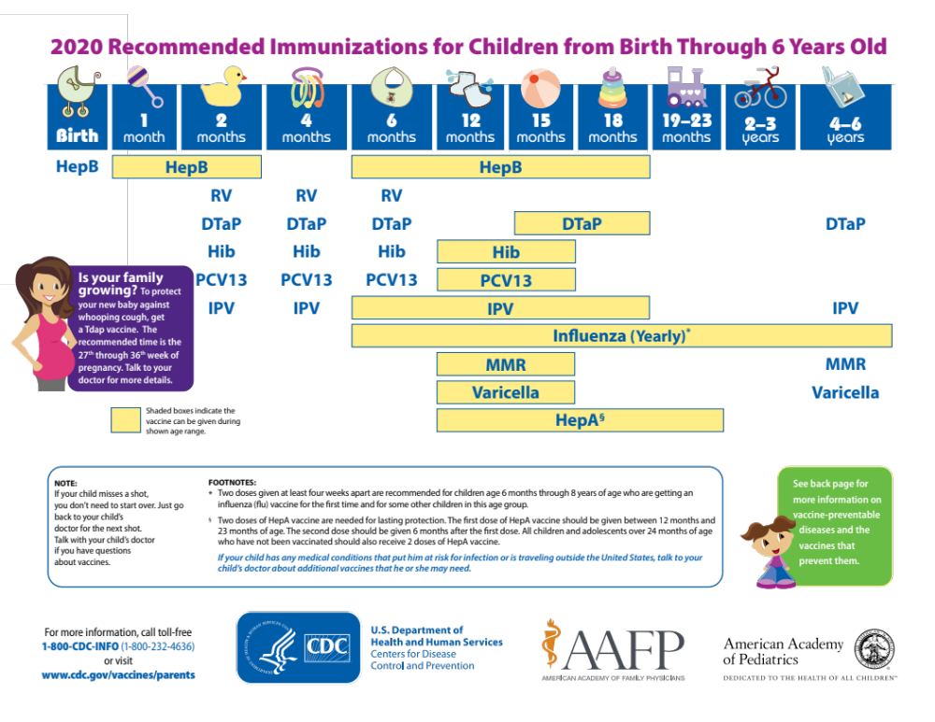
Infant vaccination is the most common routine immunization

Slide 24
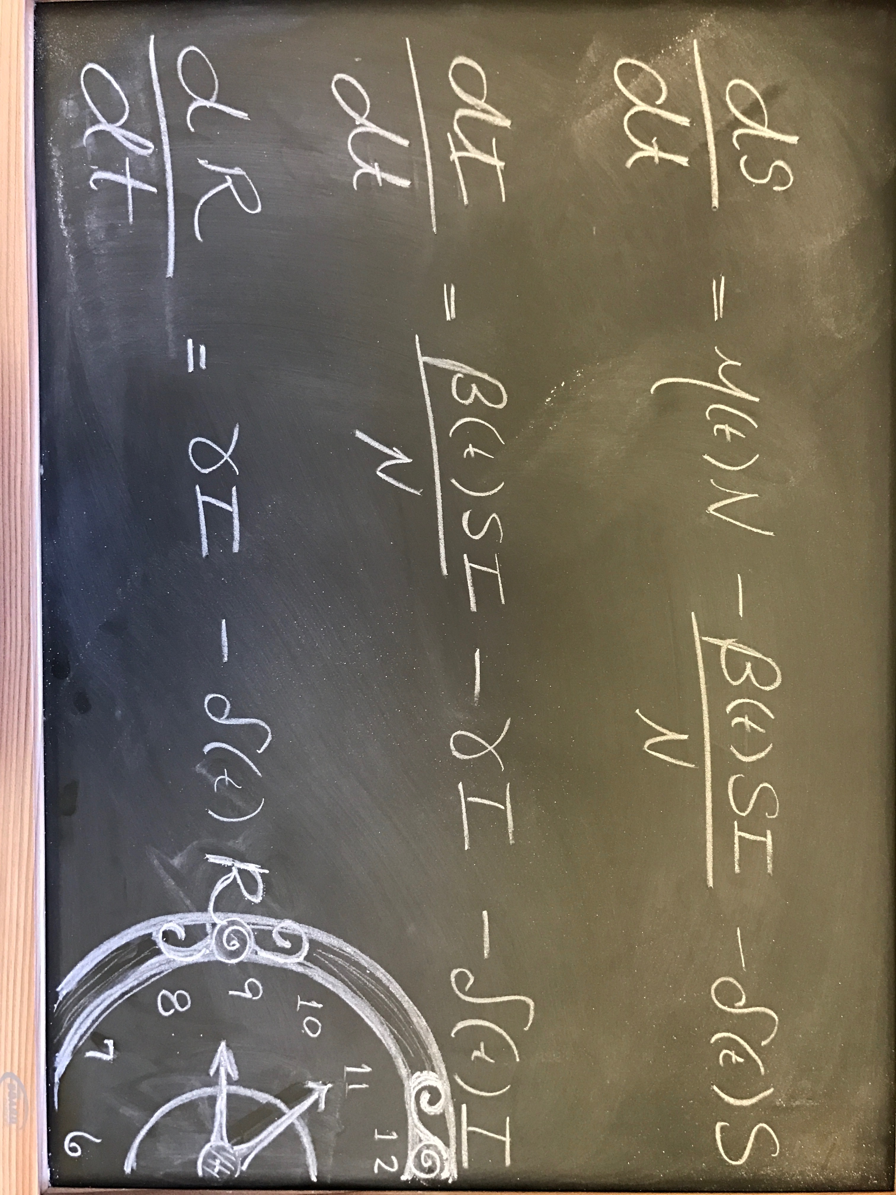
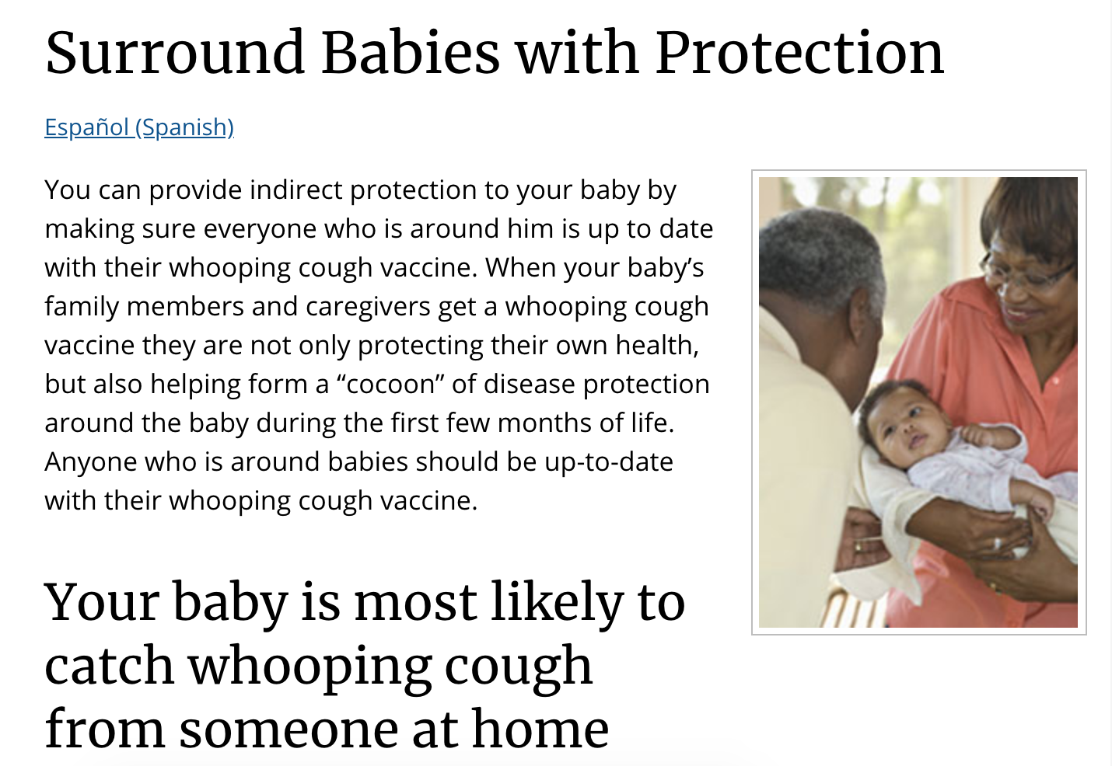
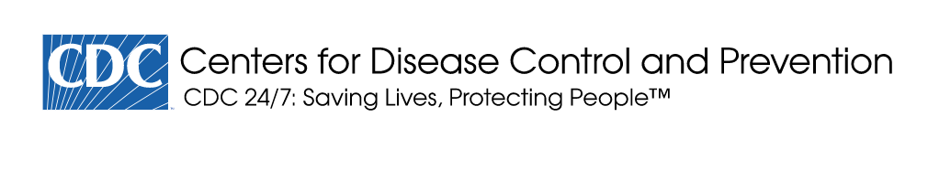
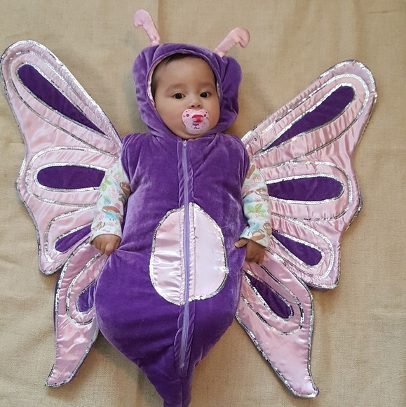
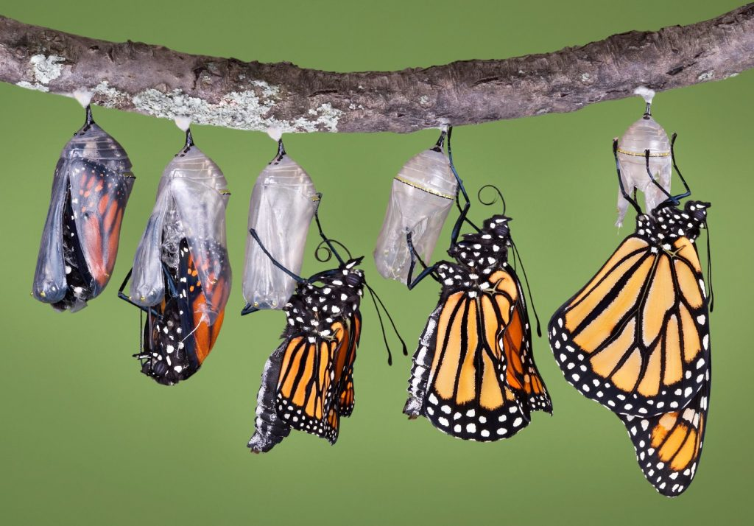
Indirect Protection via Cocooning
Infants too young to be vaccinated may be cocooned by vaccinated caretakers. This is one way in which vaccinated individuals may confer indirect protection to unvaccinated individuals

Slide 25
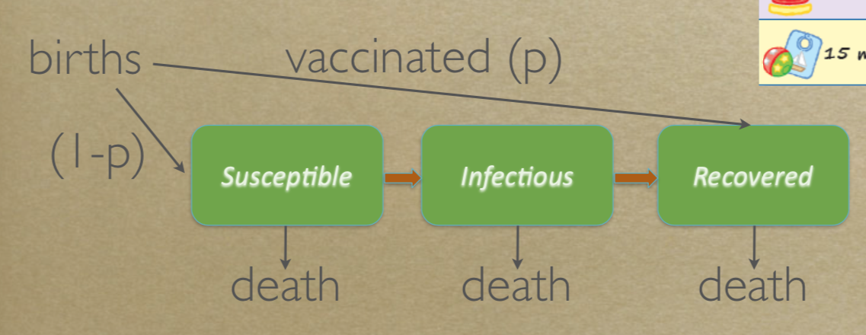
Infant Immunization – Routine Vaccination
Infant immunization generally treated in SIR models as a fraction (p) of newborns vaccinated
Slide from Rohani SISMID 2019

Slide 26
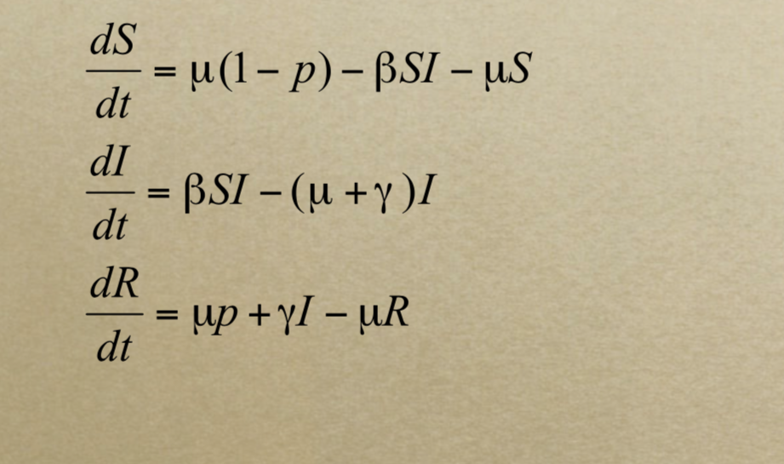
Infant Immunization – Routine Vaccination
If p is the critical vaccination threshold;
p = 1 - (1/R0)
Vaccinate new birth cohorts at the critical vaccination level.
Catch-up campaigns can also be used to fill immunity gaps in older age groups
Slide from Rohani SISMID 2019

Slide 27
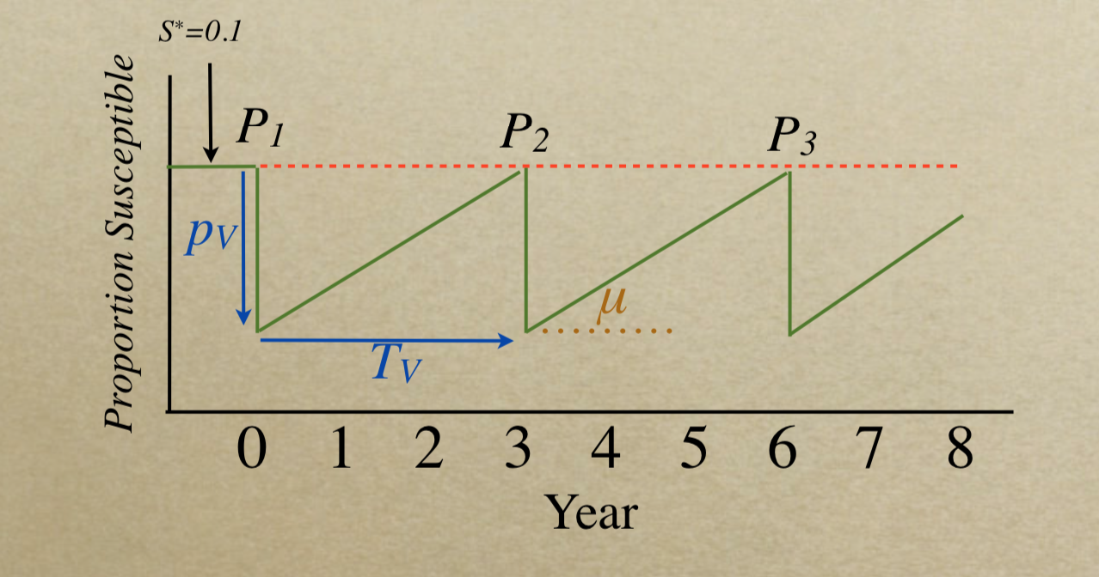
Pulsed Vaccination & Vaccination Campaigns
pulse vaccinate to drop the susceptibility pool far below the critical threshold
new births will build up the susceptible pool
pulse again before the susceptible pool grows too much
Slide from Rohani SISMID 2019

Slide 28
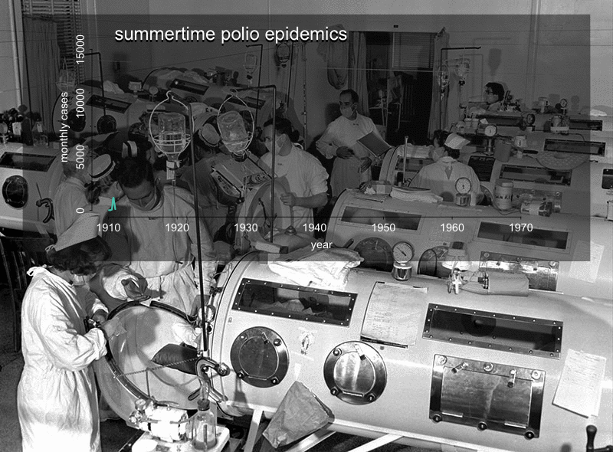
Polio Vaccination
IPV was initially studied and rolled-out in 2nd and 3rd graders before expanding across age groups and eventually becoming an infant vaccine

Slide 29
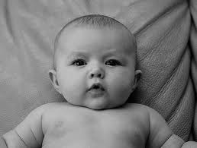
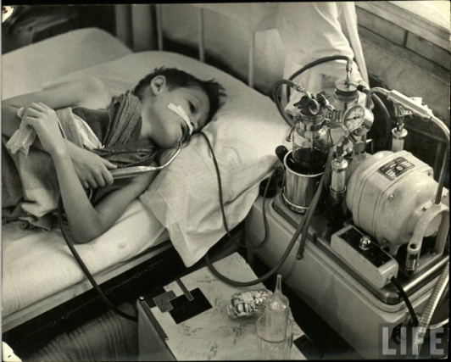
Modeling Pre-Vaccine Transmission Dynamics
Types of data that can be used:
Monthly, weekly, daily cases, hospitalizations, or deaths
Monthly or annual births
Annual population size
ME Martinez-Bakker, King, & Rohani 2015.
PLoS Biology

Slide 30
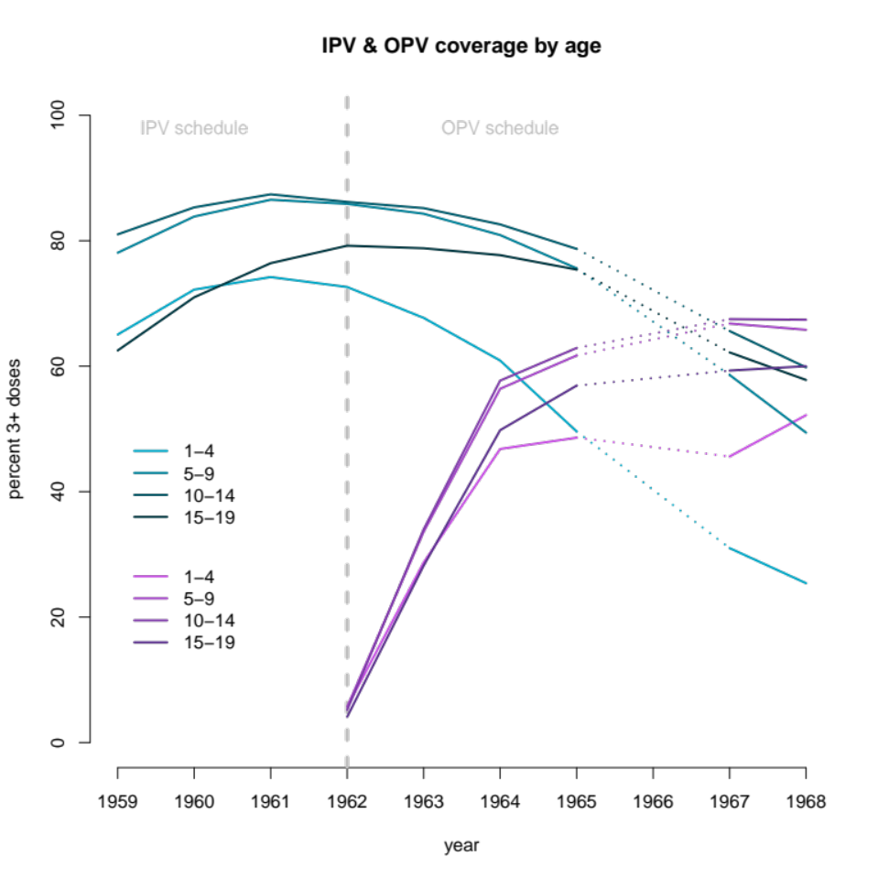
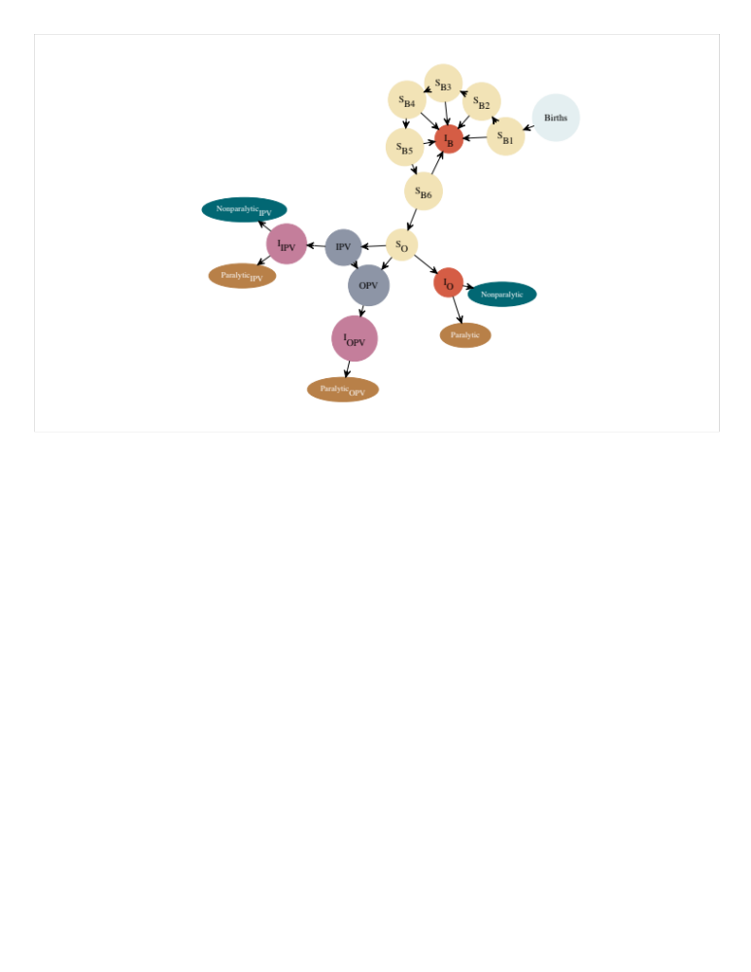
Modeling Vaccine-Era Transmission Dynamics
ME Martinez-Bakker, 2015. Dissertation

Slide 31
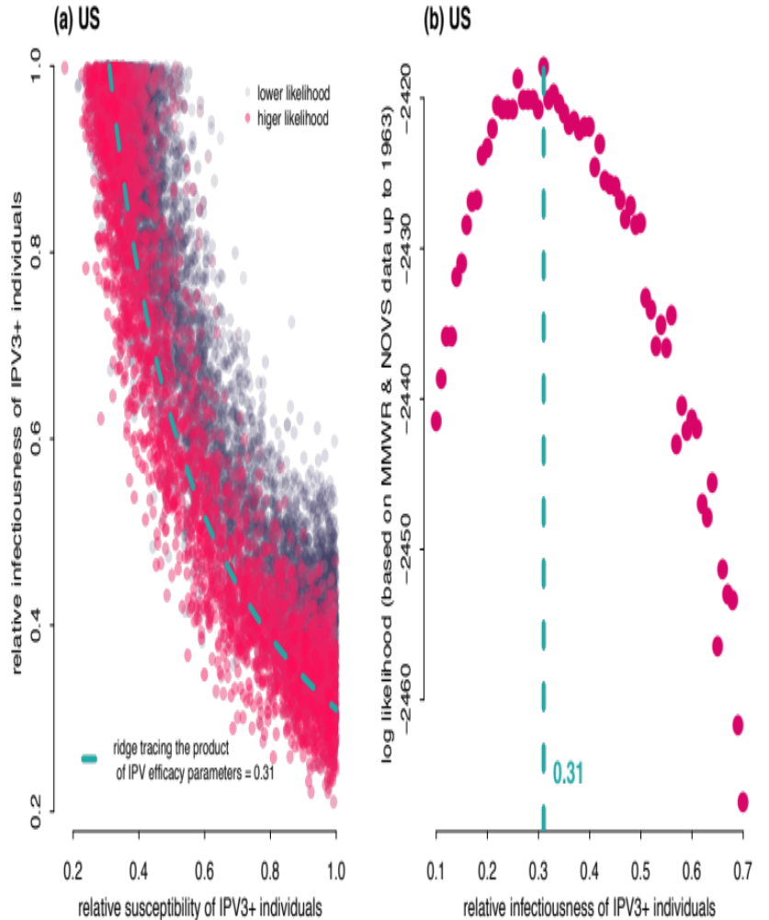
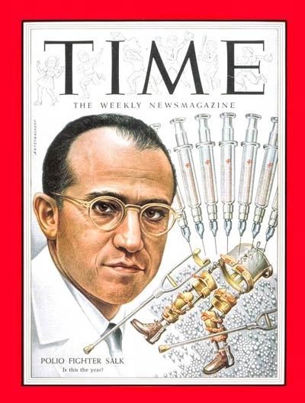
Salk Vaccine Efficacy
Relative rates, compared to unvaccinated individuals
Identifiability is an issue
Integrate clinical trial data
Martinez et al. (in prep)

Slide 32
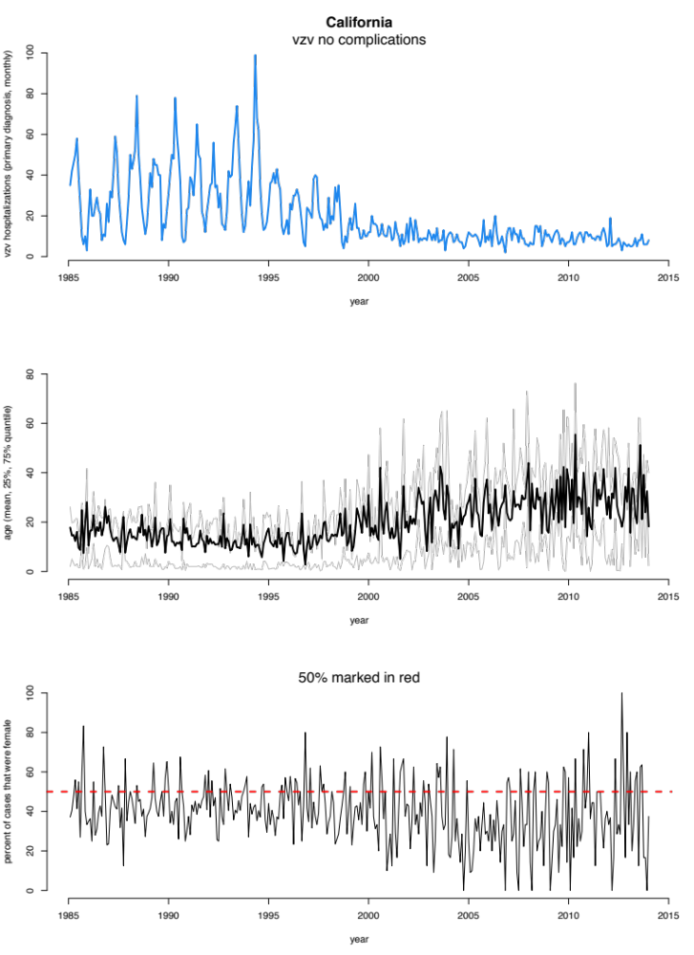
Considerations for New Vaccine Roll-Out
When transmission-reducing vaccines are rolled out, for childhood infectious diseases, there is often an increase in the mean age of infection as shown here by chickenpox hospitalizations in California
Jesus Cantu, Y Maldonado, Contopoulos-Ioannidis ME Martinez (in prep)

Slide 33
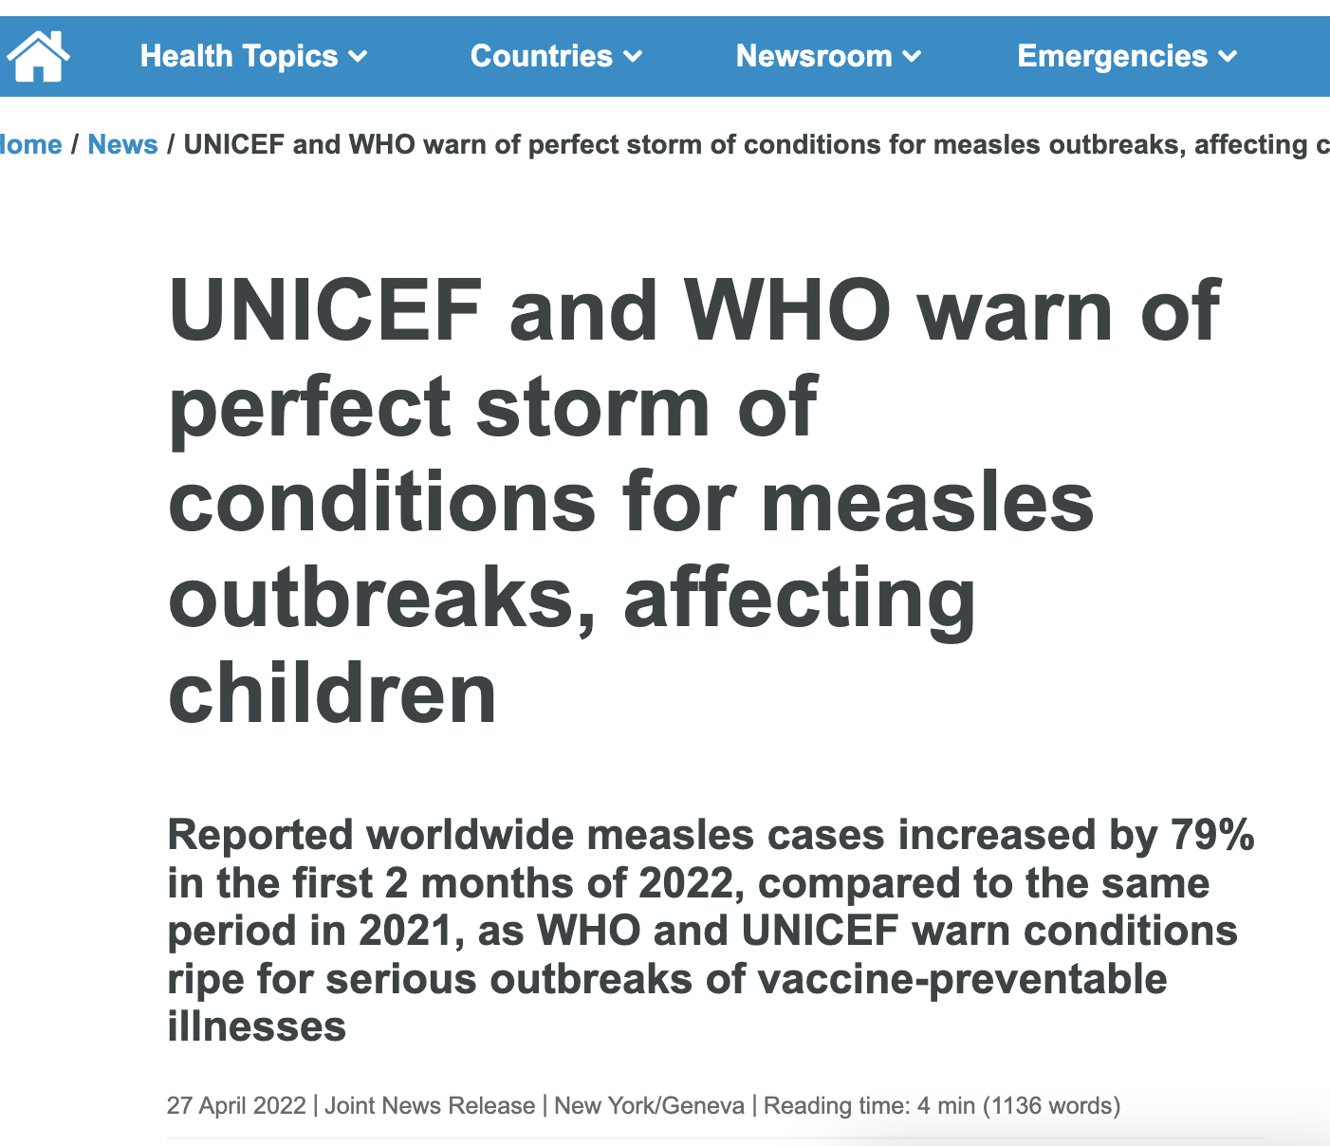
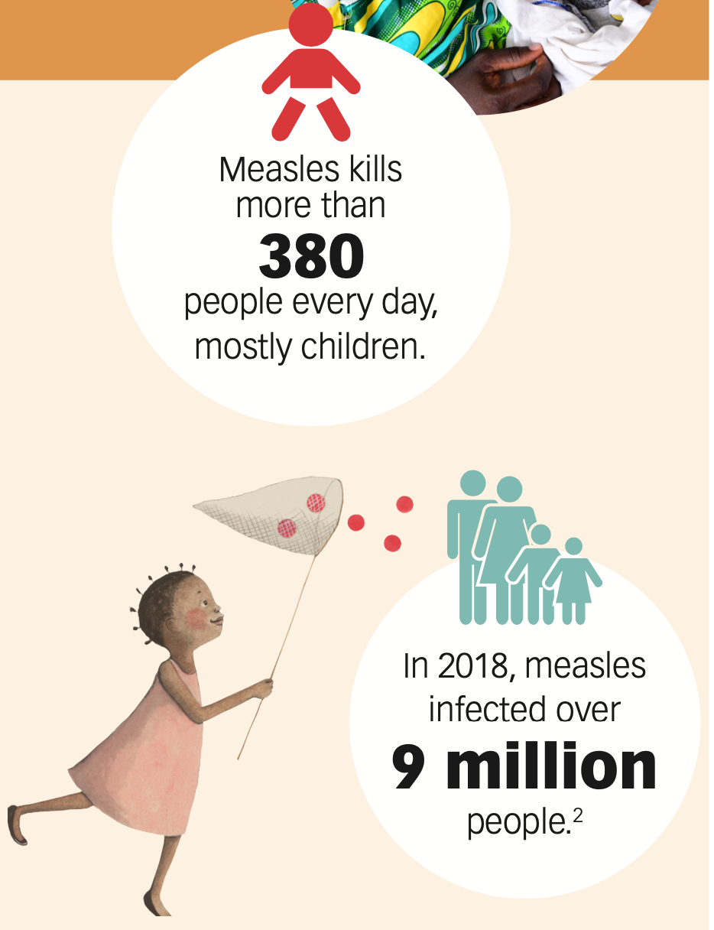
Measles Status
Stats from Measles & Rubella Initiative 2020 fact sheet.

Slide 34
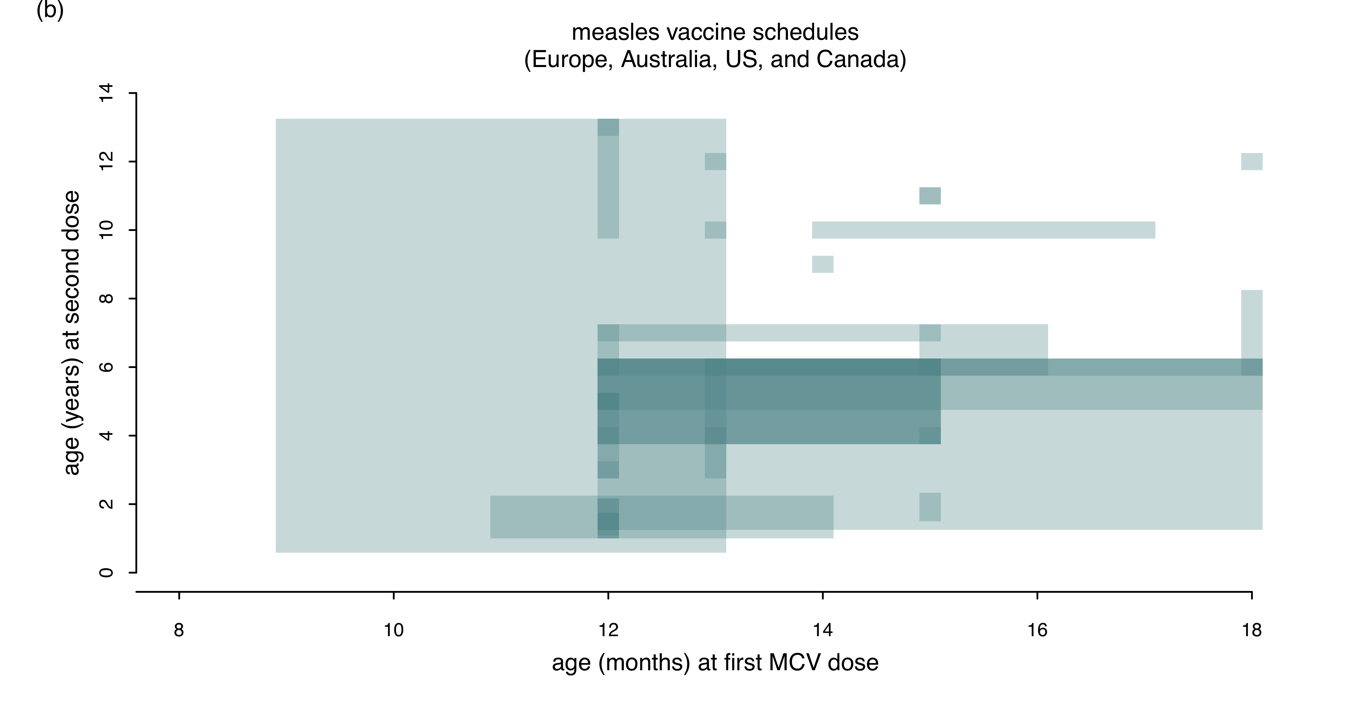
Measles Routine Vaccination Schedule Differs Among Countries
Martinez, Wallinga, Gans, et al (in prep)

Slide 35
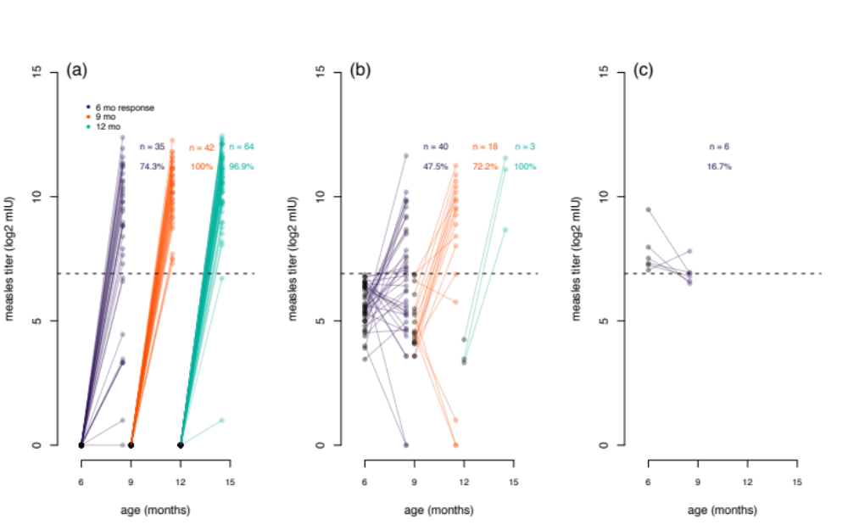
Variation in Vaccine Response
Young infants are less likely to have a robust antibody response to their first dose of measles vaccine
Martinez, Wallinga, Gans, et al (in prep)

Slide 36
Childhood Diseases as a Global Problem
5.3M under-5 deaths in 2018
50% from sepsis, tetanus, pneumonia, diarrhea, malaria, AIDS, measles, and meningitis
70-80% are infant deaths
Data from: https://data.unicef.org/topic/child-survival/under-five-mortality/

Slide 37

Childhood Diseases as a Global Problem
5.3M under-5 deaths in 2018
50% from sepsis, tetanus, pneumonia, diarrhea, malaria, AIDS, measles, and meningitis
70-80% are infant deaths
Data from: https://data.unicef.org/topic/child-survival/under-five-mortality/

