Slide 1
SIR MODELS & HERD IMMUNITY
Micaela E. Martinez
Emory University Dept. of Biology

Slide 2
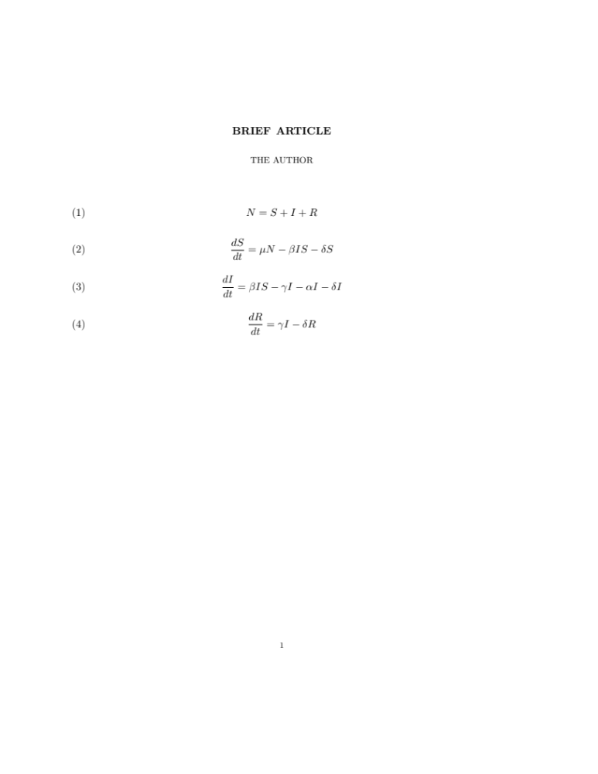
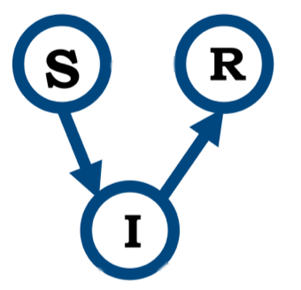
Susceptible-Infected-Recovered Models
Population size
Change in susceptible over time
Change in infected over time
Change in recovered over time

Slide 3
Susceptible-Infected-Recovered Models
+ individuals added to the class
- individuals leaving the class
New infections
Change in susceptible over time
New births
Natural death

Slide 4
Susceptible-Infected-Recovered Models
+ individuals added to the class
- individuals leaving the class
Infection-induced mortality
New infections
Change in infected over time
recovery
Natural death

Slide 5
Susceptible-Infected-Recovered Models
+ individuals added to the class
- individuals leaving the class
Natural death
Change in recovered over time
recovery

Slide 6

Growth of the Infected Class
Rate in
Rate out
I
Rate in
Rate out

Slide 7
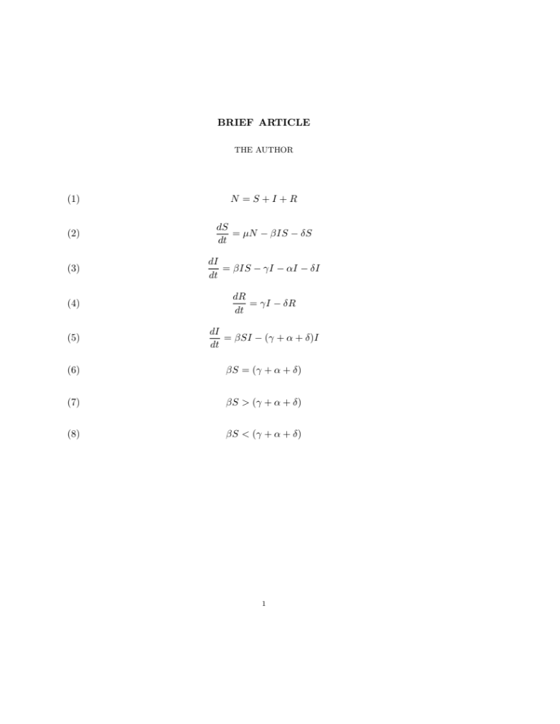
Growth of the Infected Class
Size of infected class remains constant
Infected class grows (rate in > rate out)
Infected class shrinks
I

Slide 8
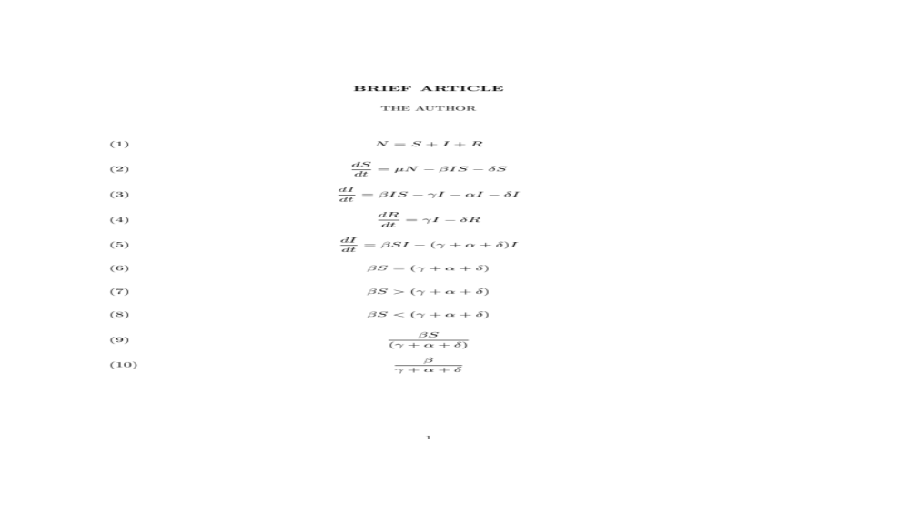
Calculating the Reproductive Ratio
If greater than 1, the infectious agent is successfully spreading and the infected class grows in size
I
Called the reproductive ratio because it tells us how many new infections “reproduced” by each infected individual before they leave the infected class

Slide 9
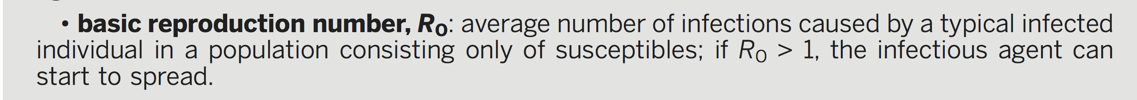
The Basic Reproductive Number
S, I, and R are fractions of the population in each class, so N = 1
I
For R0 assume S = N

Slide 10
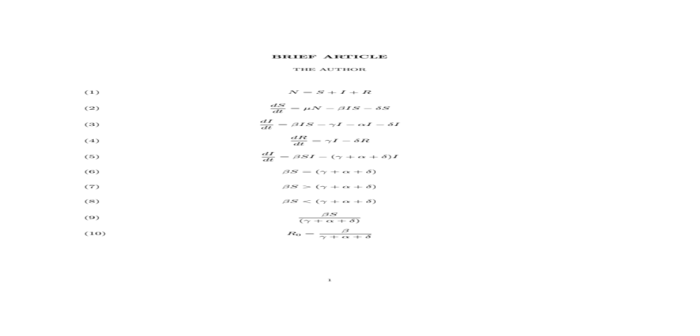
The Basic Reproductive Number
S, I, and R are fractions of the population in each class, so N = 1
I
For R0 assume S = N

Slide 11
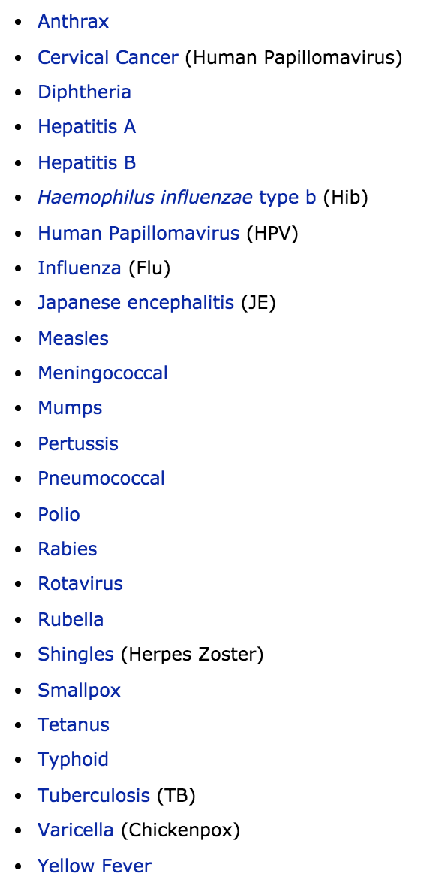
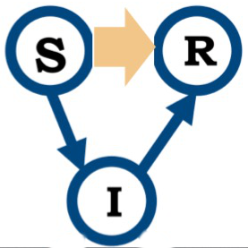
Vaccination
To keep the infected class from growing, S can be reduced via vaccination
http://www.cdc.gov/vaccines/vpd-vac/vpd-list.htm

Slide 12
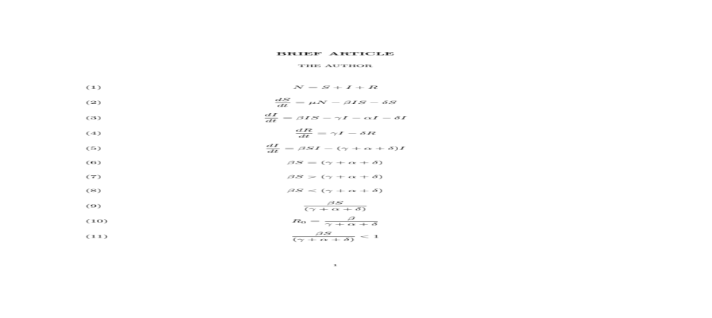
Herd Immunity
To keep the infected class from growing (prevent epidemics), not everyone needs to be vaccinated
Vaccinate enough such that infected class shrinks

Slide 13
Herd Immunity
A sufficient proportion of a population is immune (via vaccination and/or prior infection) to make transmission unlikely. Even individuals not vaccinated (such as newborns and those with chronic illnesses) are offered some protection because the disease has little opportunity to spread within the population.
http://www.cdc.gov/vaccines/about/terms/glossary.htm

Slide 14
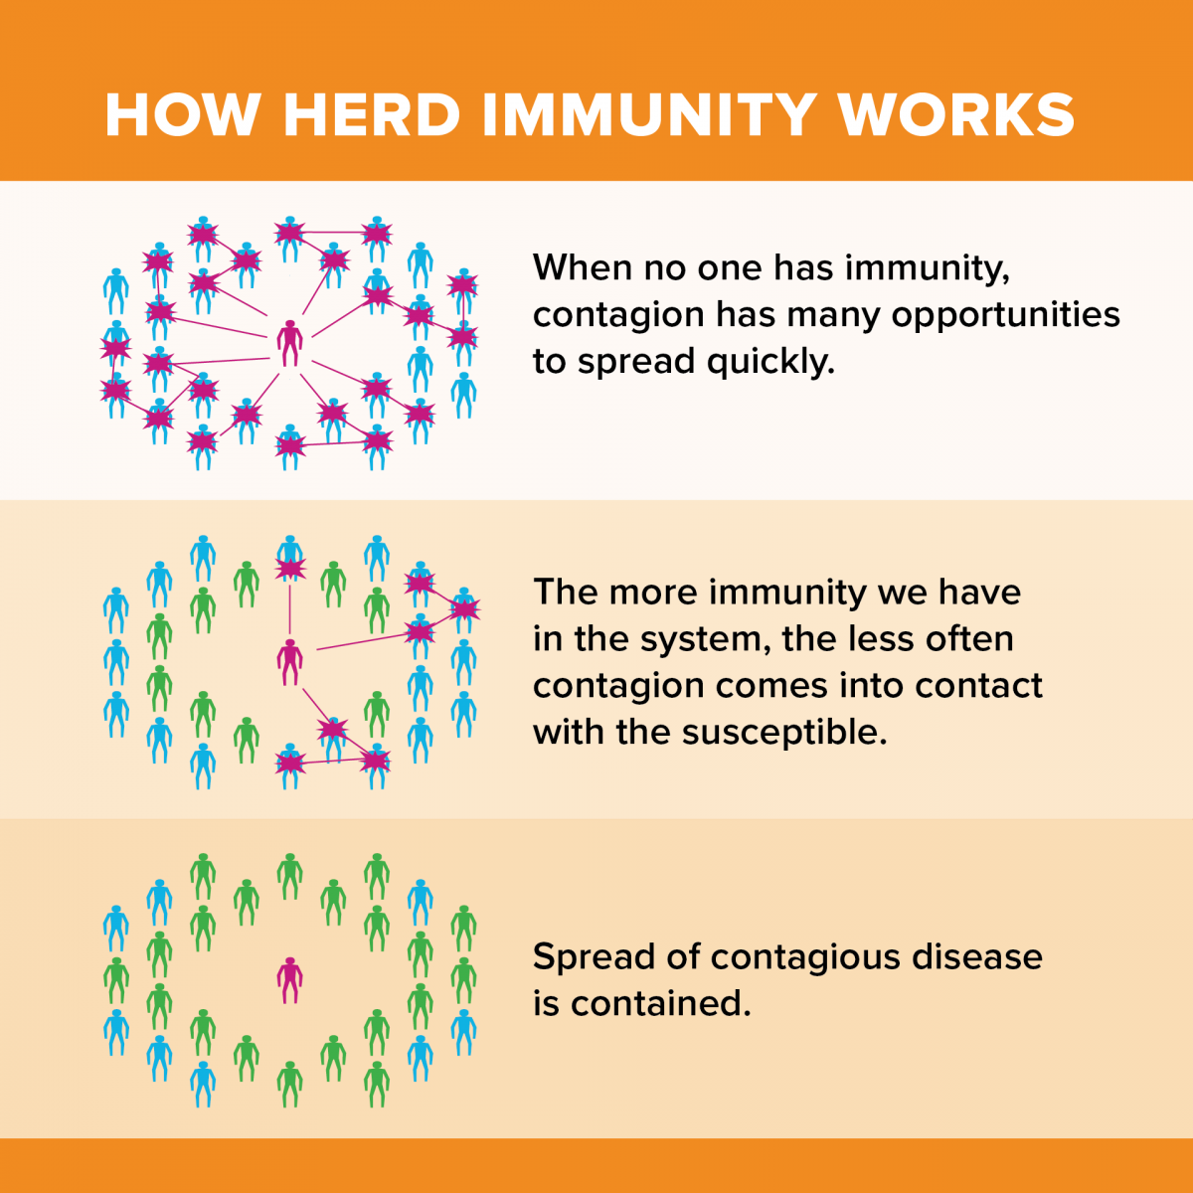
Herd Immunity
Credit: UC Davis

Slide 15
Disease Eradication
Disease eradication: driving the infectious agent to extinction (local vs. global)
Local eradication happens if S is small-enough that the number of infected individuals declines to zero

Slide 16
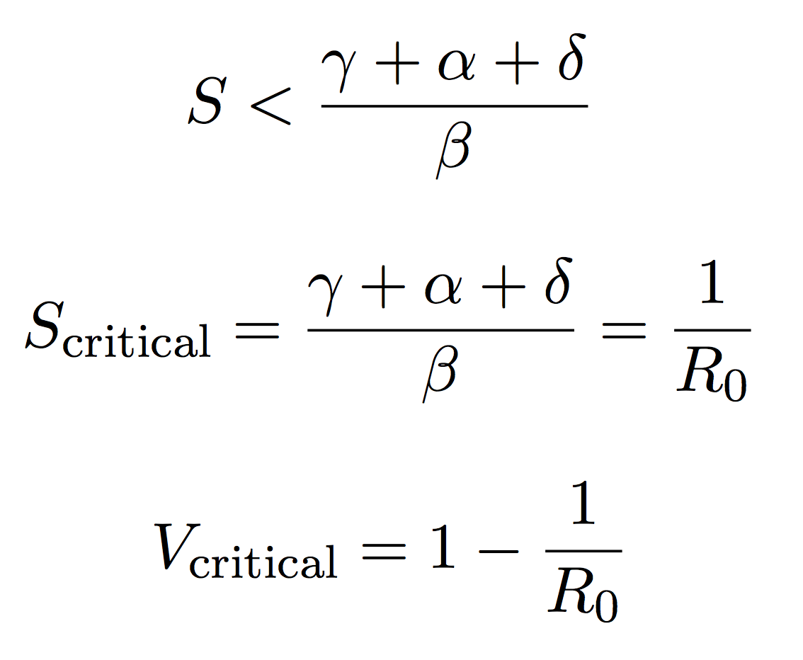
Eradication Criterion
Calculating the critical vaccination fraction

Slide 17
Eradication Criterion
Calculating the critical vaccination fraction

Slide 18
R0 and Eradication
infection | Geographic location | R0 | V_{critical (%)}
measles | England & Wales | 16-18 | 94%
measles | Kansas, USA | 5-6 | 83%
pertussis | Maryland, USA | 16-17 | 94%
chicken pox | New Jersey, USA | 7-8 | 88%
mumps | Netherlands | 11-14 | 93%
rubella | West Germany | 6-7 | 86%
polio | USA | 5-6 | 83%

Slide 19
Eradication vs. Elimination
Global Eradication: driving the infectious agent to extinction globally
Disease Elimination:
interruption of endemic transmission or maintaining the disease below a defined threshold

Slide 20
What have we eradicated or eliminated?
Eradicated:
Smallpox
Rinderpest (veterinary)
Eradication Attempts:
Yellow fever
Yaws
Malaria
Eradication “in progress”:
Polio
Guinea Worm
Eliminated:
Leprosy
Measles (regions)
Rubella (Americas)

Slide 21
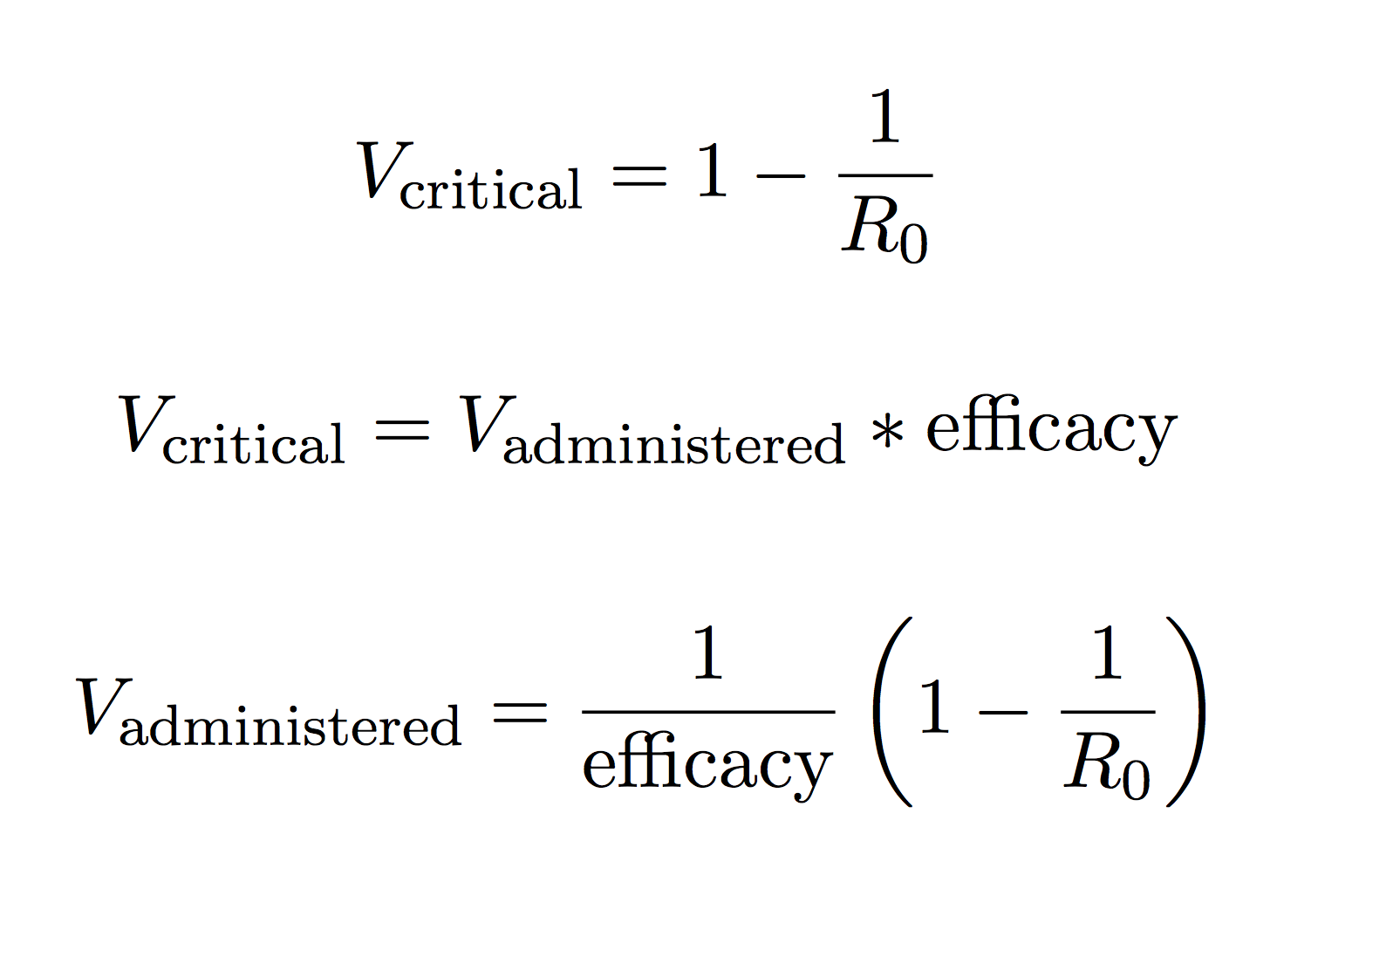
Imperfect Vaccine Efficacy
V_{critical} are those effectively immunized. We must account for vaccine failure
state

Slide 22
Imperfect Vaccine Efficacy
V_{critical} are those effectively immunized. We must account for vaccine failure
state

Slide 23

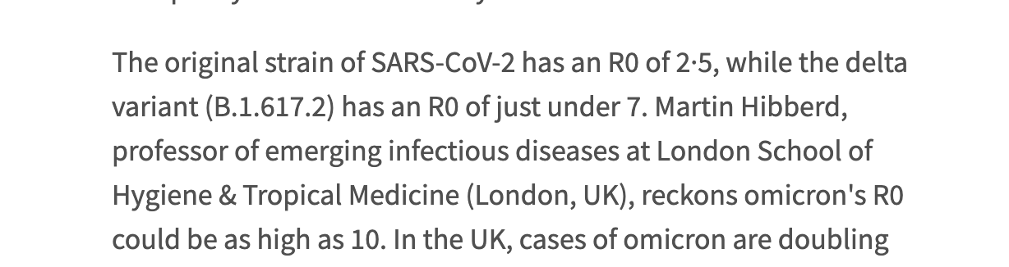

Slide 24
Exercises
(ex) Assume R0:
OG SARS-CoV-2 is 2.5
Delta is 7
Omicron is 10
What fraction of the population needs to be vaccinated if we have a vaccine that is 100%, 90%, 70% of 50% effective in blocking transmission?
state

Slide 25
Exercises
(ex) Assume R0:
OG SARS-CoV-2 R0 = 2.5: 60%, 67%, 86%, 120%
Delta is R0 = 7: 86%, 95%, 122%,170%
Omicron is R0 = 10: 90%, 100%, 129%, 180%
What fraction of the population needs to be vaccinated if we have a vaccine that is 100%, 90%, 70% of 50% effective in blocking transmission?
state

Slide 26
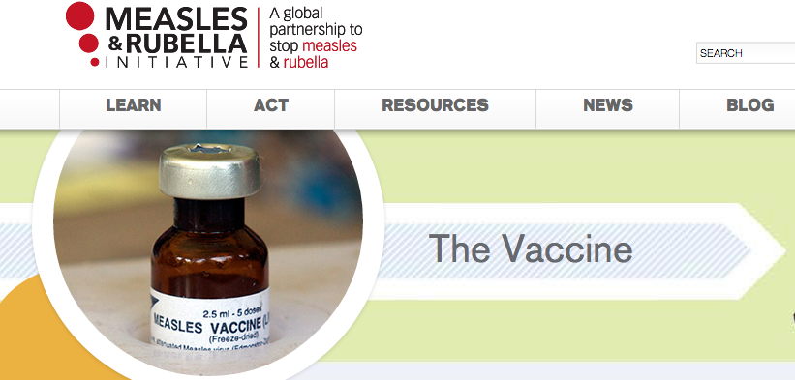
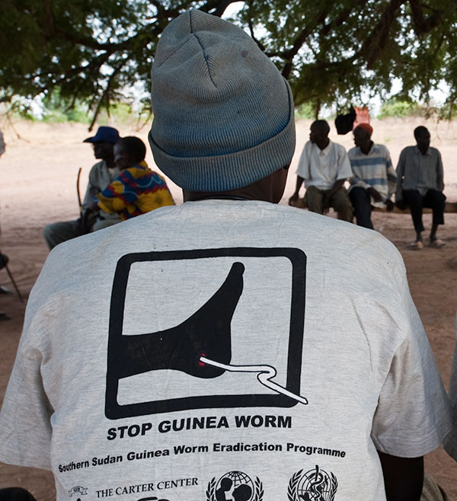
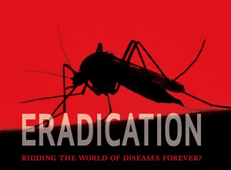
Initiatives
Disease Elimination and Eradication Efforts:
Malaria
Rubella
Rabies
Measles
Which programs will be set back due to COVID-19 pandemic?

Slide 27
break

