Slide 1
Lecture 1
Intro to modeling: Continued
Micaela E. Martinez
Emory University

Slide 2
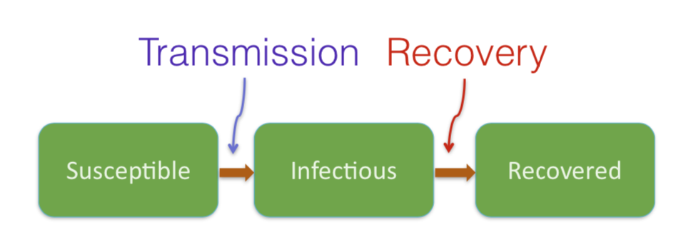

Slide 3

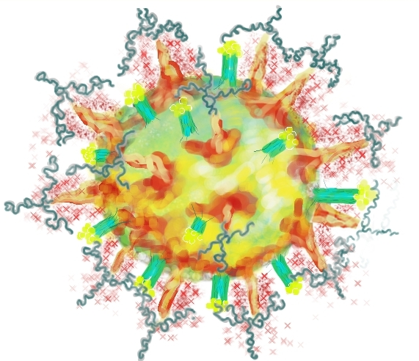
Transmission Chain
Concept: The set of host-to-host pathogen transmission events
Insert a schematic of who infects who

Slide 4
Transmission Chain
secondary
The set of host-to-host pathogen transmission events
Insert a schematic of who infects who
primary
secondary
Each individual infected two others
Week 0
Week 1
Week 2
Week 3

Slide 5
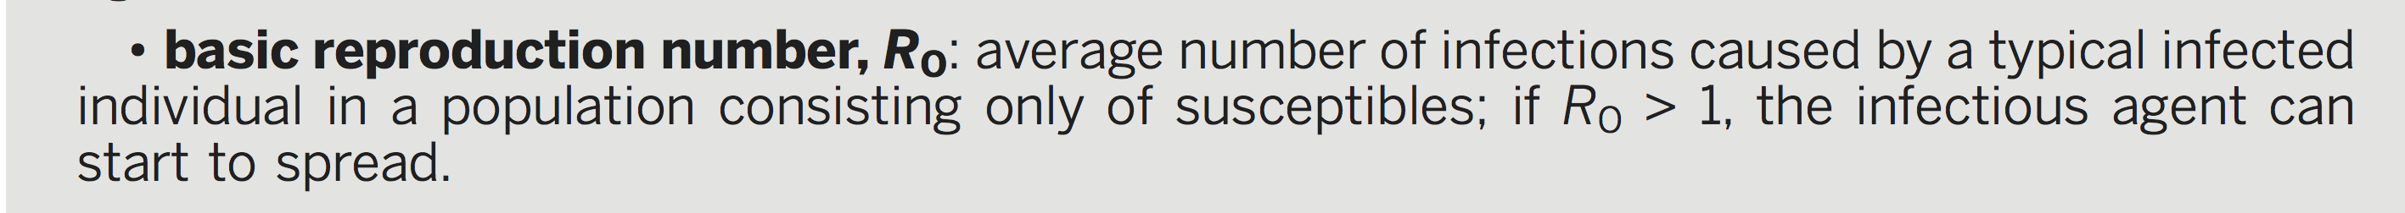
The Basic Reproductive Number
infection | Geographic location | Time period | R0
measles | England & Wales | 1950-1968 | 16-18
measles | Kansas, USA | 1918-1921 | 5-6
pertussis | Maryland, USA | 1943 | 16-17
chicken pox | New Jersey, USA | 1912-1921 | 7-8
mumps | Netherlands | 1970-1980 | 11-14
rubella | West Germany | 1970-1977 | 6-7
polio | USA | 1955 | 5-6
R0 varies among:
diseases
2. populations
3. time periods
(Heesterbeek at al. 2015; Anderson & May 1991)

Slide 6
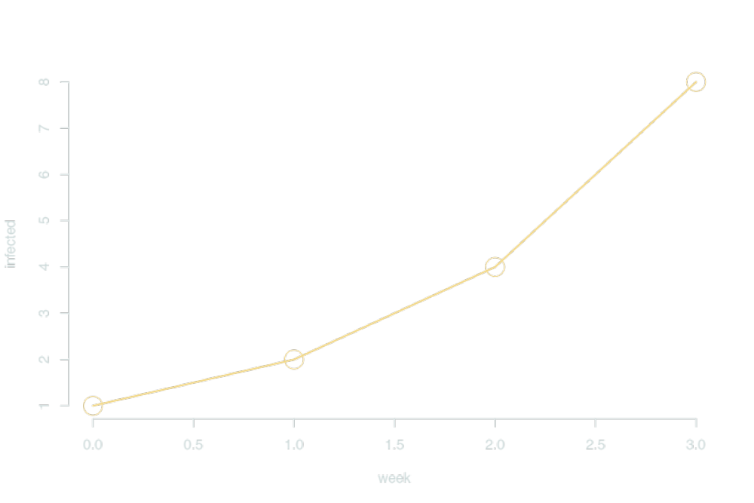
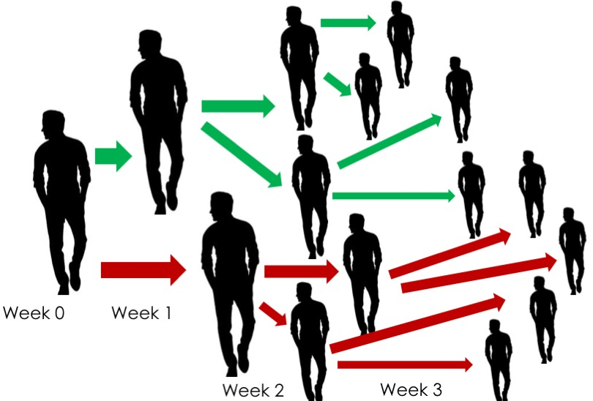
Infections in the population
R0 = 2; Each individual infected two others
I_{t} = 2^{t}

Slide 7
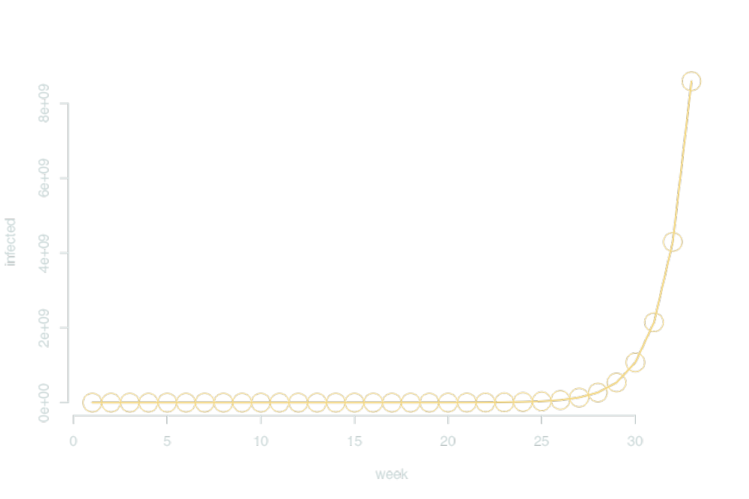
Infections in the population
^{8,589,934,592 > world pop}
What if this doubling continued?
I_{t} = 2^{t}

Slide 8
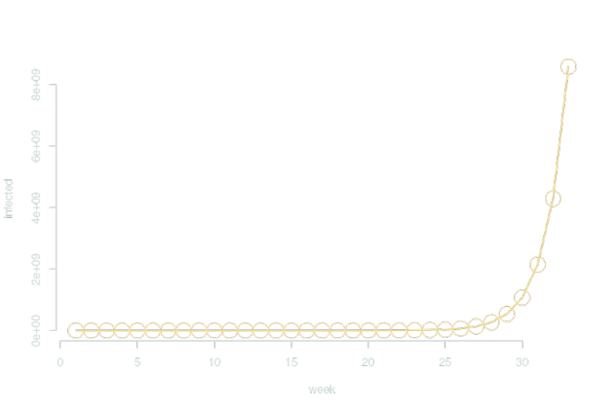
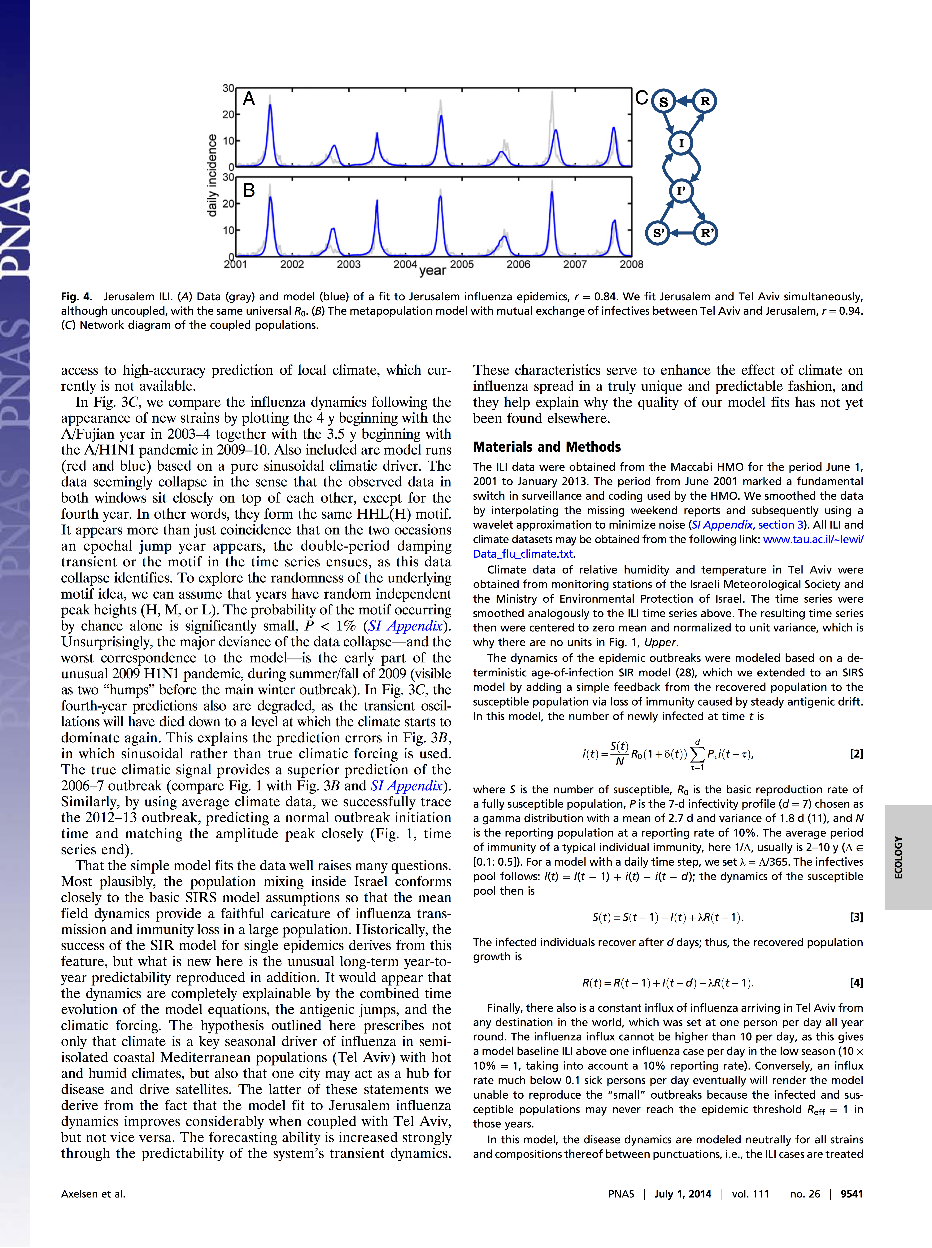
Structure of Epidemics
Features:
Exponential growth
Curtails (susceptible depletion and/or transmission decline)
Inter-epidemic period
Influenza in Jerusalem
repeat
(Axelsen et al., 2014)

Slide 9
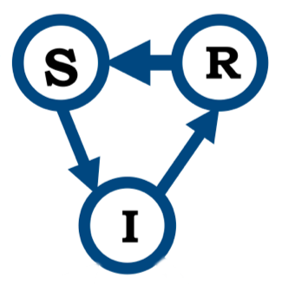
Recurrent Epidemics
S: Susceptible
I: Infected
R: Recovered
(Axelsen et al., 2014; Heesterbeek at al. 2015)

Slide 10
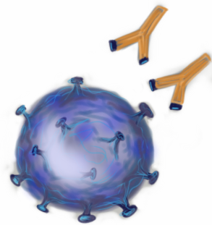

Immunological Memory
Immunological memory refers to the ability of the immune system to respond more rapidly and effectively to a pathogen that has been encountered previously.
S: Susceptible
I: Infected
R: Recovered class contains individuals with immunological memory
Immune system remembering pathogens

Slide 11
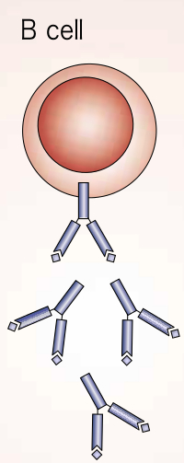
Immunological Memory: Antibodies
Antibodies are found in the fluid component of blood, or plasma, and in extracellular fluid
The simplest and most direct way in which antibodies can protect from pathogens is by binding to them and blocking their access to cells that they might infect or destroy. This is known as neutralization.
Antibodies
Virus to be neutralized
Antibodies
Immunobiology, 5th edition

Slide 12
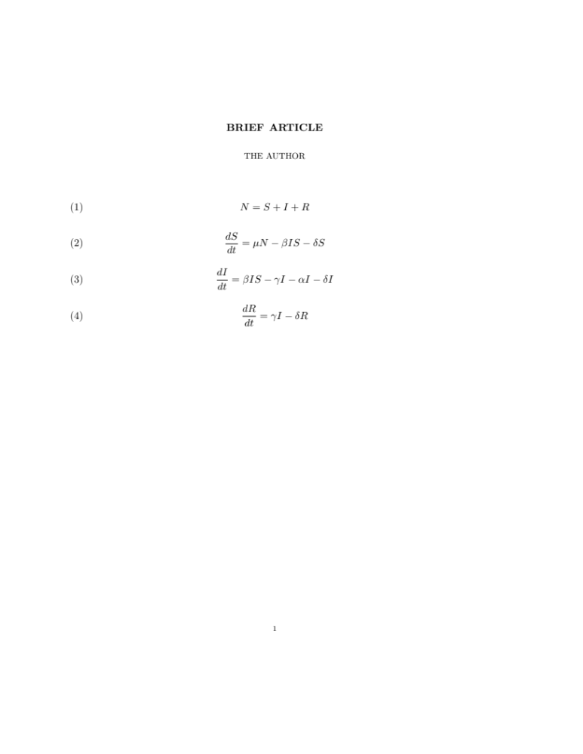
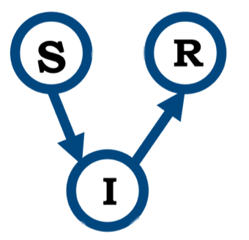
Susceptible-Infected-Recovered Models
Population size
Change in susceptible over time
Math
Change in infected over time
Change in recovered over time

Slide 13
Susceptible-Infected-Recovered Models
Population size
Change in susceptible over time
Change in infected over time
Change in recovered over time

Slide 14
Susceptible-Infected-Recovered Models
+ individuals added to the class
- individuals leaving the class
New infections
Change in susceptible over time
New births
Natural death

Slide 15
Susceptible-Infected-Recovered Models
+ individuals added to the class
- individuals leaving the class
Infection-induced mortality
New infections
Change in infected over time
recovery
Natural death

Slide 16
Susceptible-Infected-Recovered Models
+ individuals added to the class
- individuals leaving the class
Natural death
Change in recovered over time
recovery

Slide 17

Growth of the Infected Class
Rate in
Rate out
I
Rate in
Rate out

Slide 18
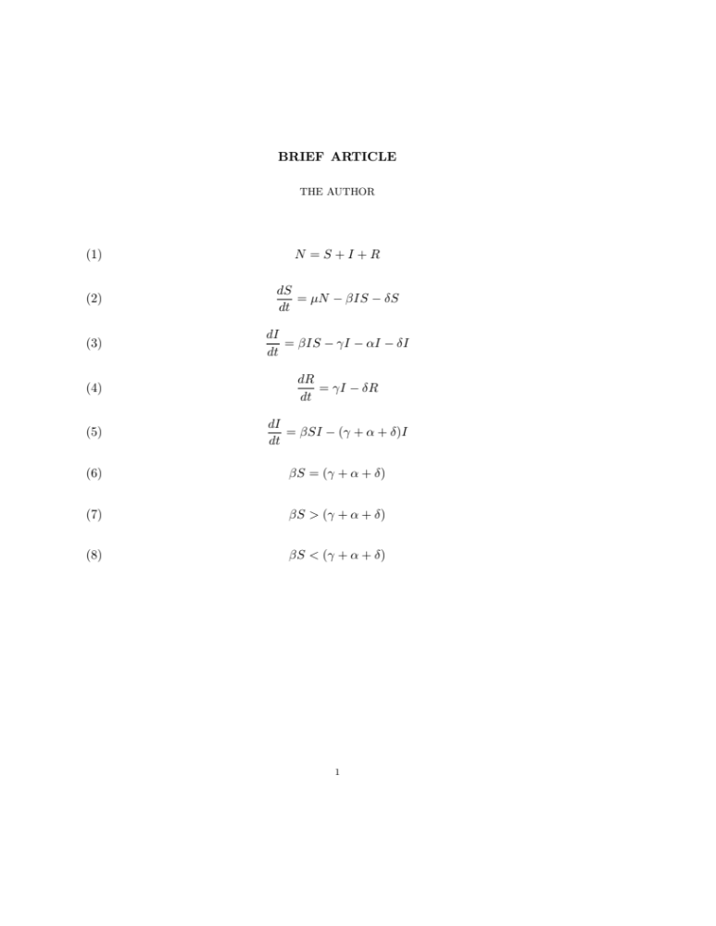
Change in Infected Class
Size of infected class remains constant
Infected class grows (rate in > rate out)
Infected class shrinks
I

Slide 19
Change in Infected Class
Size of infected class remains constant
Infected class grows (rate in > rate out)
Infected class shrinks
I

Slide 20
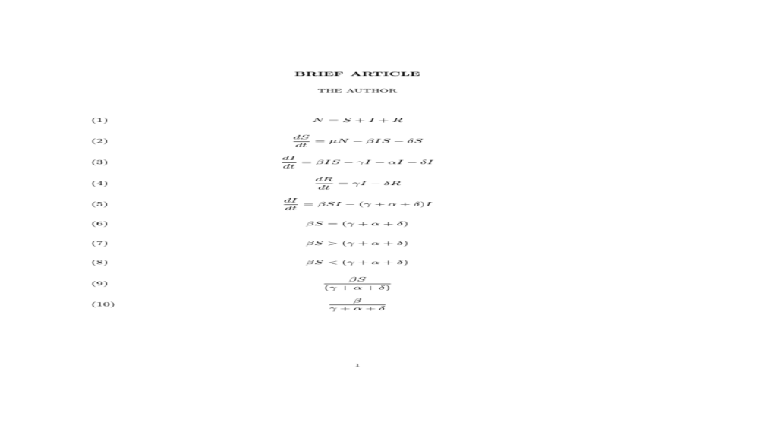
Calculating the Reproductive Ratio
If greater than 1, the infectious agent is successfully spreading and the infected class grows in size
I
Called the reproductive ratio because it tells us how many new infections “reproduced” by each infected individual before they leave the infected class

