Slide 1
Lecture 1
Intro to Modeling
Micaela E. Martinez
Emory University
slides in part adapted from Pej Rohani & John Drake’s SISMID 2019 course materials

Slide 2
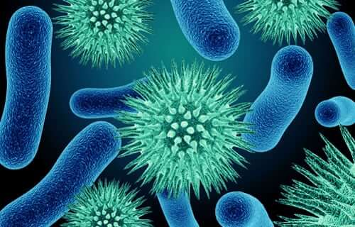

Modeling Infectious Diseases
Course Objectives:
Modeling 101
Basic Reproduction Ratio (R0)
Simple Epidemic Dynamics
Vaccination & interventions
Heterogeneity
Modeling during a pandemic
Informing models with data
Stochasticity and uncertainty

Slide 3
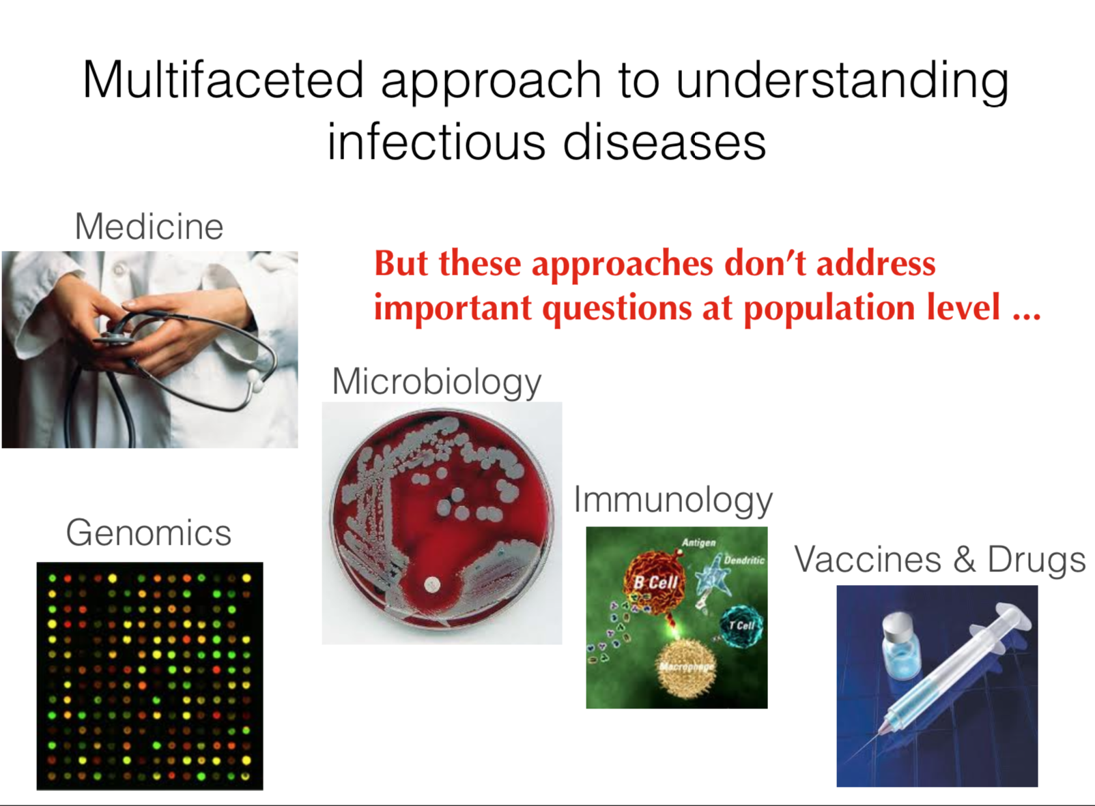
Many ways to study infectious diseases
Some disciplines focus on
infectious diseases from the:
(1) individual level
(2) within-host scale
(3) microbe perspective

Slide 4
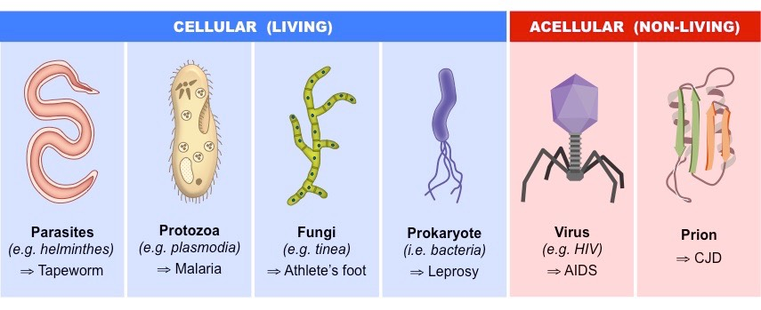
Agents of infectious diseases

Slide 5

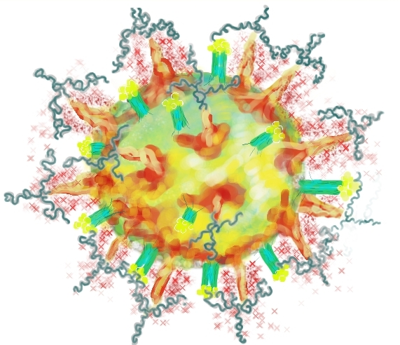
Epidemiology & Disease Ecology focus on the population-level
Concept: We can track the movement of pathogens throughout populations
Insert a schematic of who infects who

Slide 6

Epidemiology & Disease Ecology focus on the population-level
Concept: We can track the movement of pathogens throughout populations
Insert a schematic of who infects who
A transmission chain is the set of infection events that occur as a pathogen moves through a population.

Slide 7
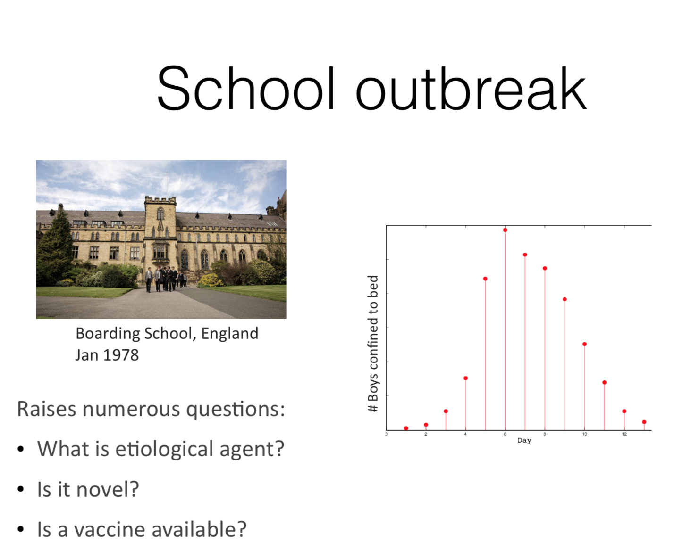

The use of time series data
1978 outbreak in a British boarding school
Students confined to bed
What pathogen is causing the illness?
Is it a novel pathogen?
Is there a vaccine or treatment?

Slide 8
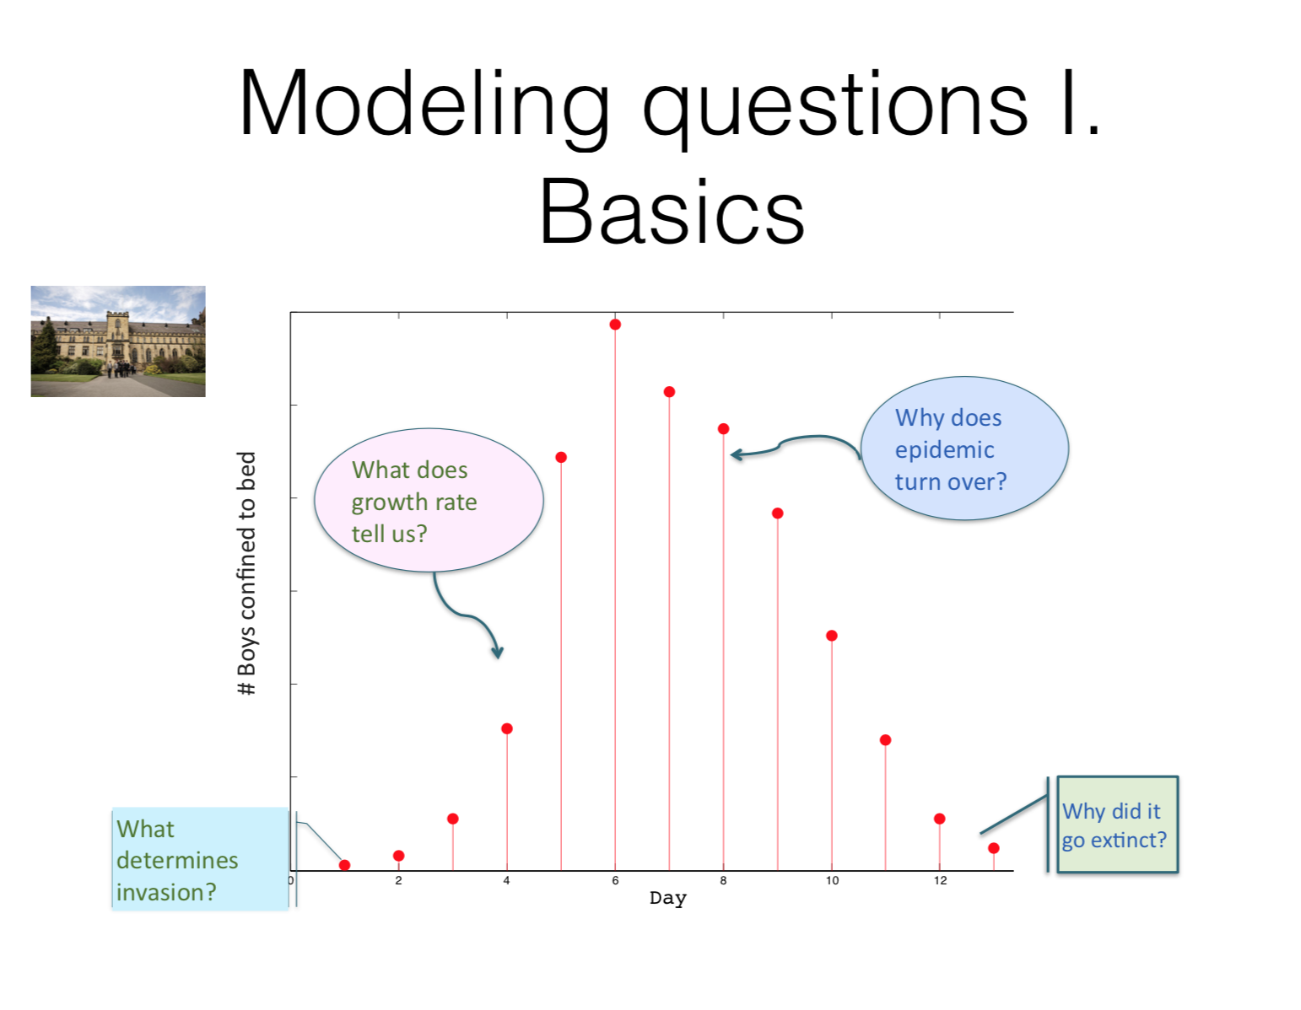
Biological questions we can ask of
time series
Students confined to bed
What allows a pathogen to enter the population?

Slide 9
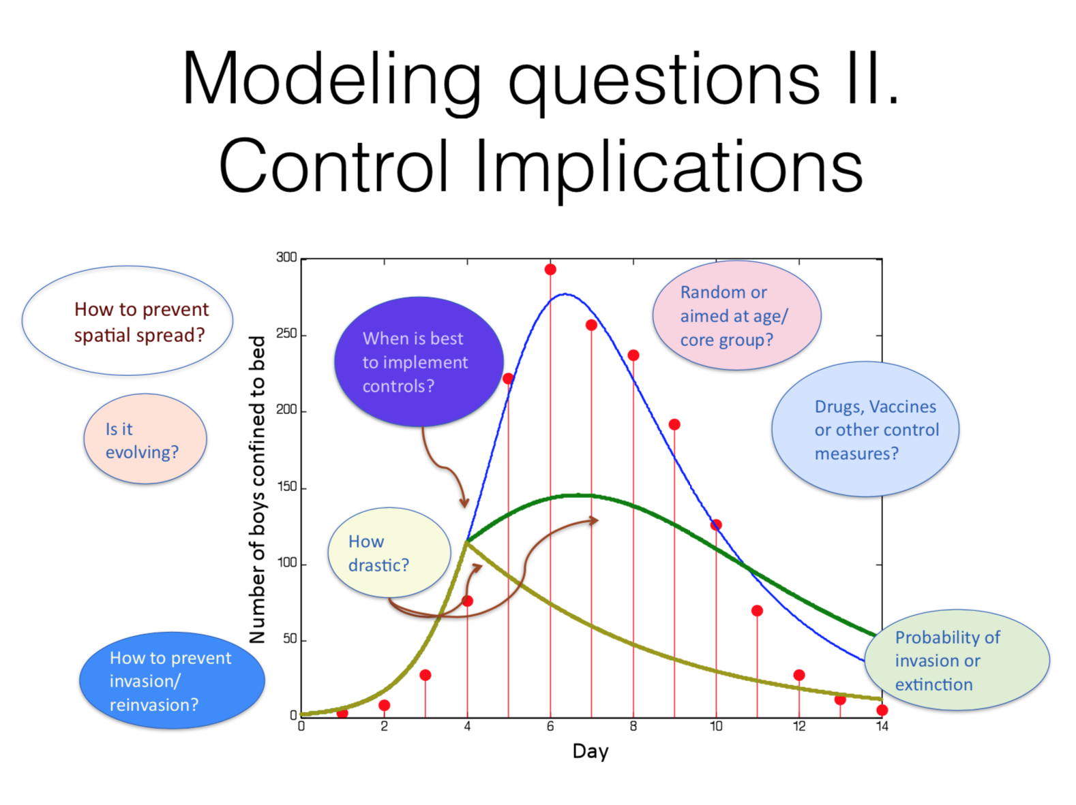
Questions about interventions we can ask of time series
How to prevent spatial spread?
Students confined to bed

Slide 10
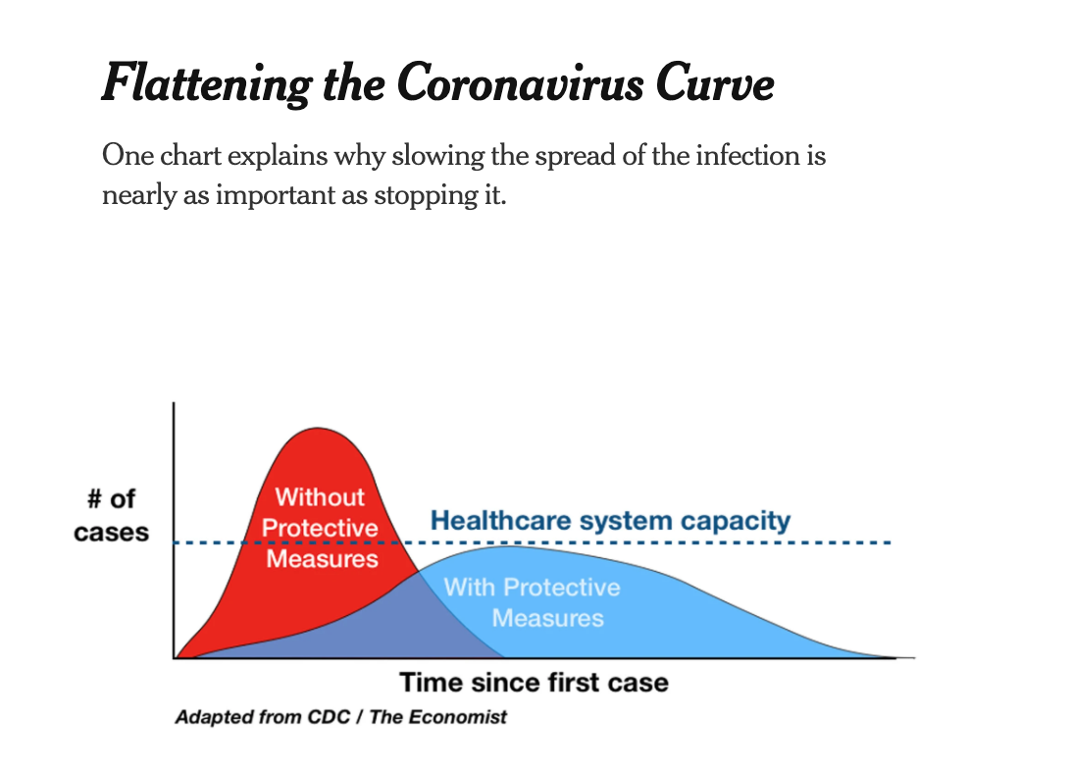
The shape of the epidemic curve contains information about transmission
Notes:
https://www.nytimes.com/article/flatten-curve-coronavirus.html

Slide 11
Different types of models:
A mathematical model is a set of equations that describe behavior of a system; such as a biological system, a physical system, a technology or social system.
A statistical model describes relationships between observed quantities and independent variables
Developing a mathematical model is different from
statistical analyses of data
What is a model?
Notes:
https://www.nytimes.com/article/flatten-curve-coronavirus.html

Slide 12
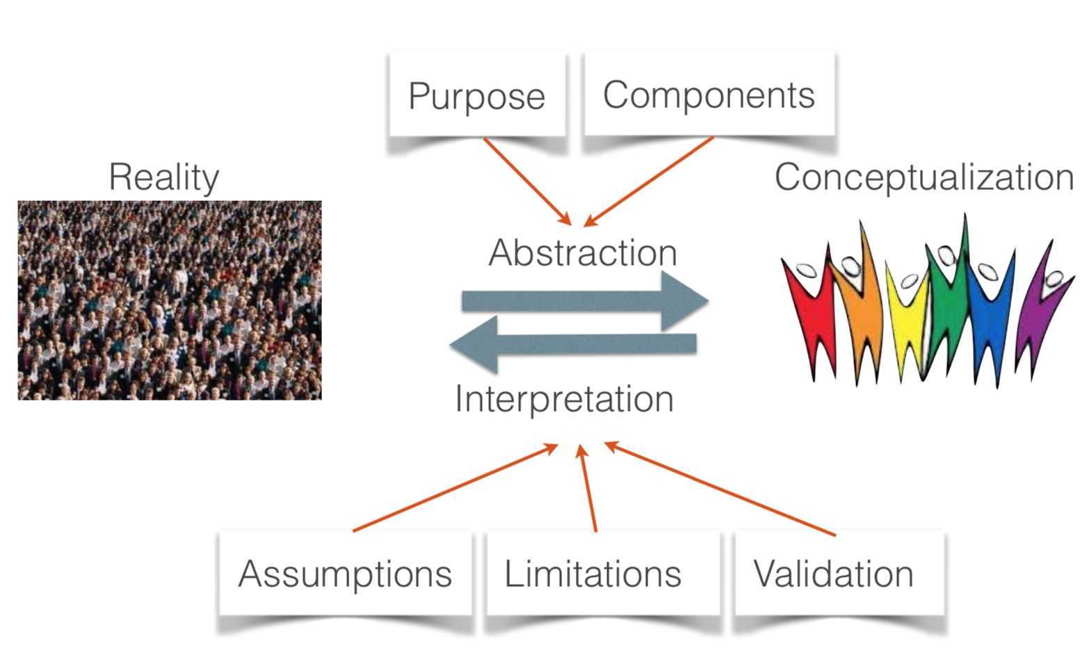
Mathematical models are abstractions
of reality
Reality
Model

Slide 13
Choice of model depends crucially on focal question and available data
Models are a tools and typically several types of models can be deployed for any given disease system
Models are used principally for understanding nature or making projections under various scenarios
What is a “good” model?
Notes:
https://www.nytimes.com/article/flatten-curve-coronavirus.html

Slide 14
^{Judging a Model...}
Three fundamental features of models, often opposing forces:
Accuracy: ability to capture observed patterns (qualitative or quantitative) and make predictions
Transparency: Ability to understand model components. Decreases with model complexity
Flexibility: How easily the model can be adapted to new scenarios. Decreases with model complexity
What is a “good” model?
Notes:
https://www.nytimes.com/article/flatten-curve-coronavirus.html

Slide 15
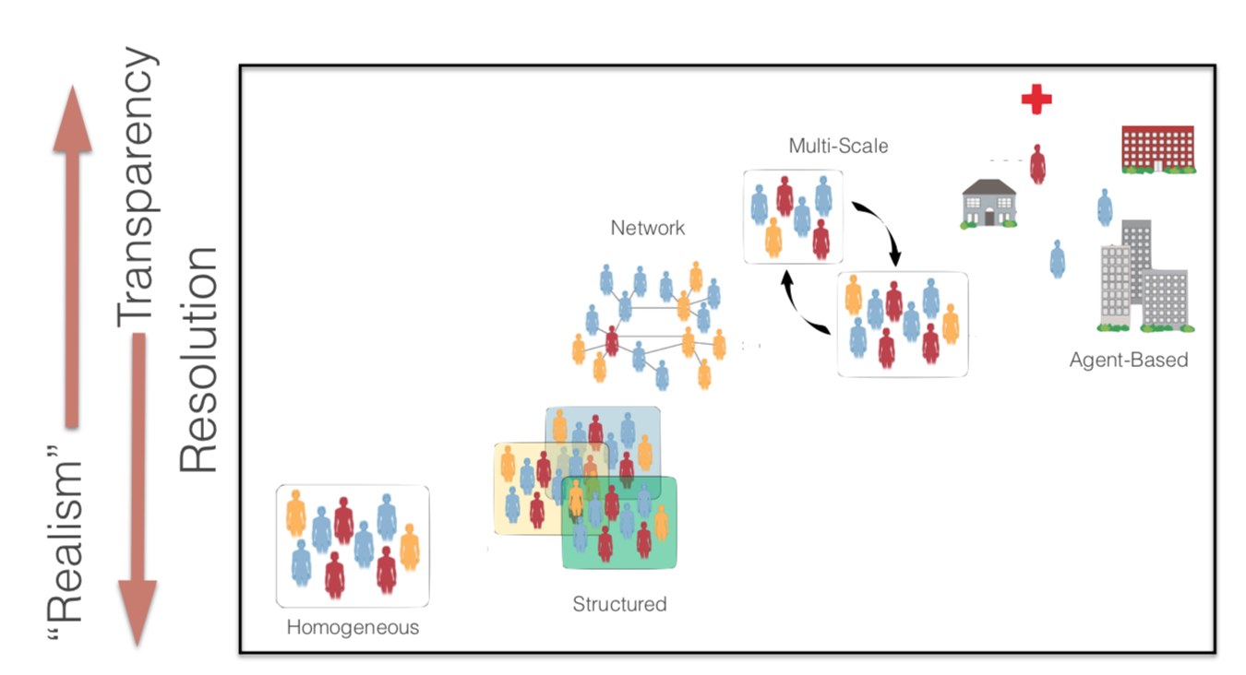
Realism & Complexity vs.
Transparency & Flexibility

Slide 16

How do you implement a mathematical model?
Analytical Models
Concentrate on problems that can be expressed and analyzed fully using analytical approaches (i.e., pure math)
Computational Models
Construct an appropriate model for the system and use a combination computational methods for analysis and scenario analysis (i.e., computer simulations)
computational
analytical

Slide 17
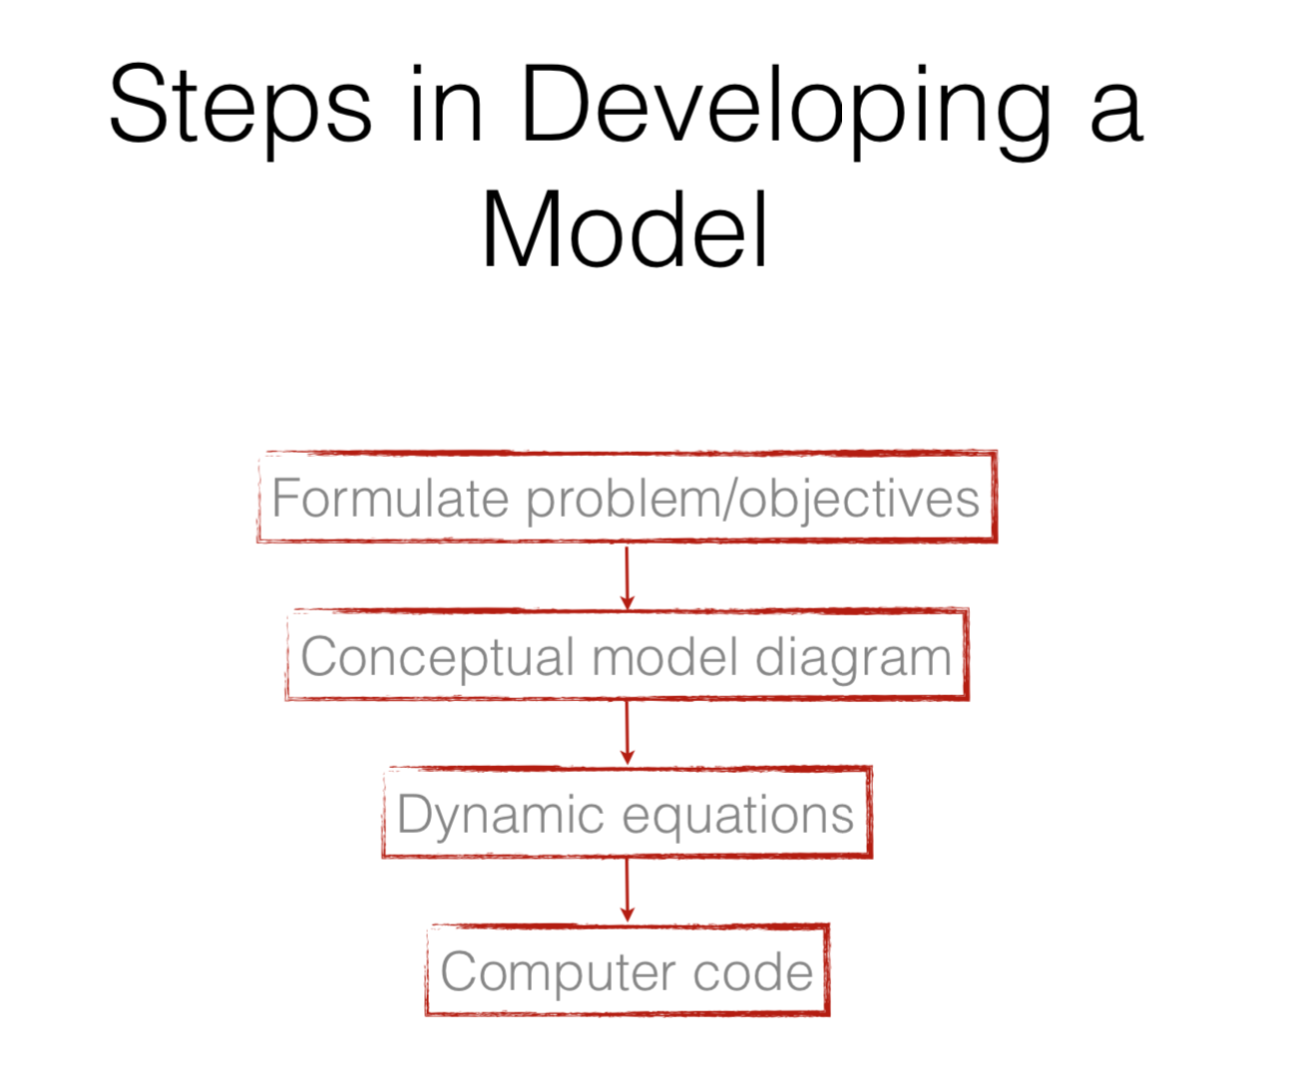

Slide 18
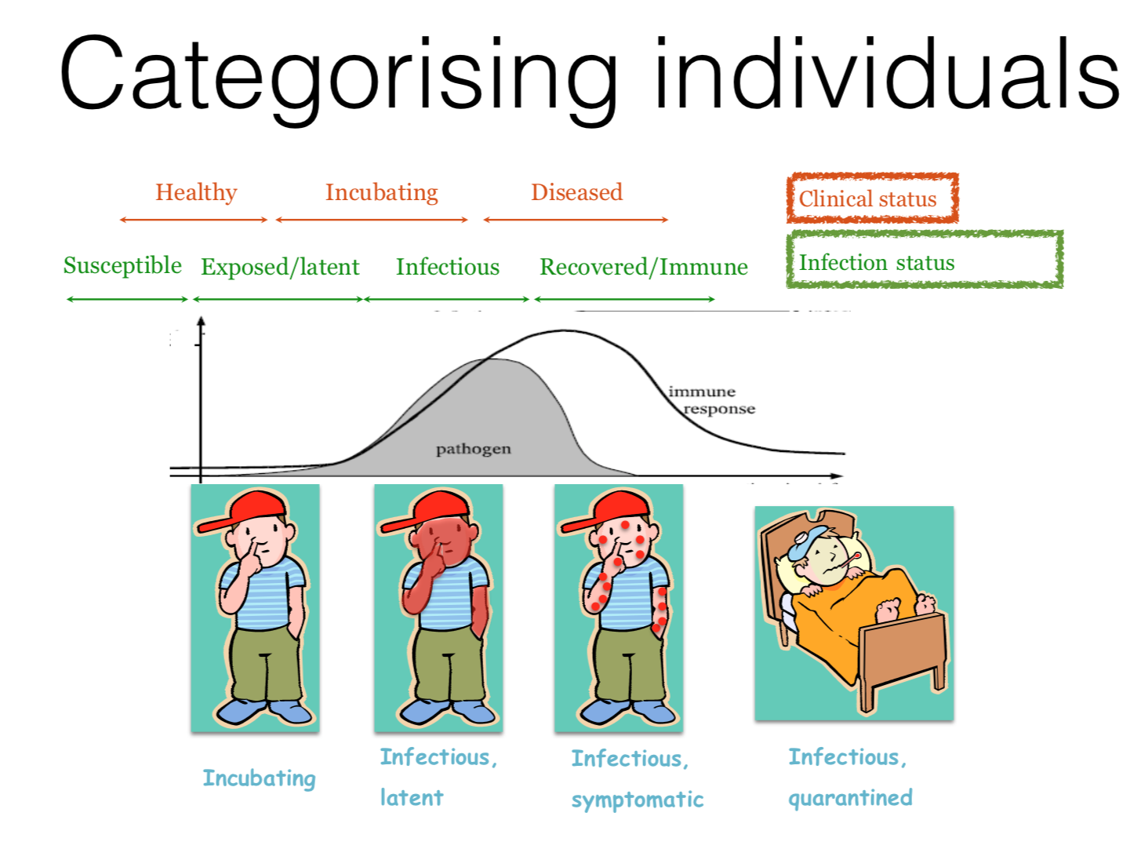
Categories of Disease Status & Infection

Slide 19

Simple Models
Pragmatic choice: categorize individuals in population according
to their infection status:
Susceptible (S)
Infectious (I)
Recovered/Immune (R)
These are called state variables, they represent different states of the system that we are modeling

Slide 20
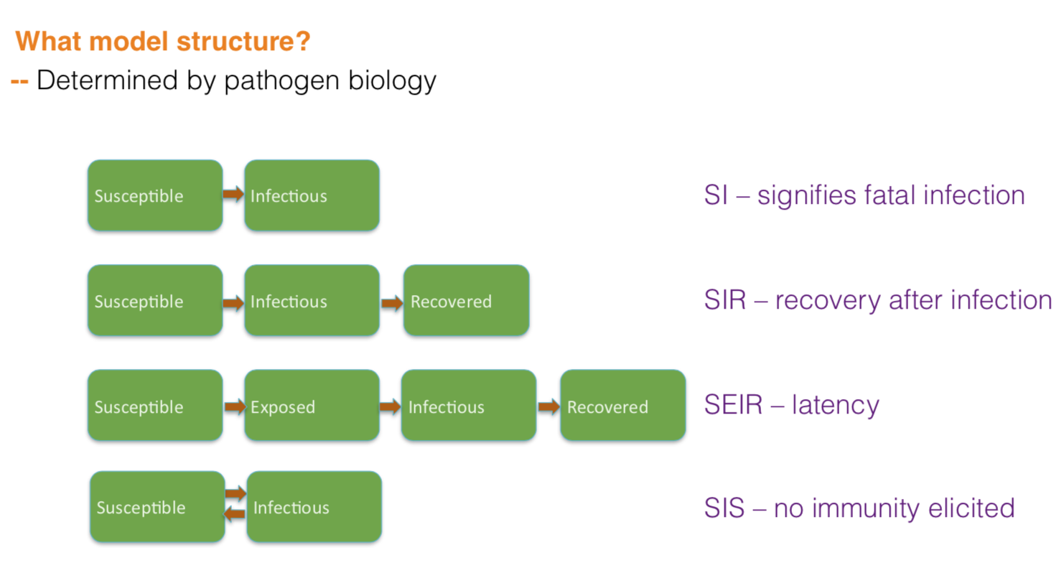
Simple Models
SI models can be used for fatal or chronic infections

Slide 21
Simple Models
SIR models can be used for infections where there is recovery and immunity

Slide 22
Simple Models
SEIR models can be used for infections where there is a non-negligible latent period when individuals are infected but not infectious. This can be a good category to have, for example for COVID-19, when considering testing and quarantine early on in infection.

Slide 23
Simple Models
SIS models are appropriate when there is little immunity elicited, or the immunity elicited will not protect from reinfection in the near-future.

Slide 24
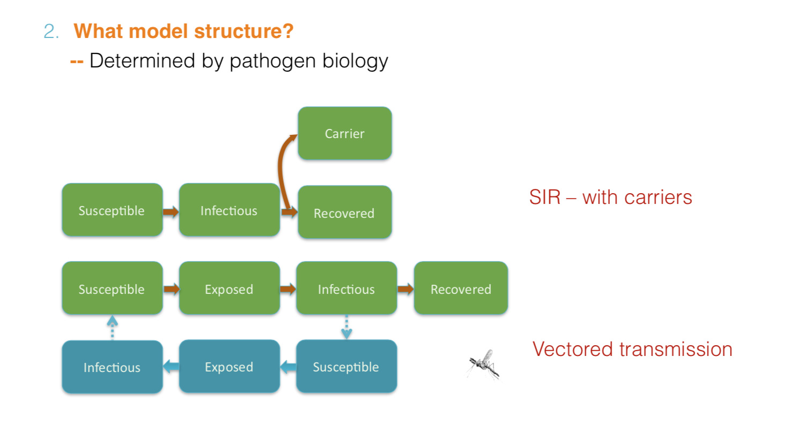
Simple Models

Slide 25
Simple Models

Slide 26
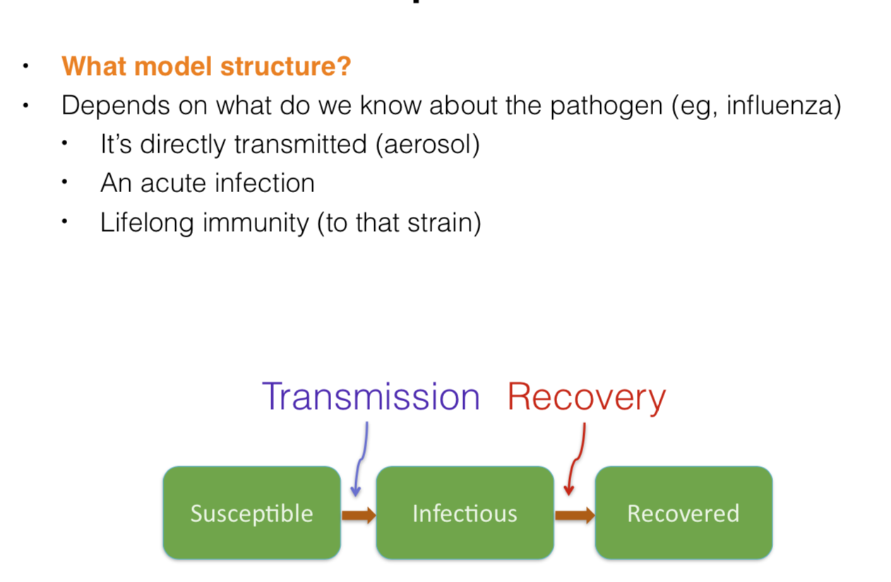
Simple Models

Slide 27
Break

