Slide 1
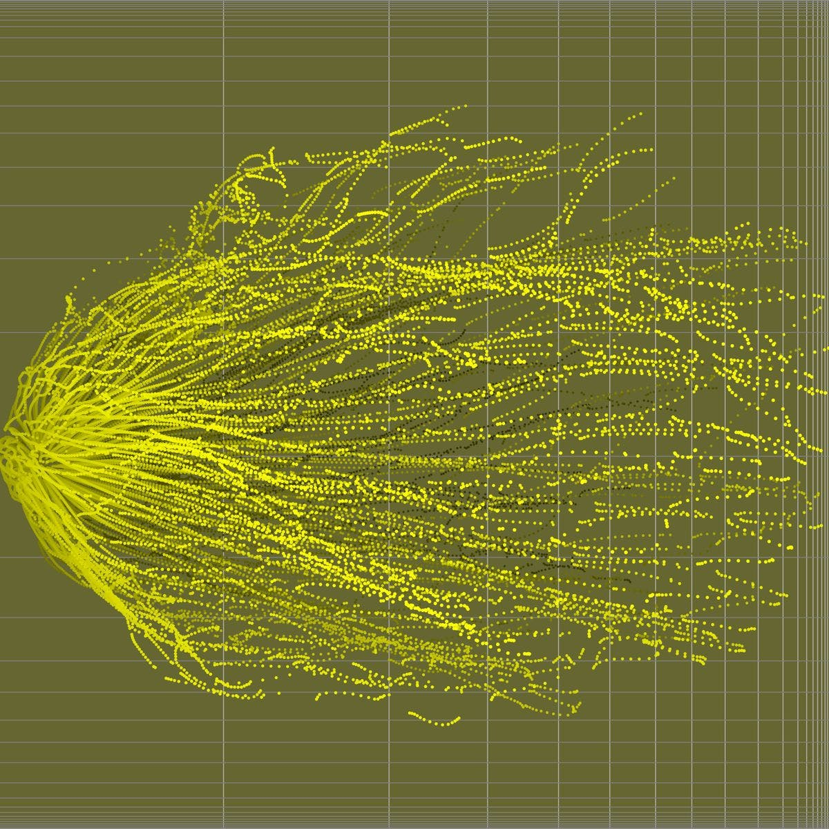
Stochastic Models & Parameter Estimation
Micaela E. Martinez
Emory University

Slide 2
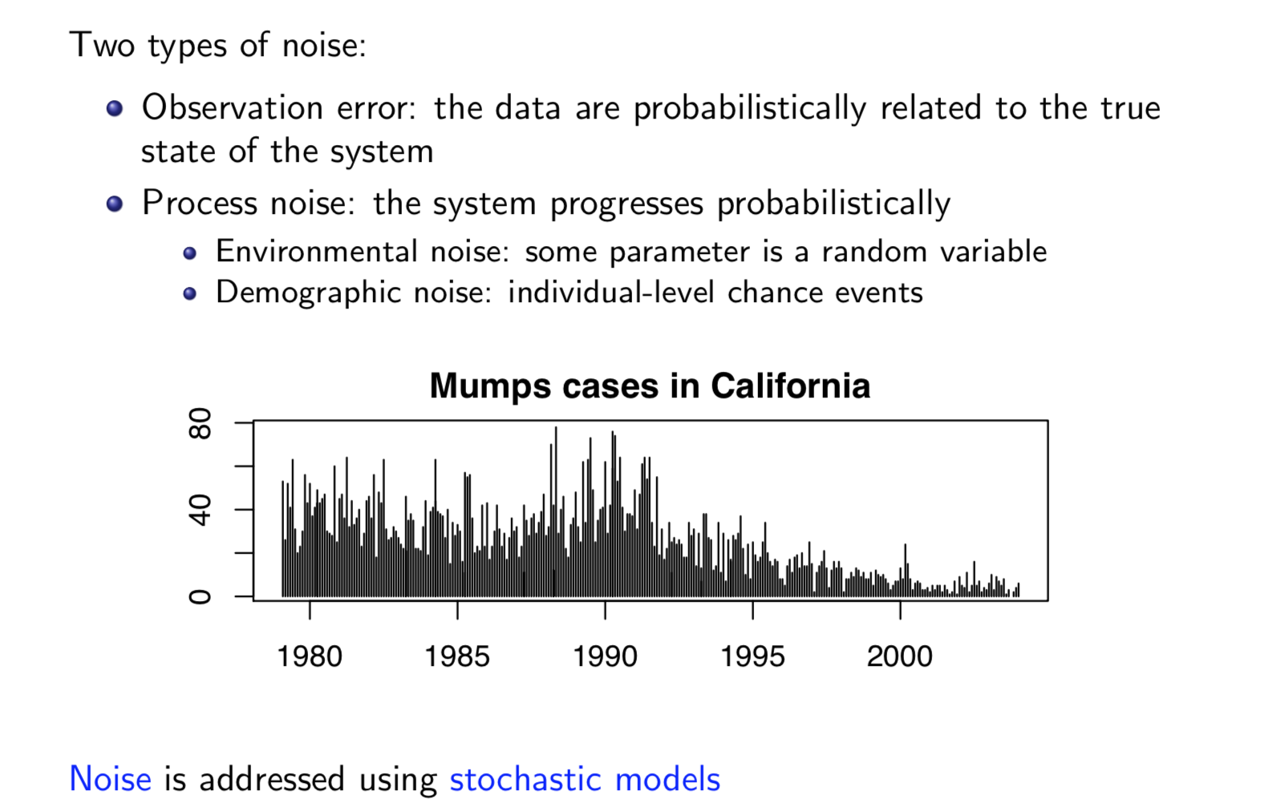
Epidemiological Data are Noisy

Slide 3
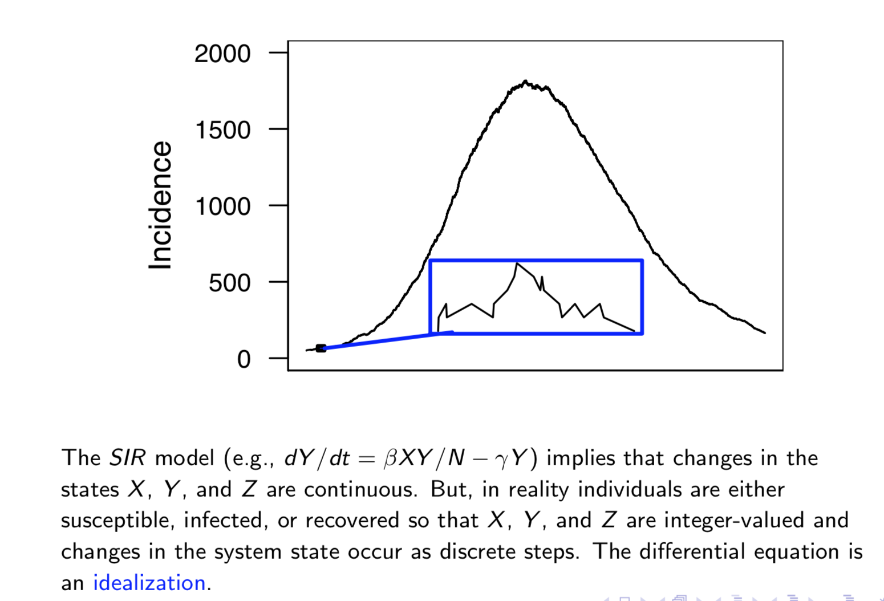
The SIR Model is an Approximation

Slide 4
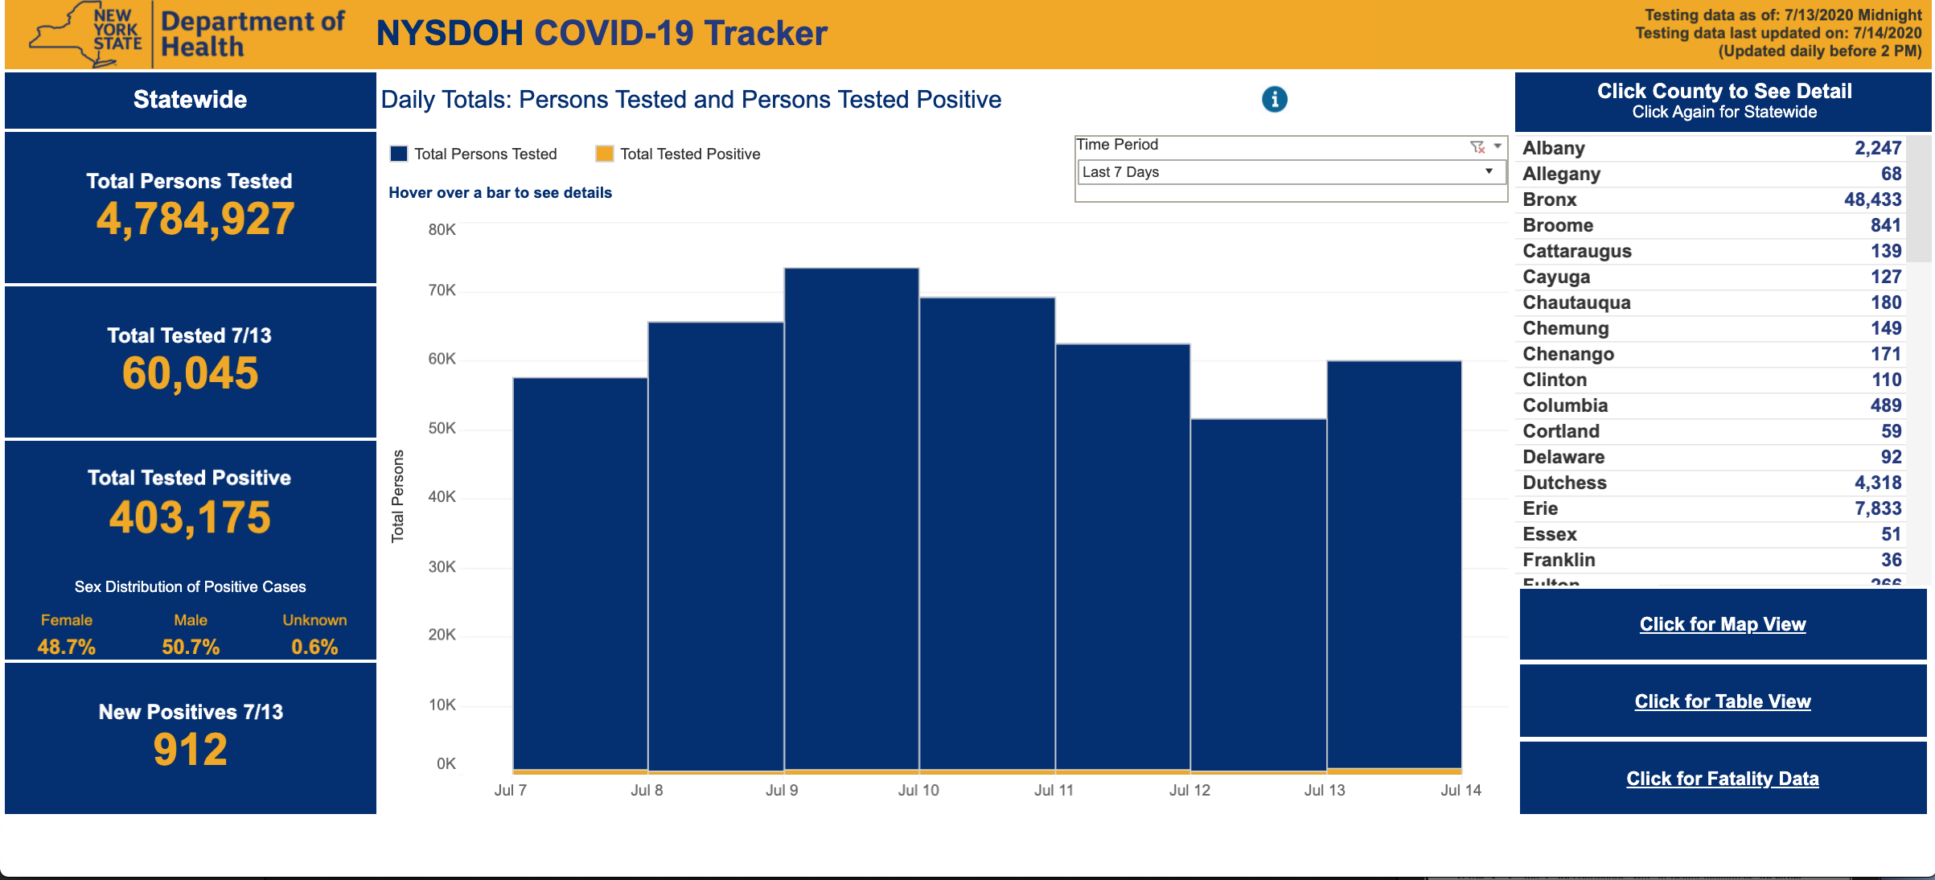
The SIR Model is an Approximation

Slide 5
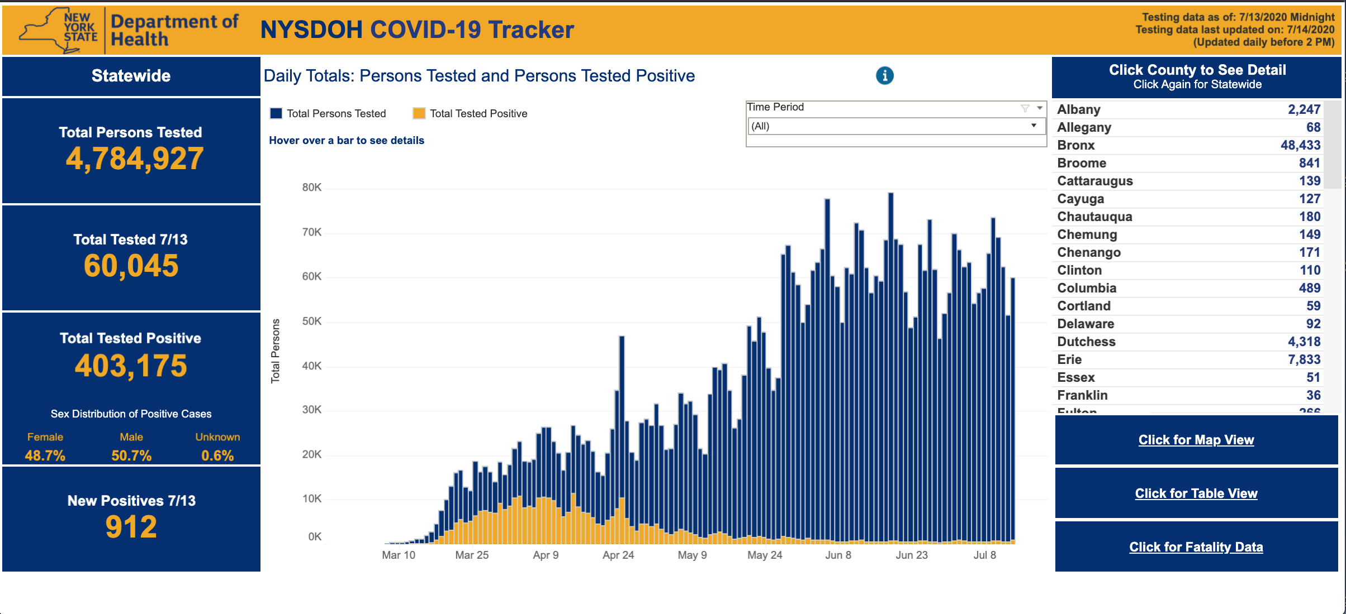
The SIR Model is an Approximation

Slide 6
Deterministic Models
Deterministic models run like “clockwork”, given the same starting conditions, exactly-the-same trajectory will always be observed

Slide 7
The SIR Model is an Approximation
Transmission is obscured by three sources of noise: observation error, environmental variability, and intrinsic demographic noise
Demographic noise is especially important in systems where R0 ≈ 1

Slide 8
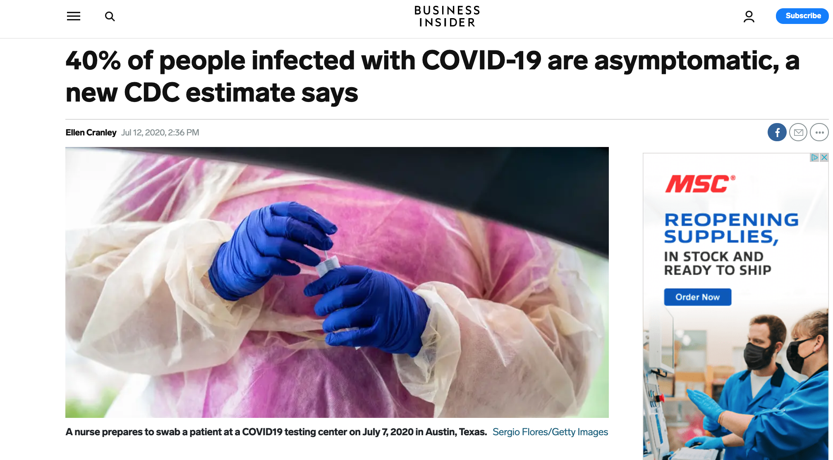
The SIR Model is an Approximation
Transmission is obscured by three sources of noise: observation error, environmental variability, and intrinsic demographic noise
Not all infections
are symptomatic
Not all symptomatic
infections reported

Slide 9
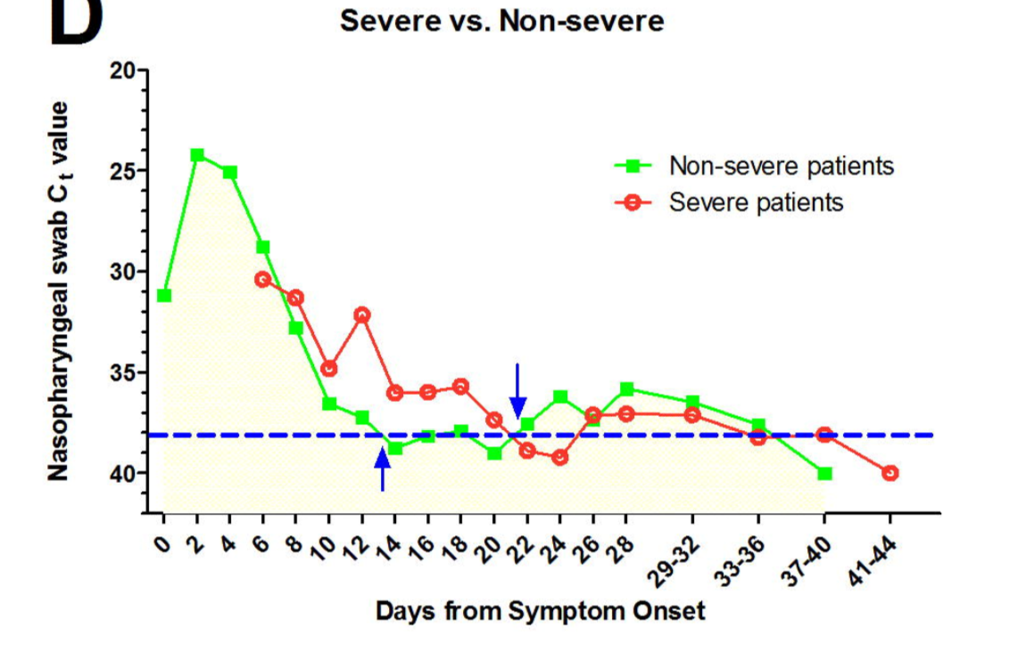
The SIR Model is an Approximation
Transmission is obscured by three sources of noise: observation error, environmental variability, and intrinsic demographic noise
Variation among
individuals can
impact parameters
Variation in environment
can impact parameters
Tan et al. MedRXIV 2020

Slide 10

The SIR Model is an Approximation
Transmission is obscured by three sources of noise: observation error, environmental variability, and intrinsic demographic noise
Think of coin flips to conceptualize
demographic stochasticity. The more
flips, the more precision you
have to approximate the mean

Slide 11

The Real World
If it were possible to “re-run” an epidemic in the real-world, we would not expect to have exactly-the-same people become infected at exactly-the-same time.
Why is this?

Slide 12
Stochastic Models
Stochastic models aim to capture some of the random and probabilistic features of the real-world.

Slide 13
Stochastic Models
Stochastic models aim to capture some of the random and probabilistic features of the real-world.
Stochasticity has the largest effect when:
# infected is small
population size is small
when the infection has just invaded
during the trough phase of an epidemic
and when control measures are successfully applied

Slide 14
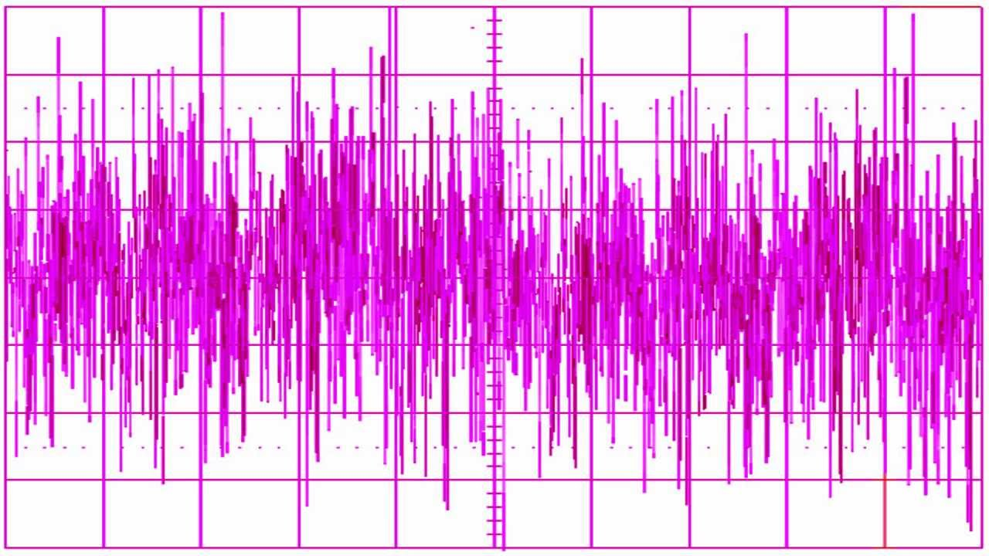
Stochastic models aim to capture some of the random and probabilistic features of the real-world.
Stochastic models use random number generators, for example:
random time-step length for events to occur
parameter values pulled randomly from distributions
reported cases pulled randomly from distributions with the mean being I_{t}*(mean report rate)
Multiplicative white or pink noise on the force of infection (beta* I_{t})
Stochastic Models

Slide 15
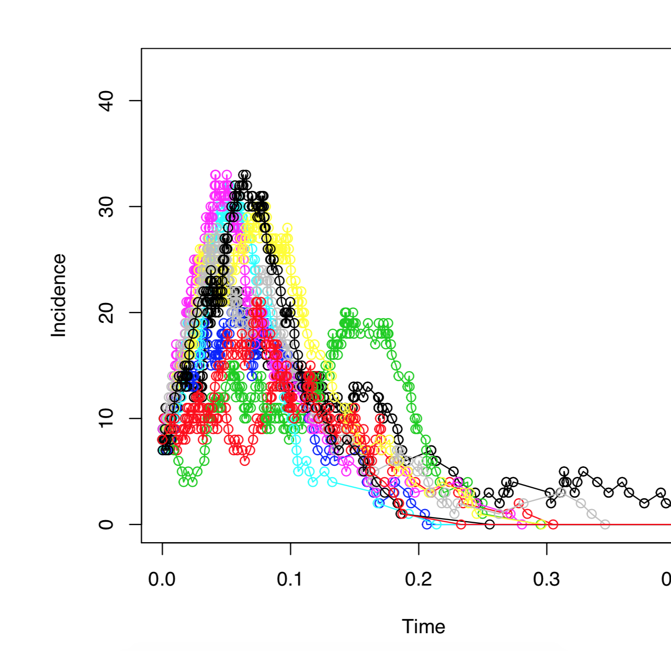
Stochastic Models: Variability Between Simulations
Variability between simulations are the most obvious element of stochastic models. Mean and variance may accurately be predicted for simulations. However, since each simulation is different, it is generally impossible to predetermine the precise disease prevalence at any time in the future.

Slide 16
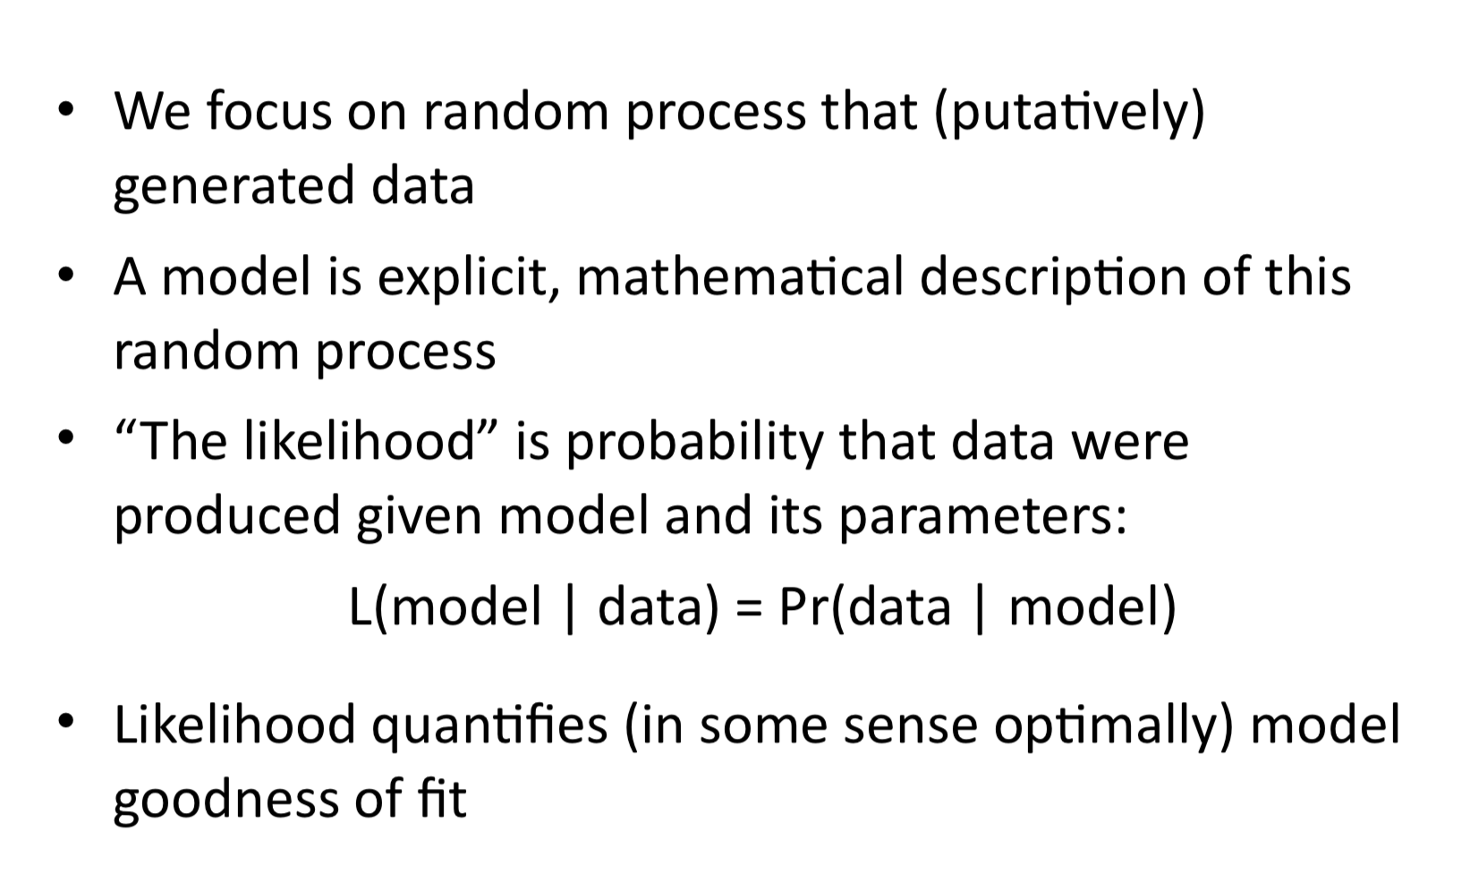
Goodness-of-Fit for Stochastic Models

Slide 17
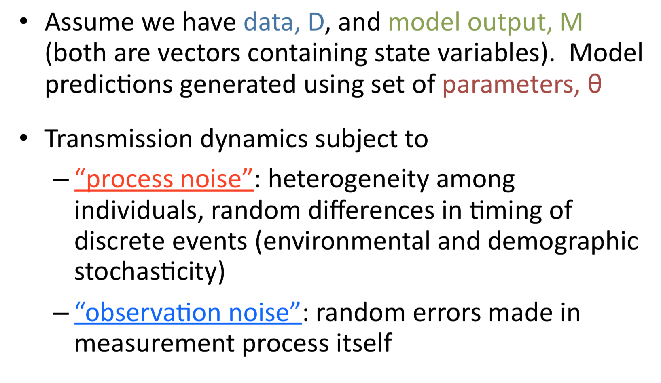
Likelihood Estimated for Stochastic Models

Slide 18
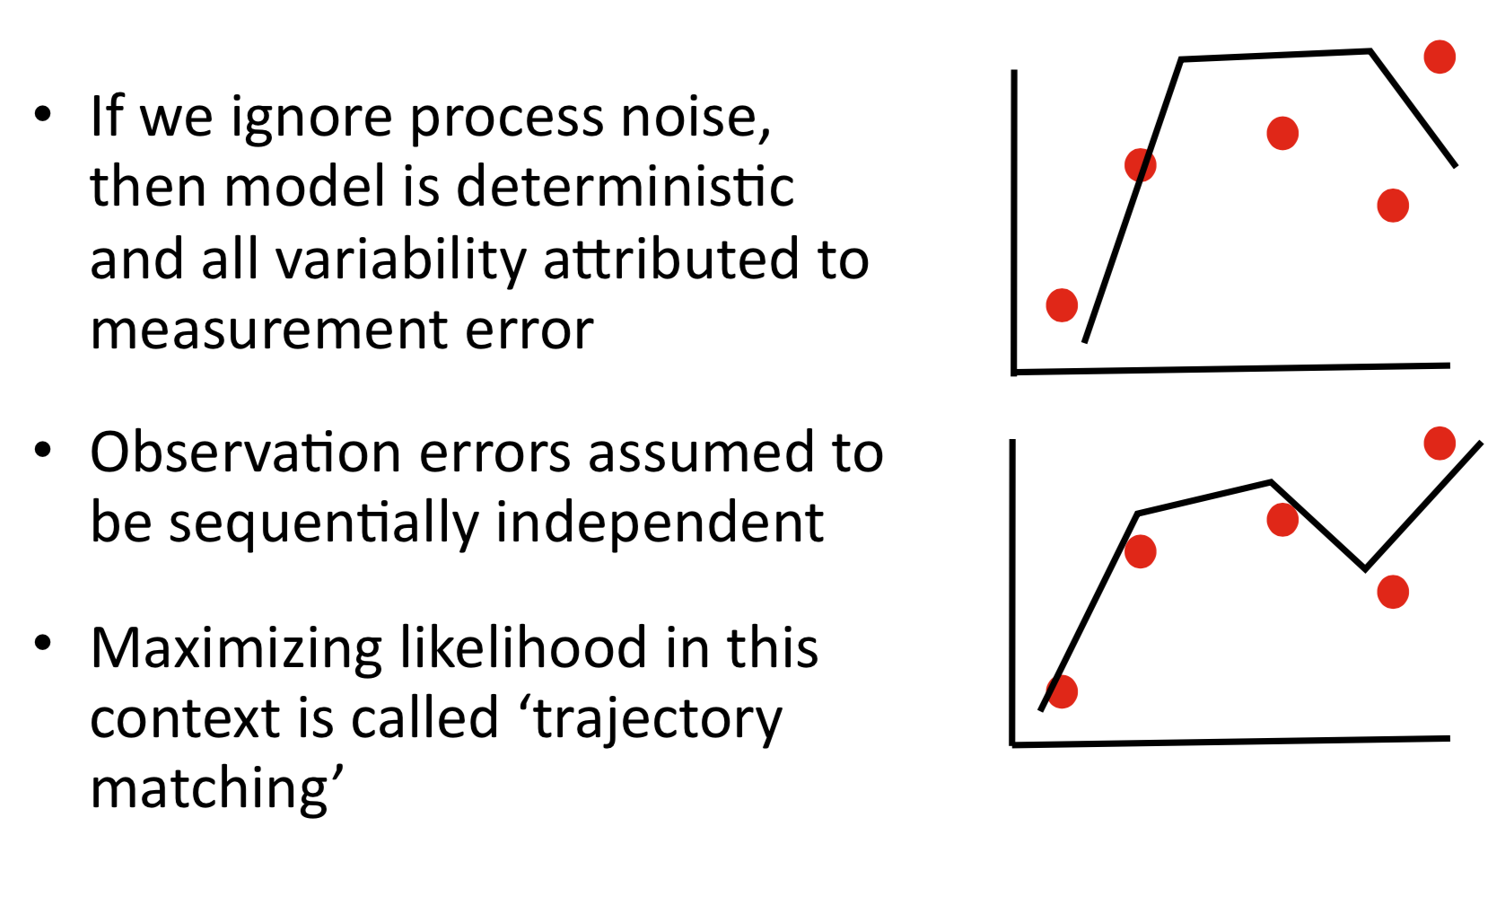
Trajectory Matching

Slide 19
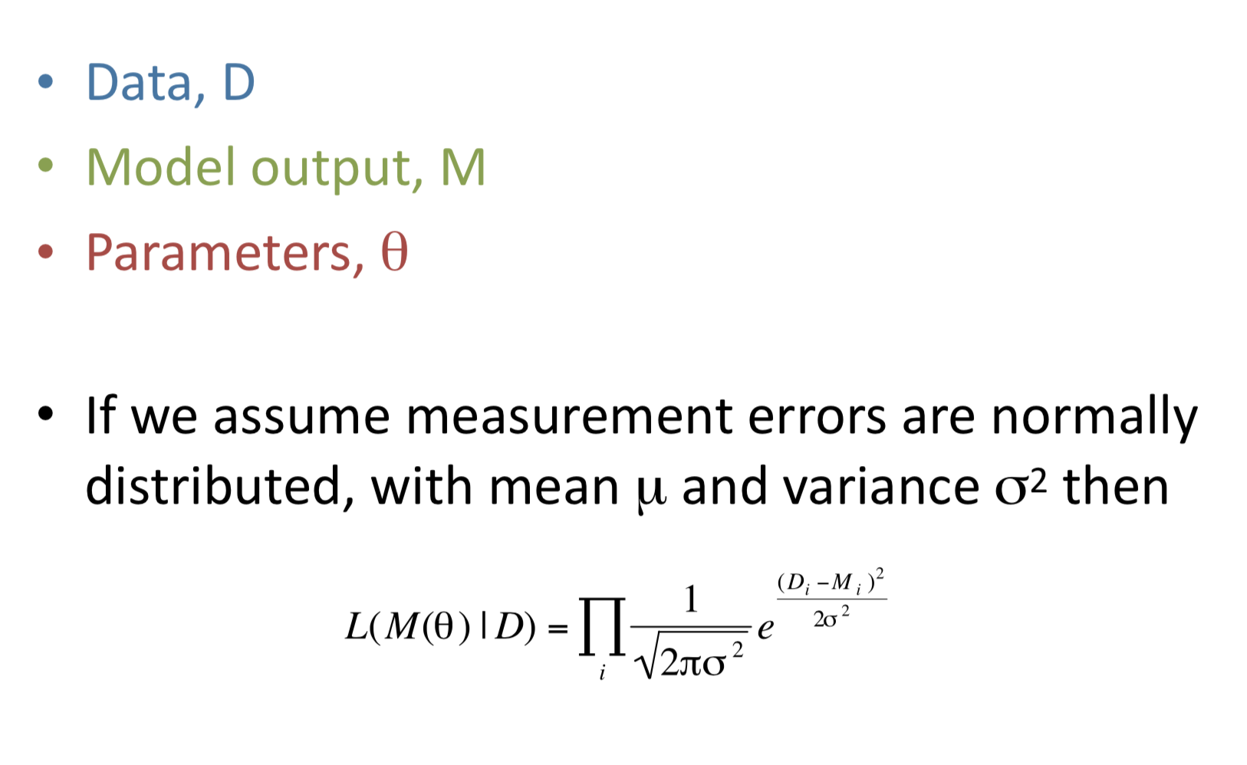
Likelihood Estimation (with no process noise)

Slide 20
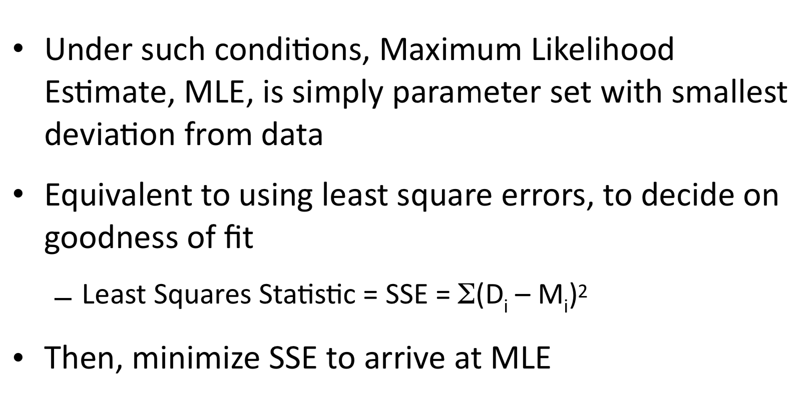
Likelihood Estimation

Slide 21
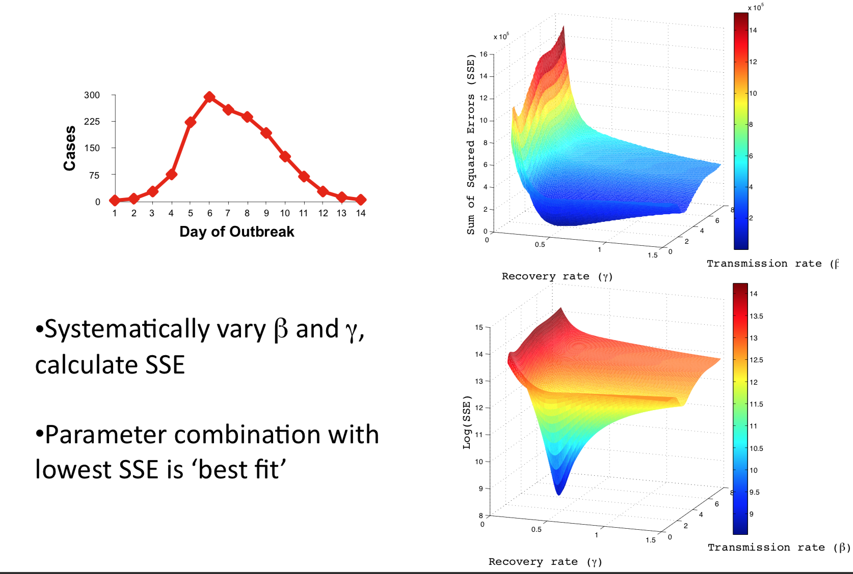
Parameter Estimation: Influenza Outbreak

Slide 22
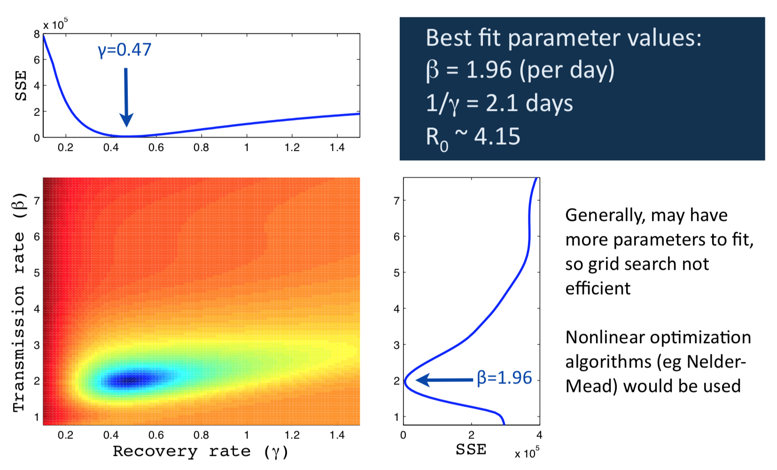
Parameter Estimation: Influenza Outbreak

Slide 23
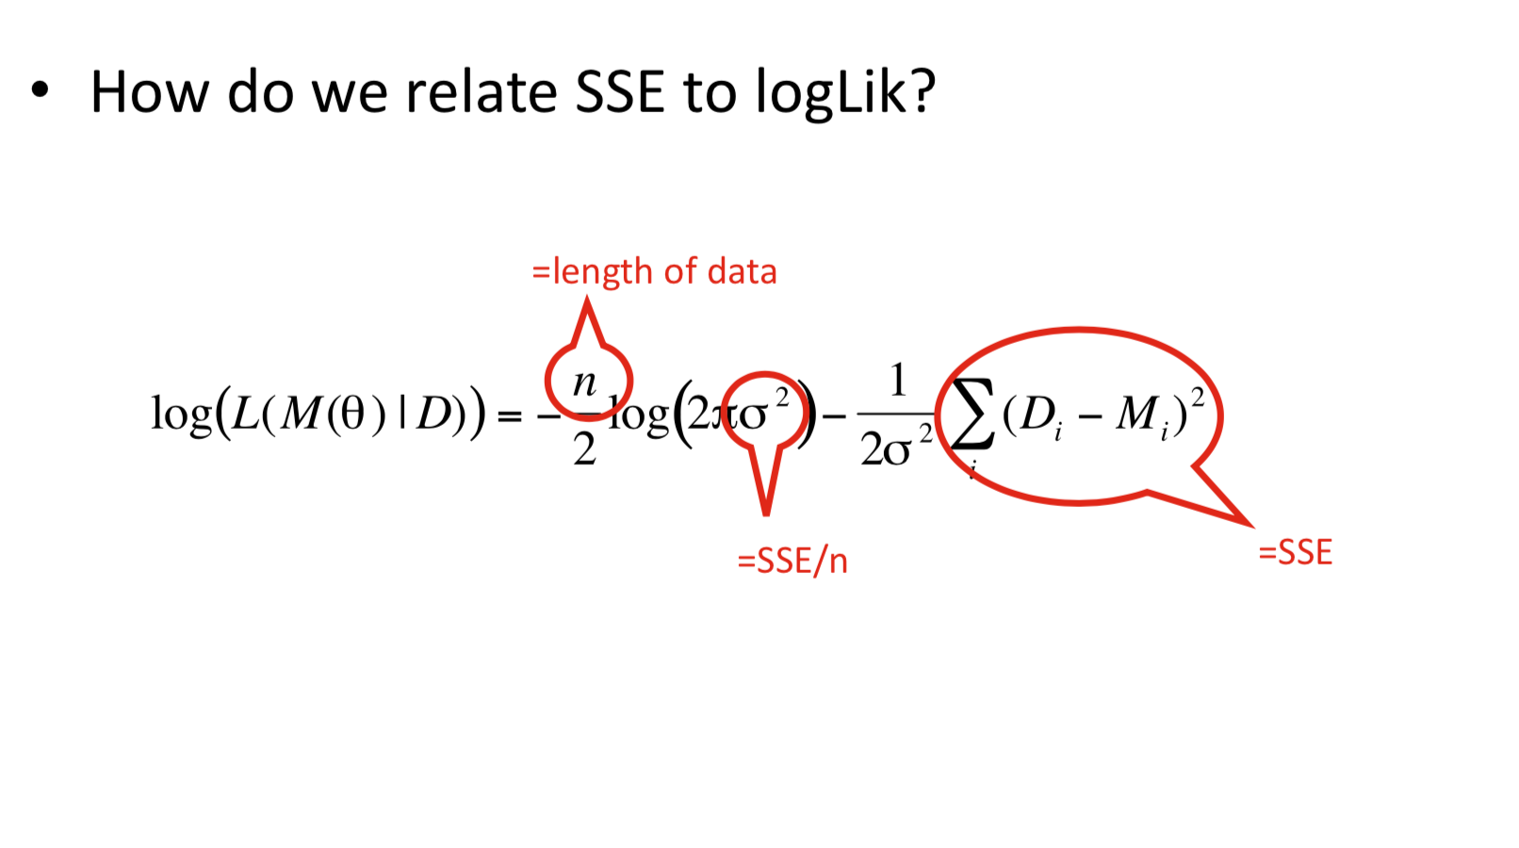
SSE vs. Log Likelihood

Slide 24
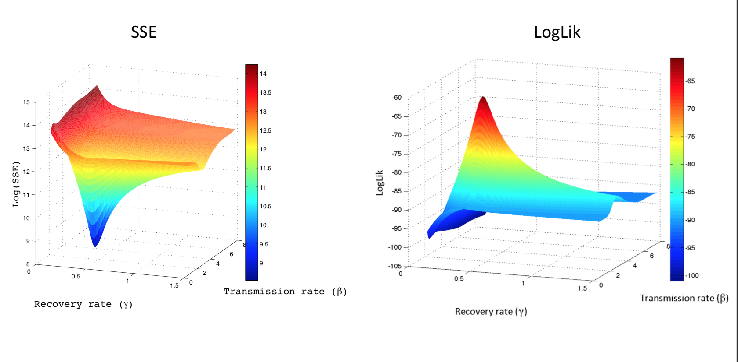
SSE vs. Log Likelihood

Slide 25
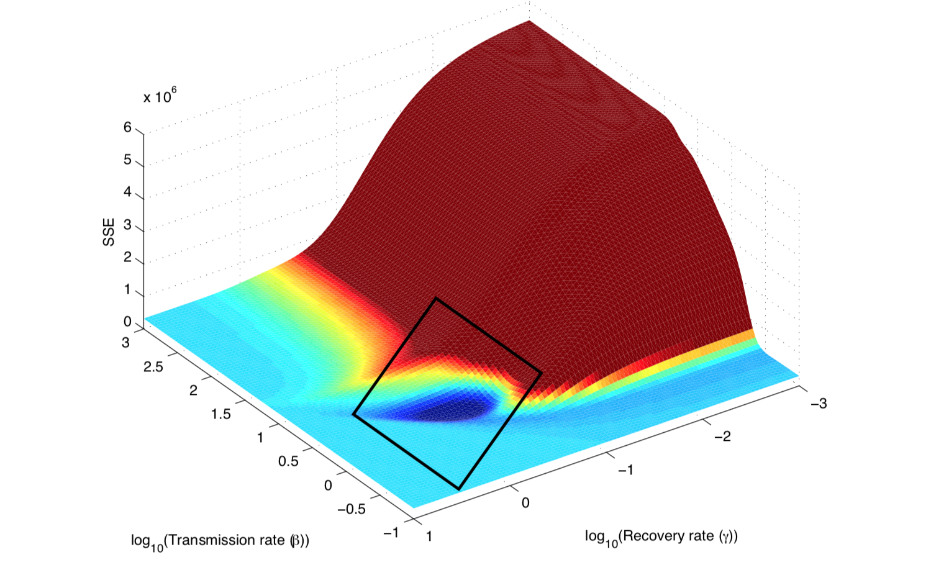
Surfaces often Complex

