Slide 1
Confronting models with data
Micaela E. Martinez
Emory University

Slide 2
Spectrum of models
There is a spectrum of models ranging from purely theoretical models to fully data driven models. They differ by the amount of data integration into the model itself and the level to which the model is fit to data
theoretical
models
data-driven models

Slide 3
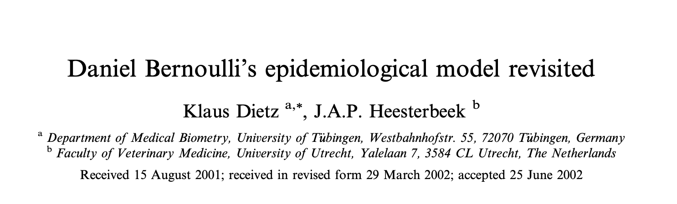
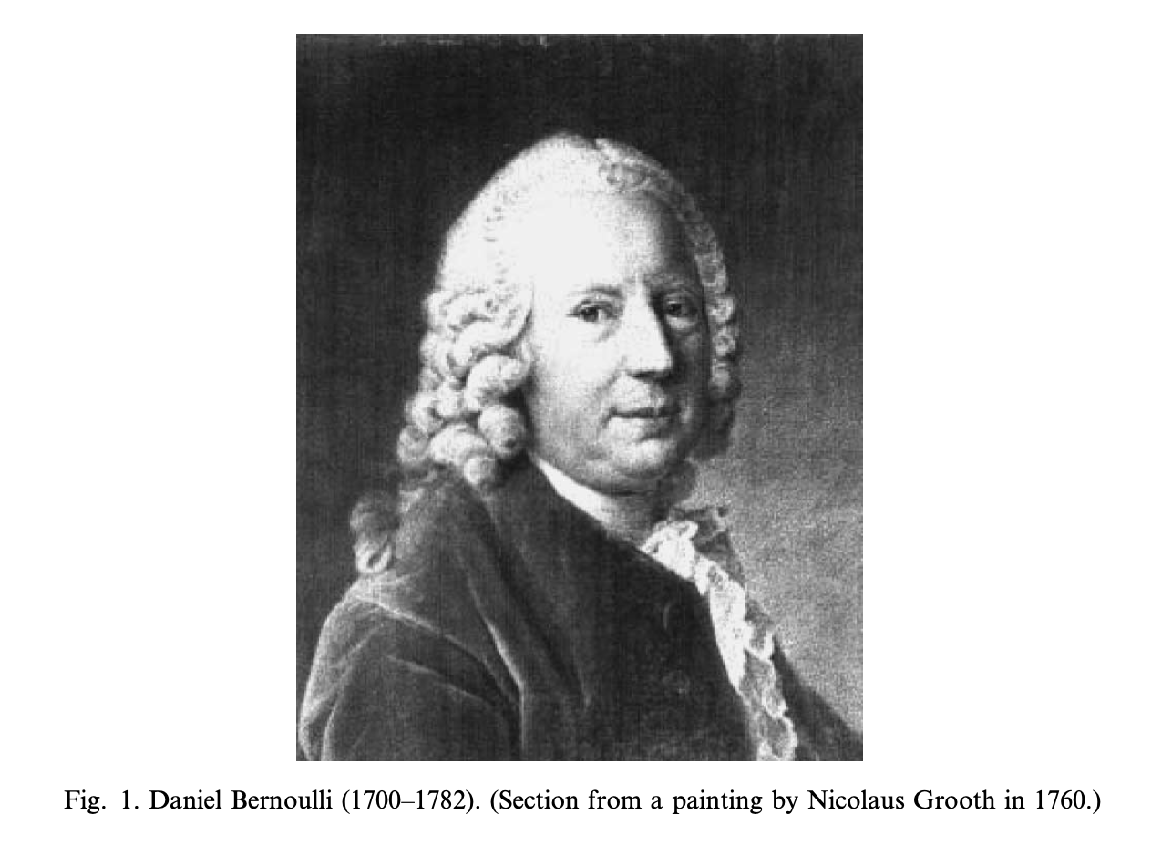
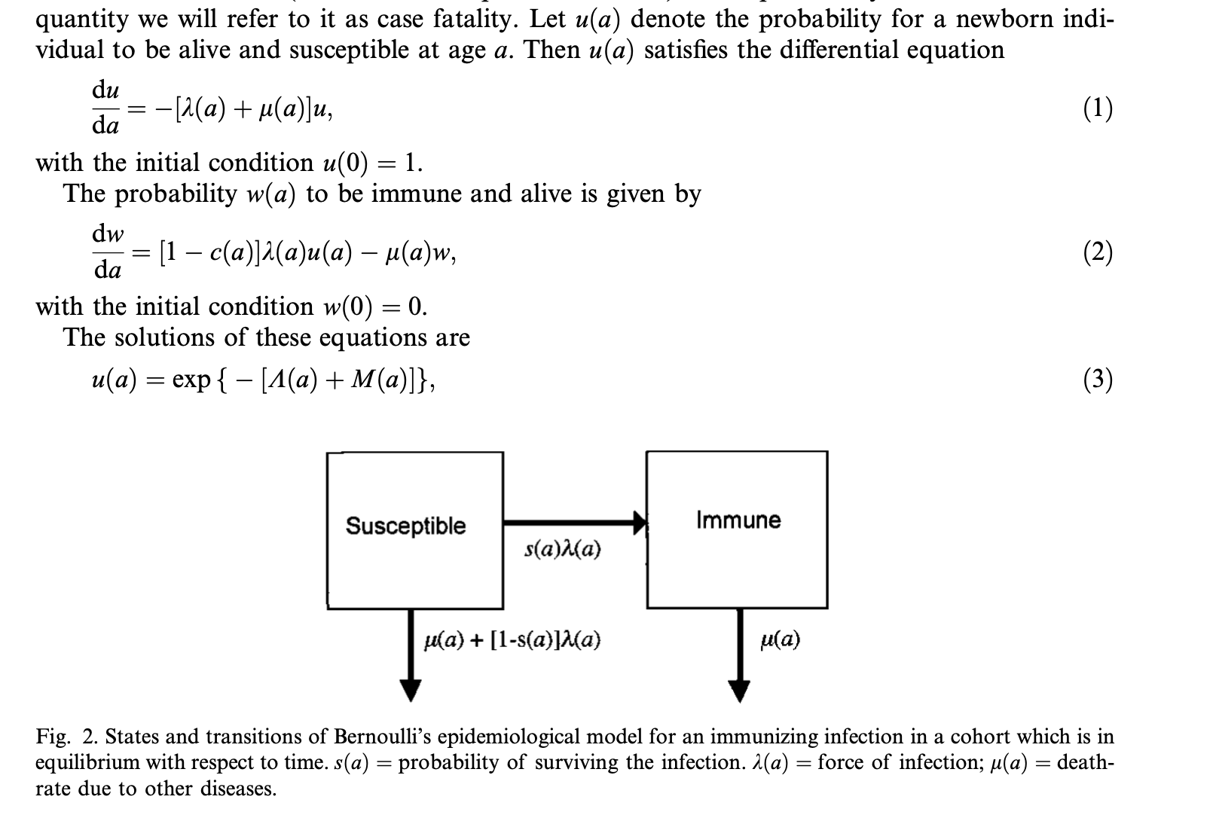
In the 1700s Bernoulli created an age structured Susceptible-Immune model to estimate the change in life expectancy if smallpox were eradicated

Slide 4
Theoretical models
Theoretical models, such as Bernoulli’s smallpox model have used to explore the behavior and impact of epidemics in theoretical populations, where simulations are run without one or more set of parameters that are not tied to a particular real-world population

Slide 5
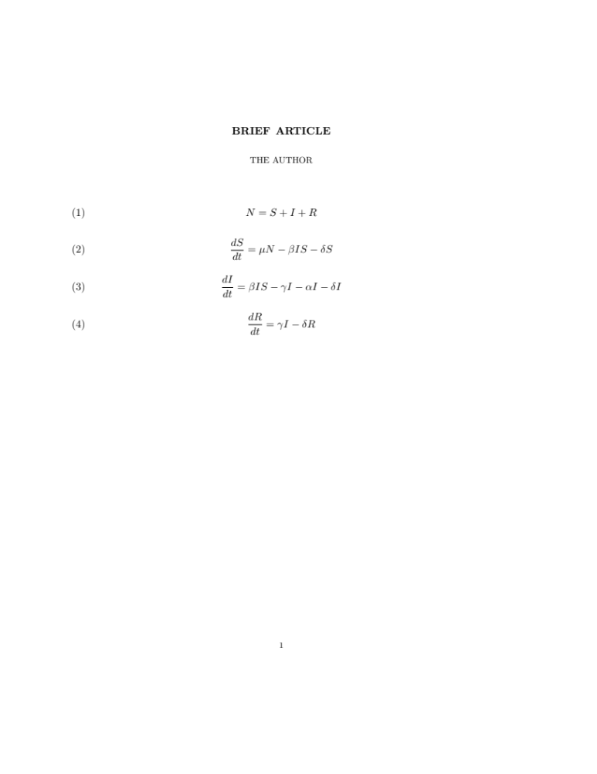
Fully theoretical
Here S, I, and R are fractions of the population and therefore can represent any population

Slide 6
Model with real-world Population
Set N equal to the population under study.
S, I, and R initial conditions can be fit to data and/or we can base them on real world data

Slide 7
Adding Demography
Demography may be added to models as covariates, fixed or time-varying parameters, and/or constraints on initial conditions:
population size
births
natural death (i.e., deaths from causes other than for the disease in study
immigration
emigration

Slide 8
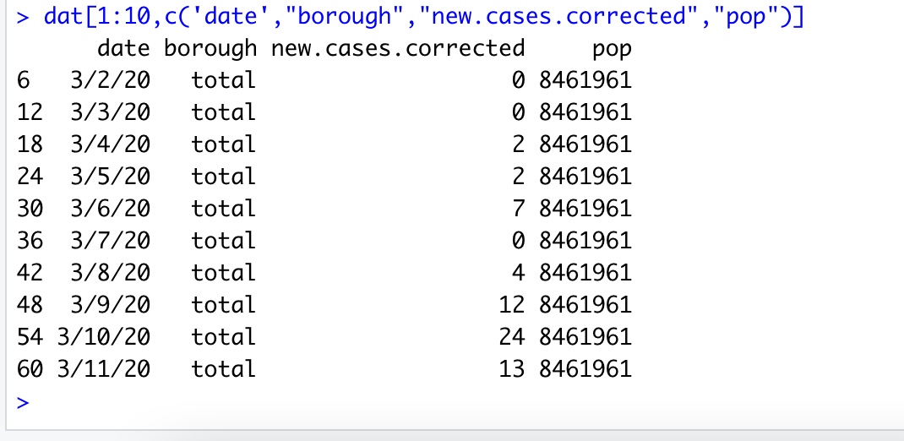
Adding real-world Population Size
Consider COVID-19 in NYC in March 2020. N = 8,461,961
We can assume that everyone was susceptible at the time SARS-CoV-2 came to NYC and there was initially one infected

Slide 9
Adding real-world Births & Deaths
Now consider the birth rate and the natural death rate in a population.
Births can be added in as a rate or as a covariate time series.
Non-specific mortality can be entered as a fixed or time varying rate.
Incorporating data on time varying births and deaths is particularly important over long time horizons when birth and death rate vary and the population size fluctuates

Slide 10
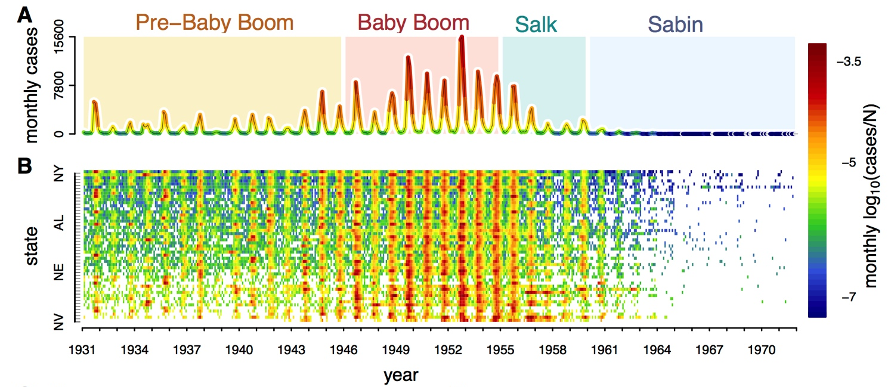
Rise and fall of polio in the 20th century
Incorporating data on time-varying births is important for studying childhood disease dynamics during time periods when birth rates varied because births are the source of susceptible recruitment
ME Martinez-Bakker, King, & Rohani 2015.
PLoS Biology

Slide 11
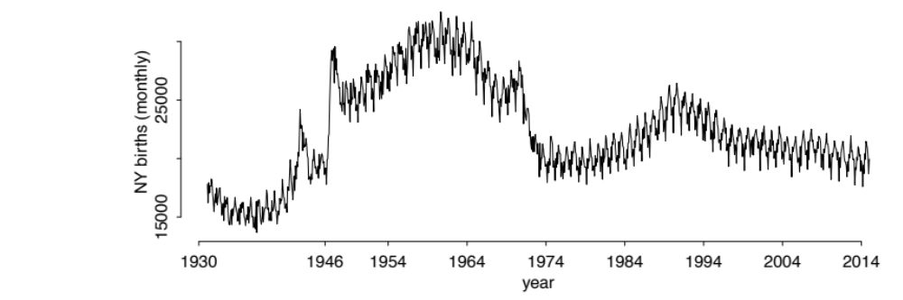
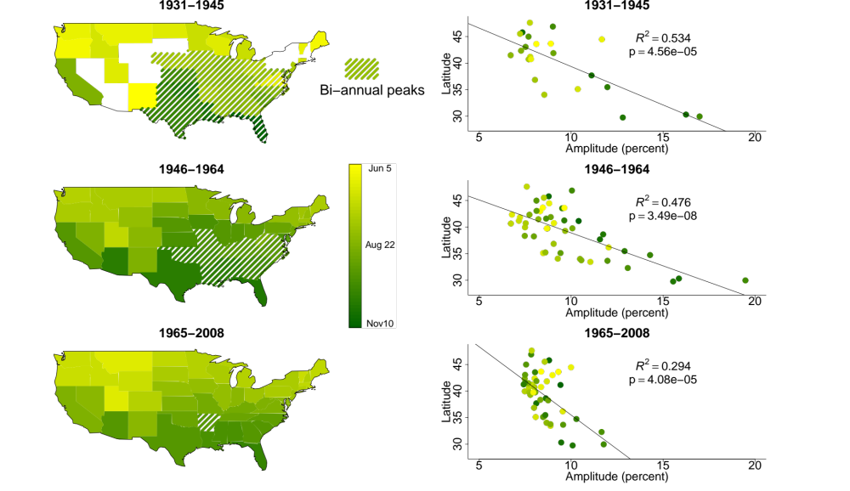
Rise and fall of polio in the 20th century
Latitudinal gradient in timing of birth peak
Birth seasonality was observed in every state
Time of birth peak
Latitudinal gradient in birth amplitude
Incorporating data on births is important for capturing time-varying birth rates
Birth data is important for studying multiple populations where birth have spatial variation
ME Martinez-Bakker, Bakker, King & Rohani (2014) Proc B

Slide 12
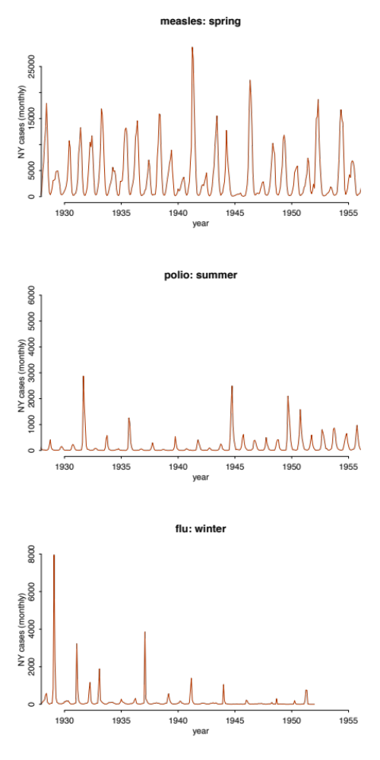
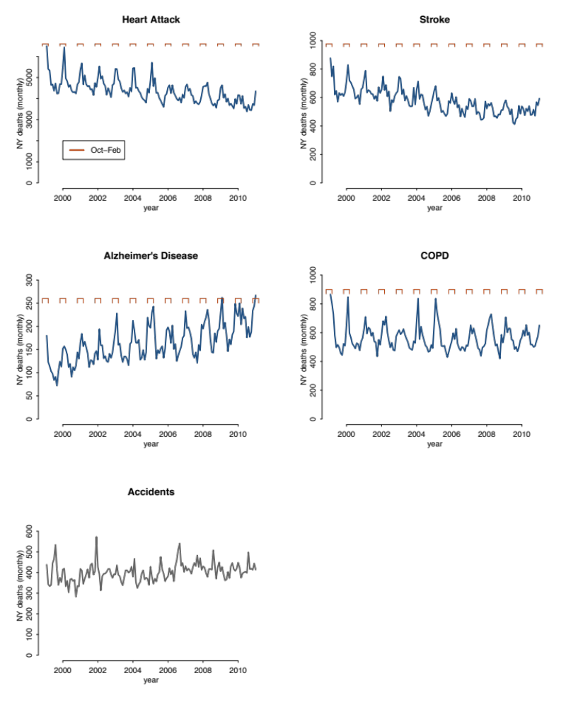
Infectious Diseases
Non-Infectious Disease Mortality
Including variation in births, mortality, and/or population size can be important when there is co-variation over. Births and non-specific deaths can impact transmission through their impact on the size of the susceptible pool.
ME Martinez (unpublished)

Slide 13
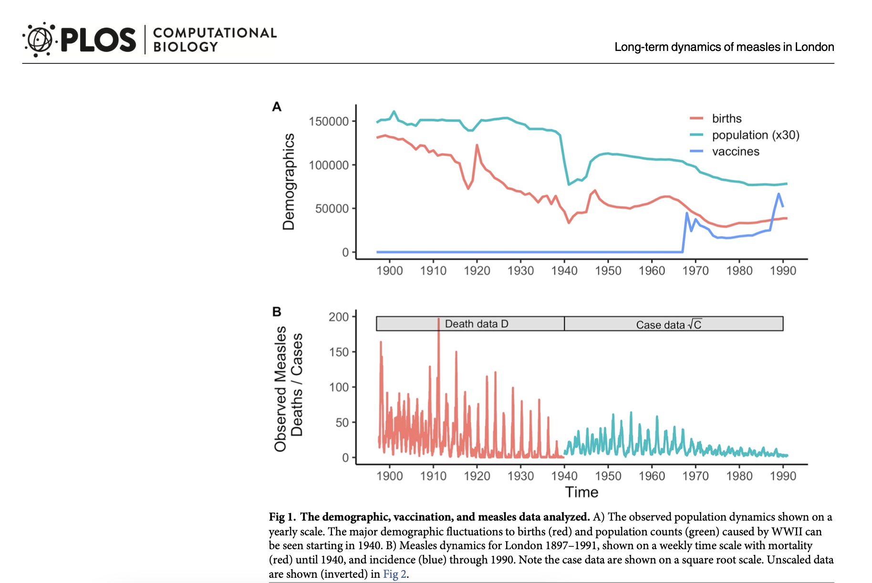
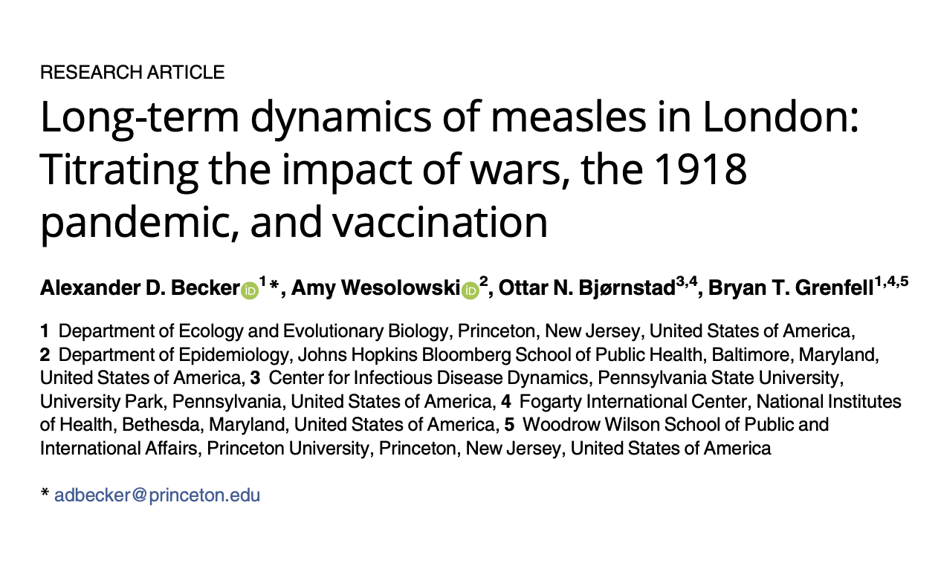

Slide 14
Adding real-world Immigration & Emigration
immigration and emigration are often used in coupled SIR models where multiple populations are coupled via migration and SIR. Since the migration of infected individuals will have the most impact on the system, we can explore an example of only tracking infection migration
1
2
+ e₂I₂ – e₁I₁
+ e₁I₁ – e₂I₂
1
1
1
1
2
2
2
2

Slide 15
Adding Covariates
Covariates are time series data or time-varying functions put into the model that covary with the infection process
Seasonal covariates are common in models of recurrent epidemics
covariates may represent behavioral changes, economic changes, interventions (essentially any time varying elements important that impact disease dynamics other than demography)

Slide 16
Seasonal forcing of transmission
Transmission may be seasonally forced via environmental conditions, host behavior, and/or host physiology
Common seasonal forcing include term-time forcing based on school terms in childhood disease models, as well as climate and weather forcing for infections whose transmission is sensitive to environmental conditions

Slide 17
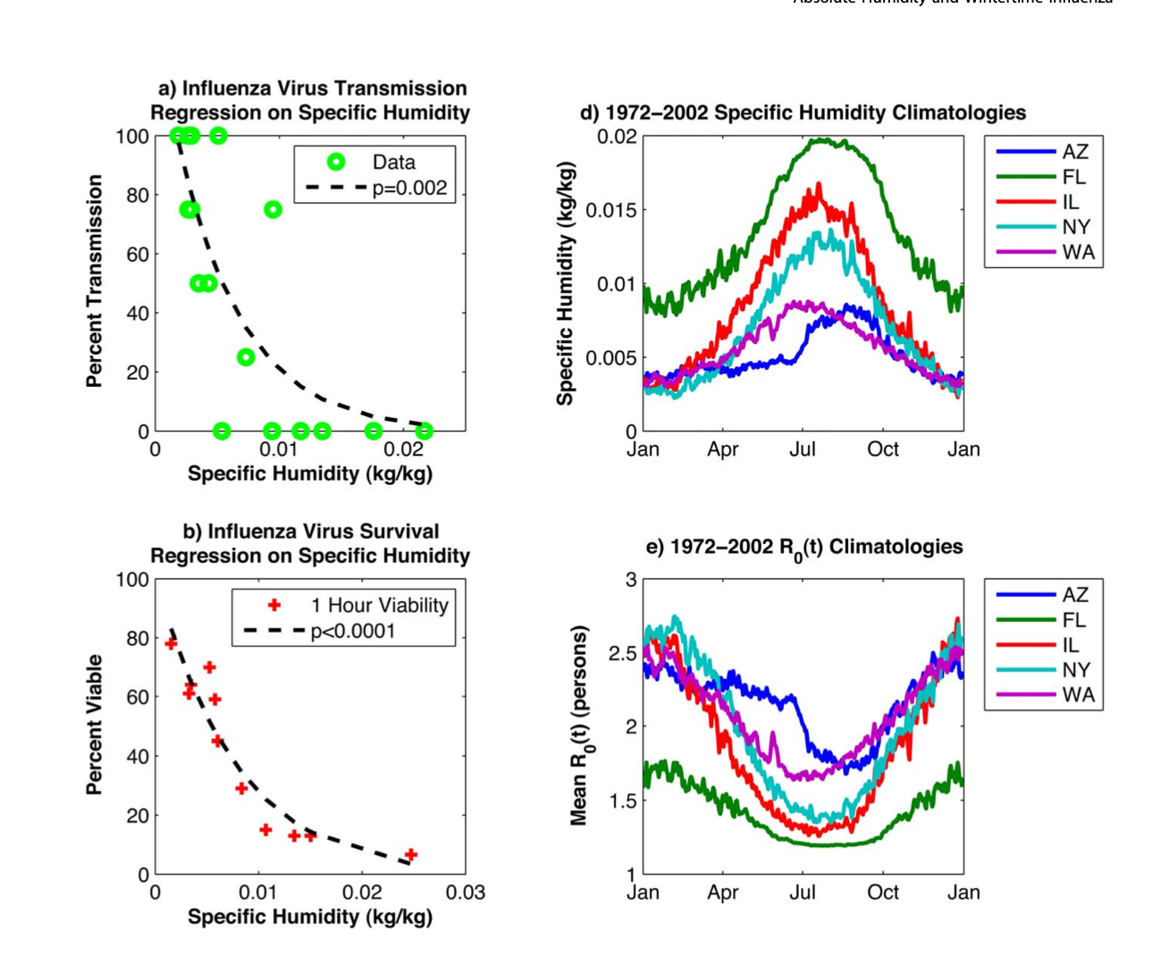
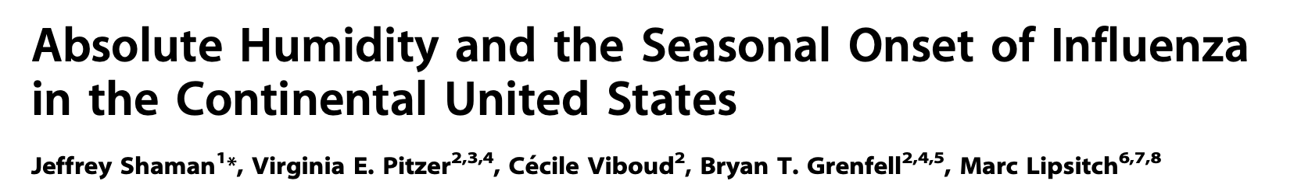
temperature and humidity in models
Specific humidity impacts flu survival and transmission and may be added into models as a covariate into Beta(t) to capture the seasonal transmission of flu

Slide 18
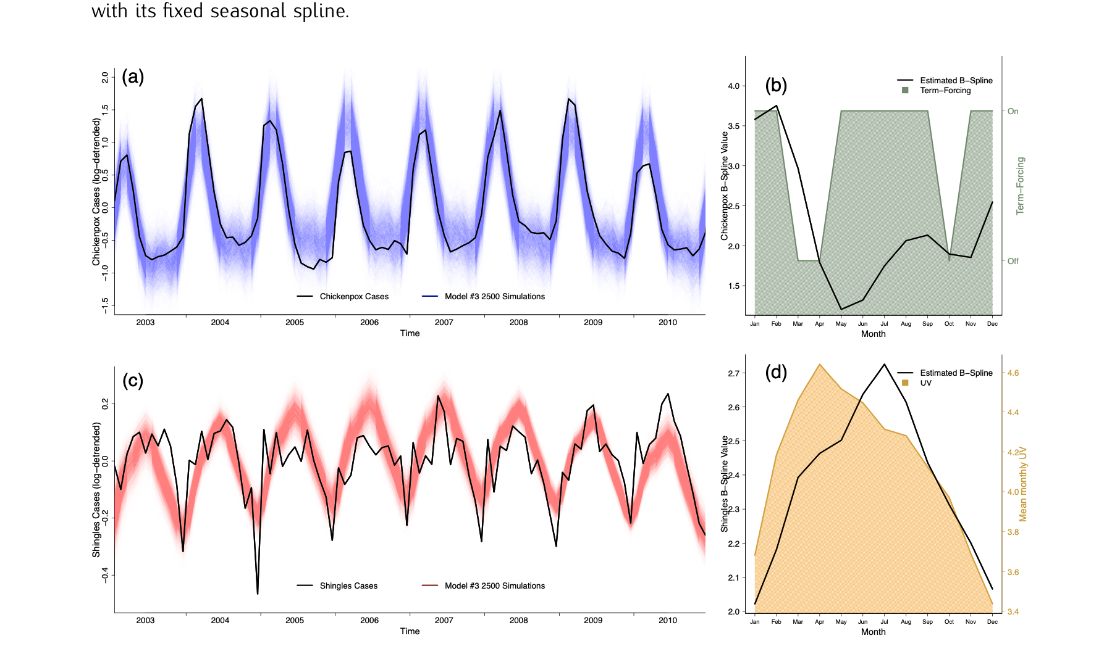

school terms
School terms can be added into models of childhood disease transmission to modulate Beta(t) seasonally.
B-splines can also be uses to estimate the seasonal transmission rate as shown here for chickenpox in Thailand
Bakker et al. Amer J Epi 2021

Slide 19
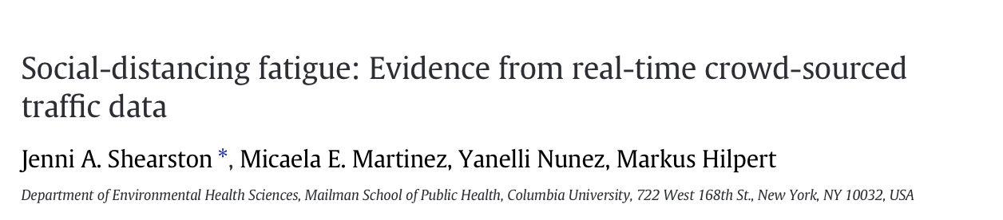
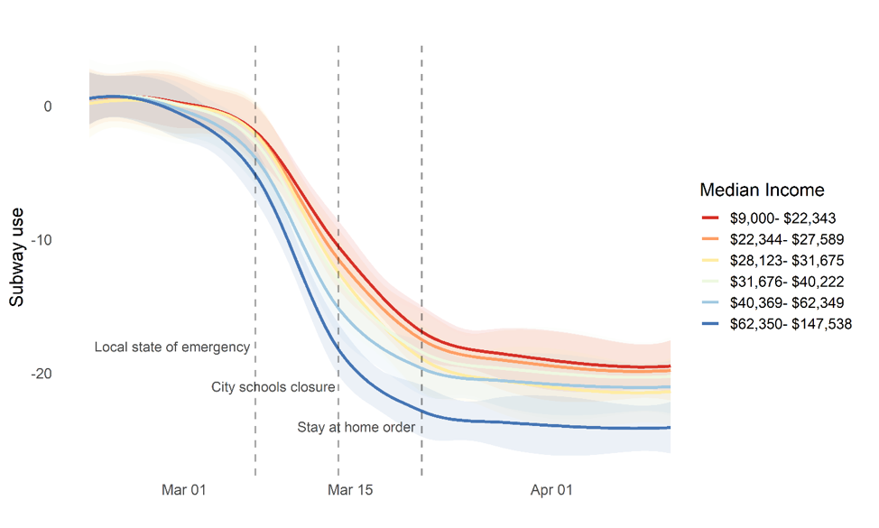
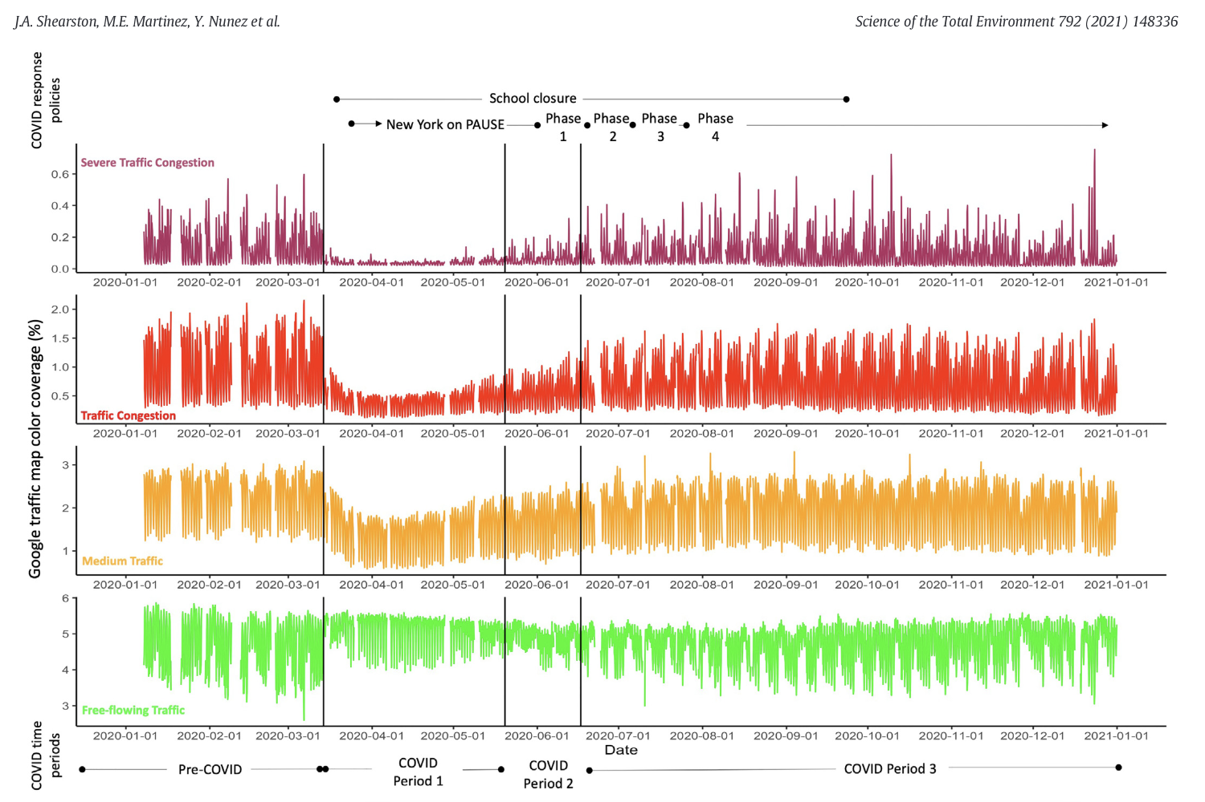
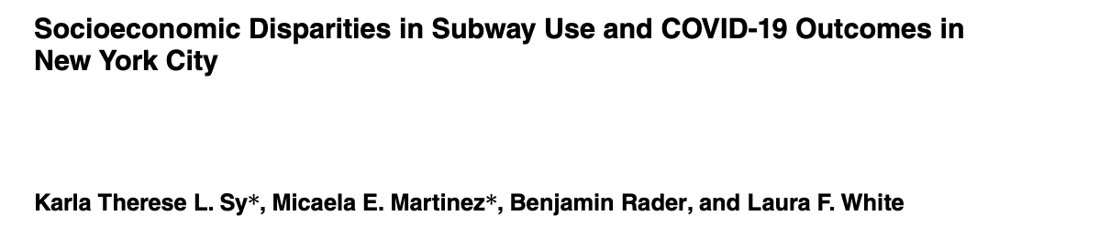
mobility

Slide 20
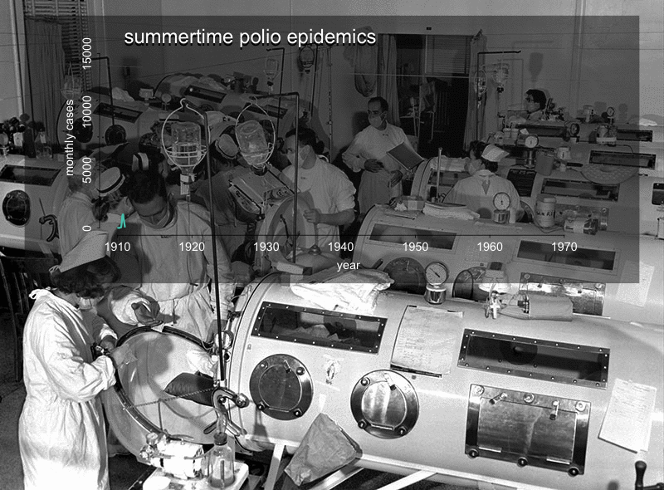
vaccination Uptake
IPV was initially studied and rolled-out in 2nd and 3rd graders before expanding across age groups and eventually becoming an infant vaccine

Slide 21
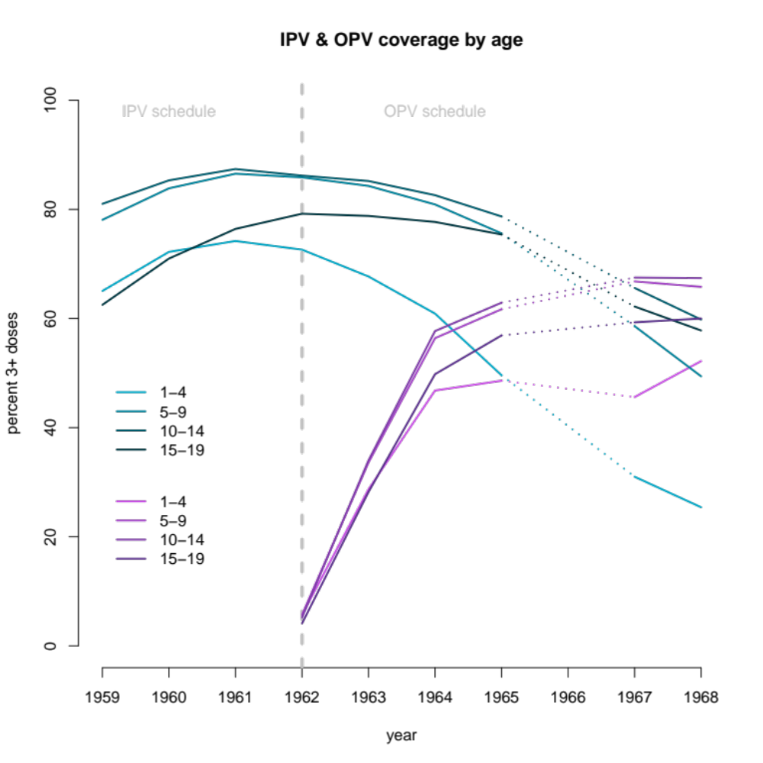
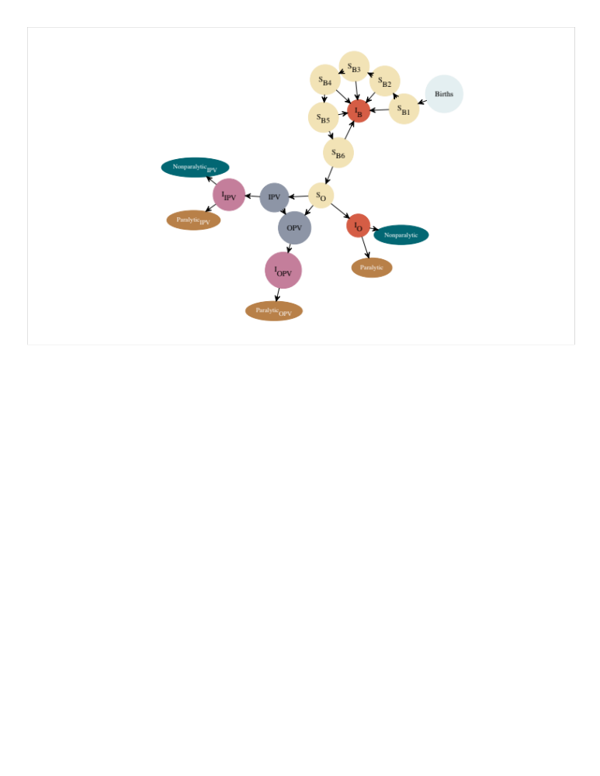
vaccination Uptake

Slide 22
Model is fit to case data

Slide 23

Maximum likelihood via Iterated particle Filtering (MIF)
Natural Selection on Parameter Sets
MIF is an algorithm that can be used to search parameter space to maximize likelihood
The “fitness” of each parameter set is the likelihood of the data given the model with that parameter set, L(Θ) = p(y|Θ)
parameter sets
After selection
After reproduction
Maximum likelihood estimate (MLE)

Slide 24
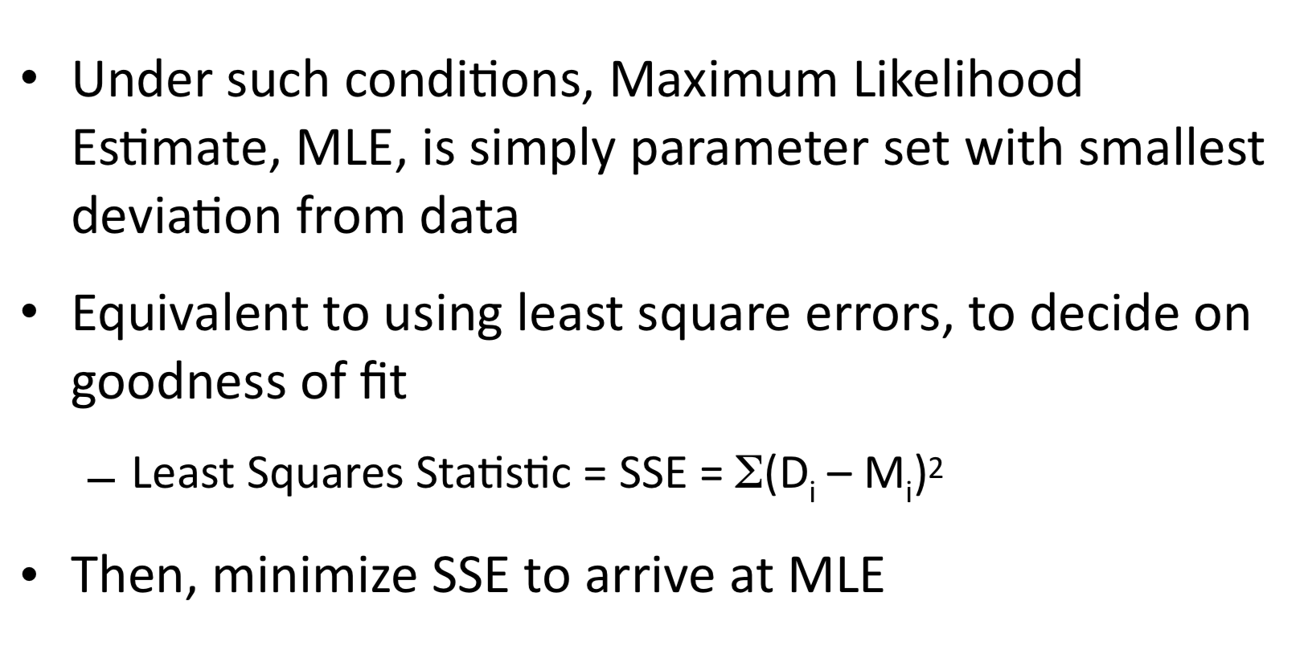
Likelihood Estimation

Slide 25
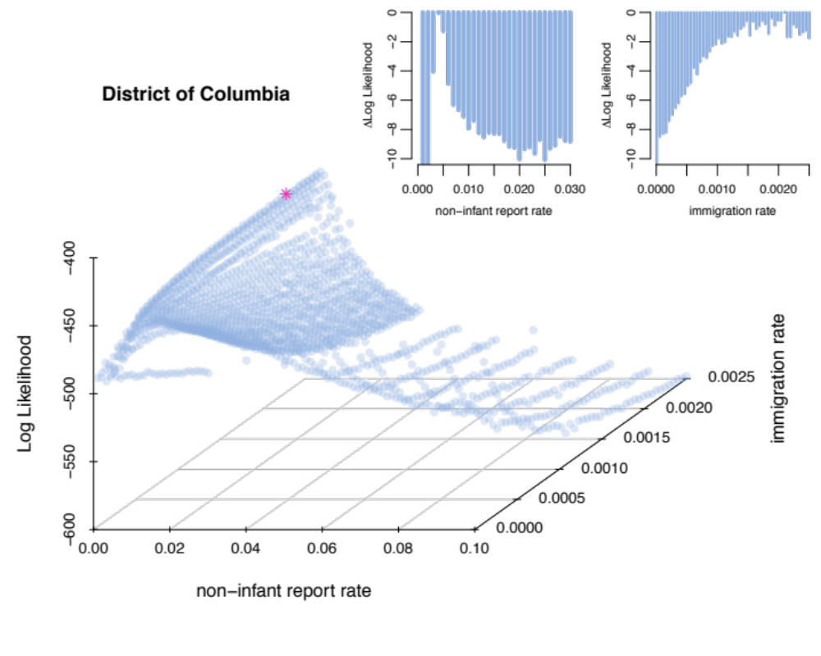
Maximum likelihood via Iterated particle Filtering (MIF)
MIF is an algorithm that can be used to search parameter space to maximize likelihood
The “fitness” of each parameter set is the likelihood of the data given the model with that parameter set, L(y|Θ)

Slide 26
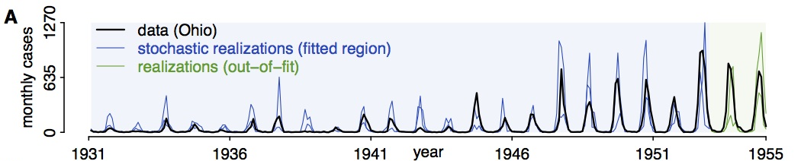
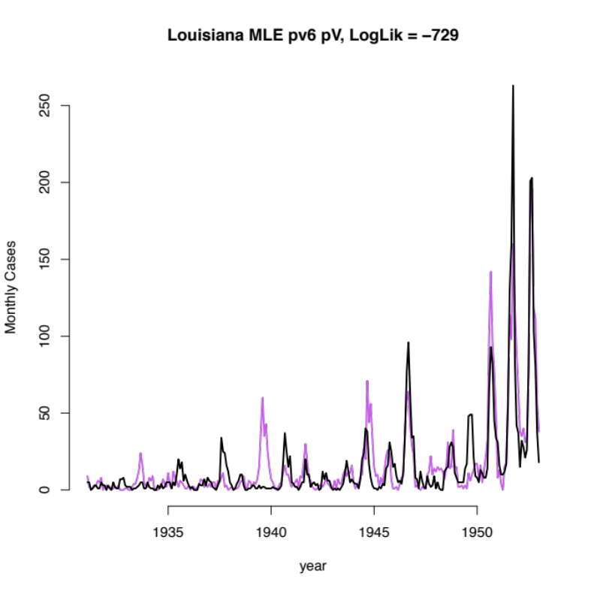
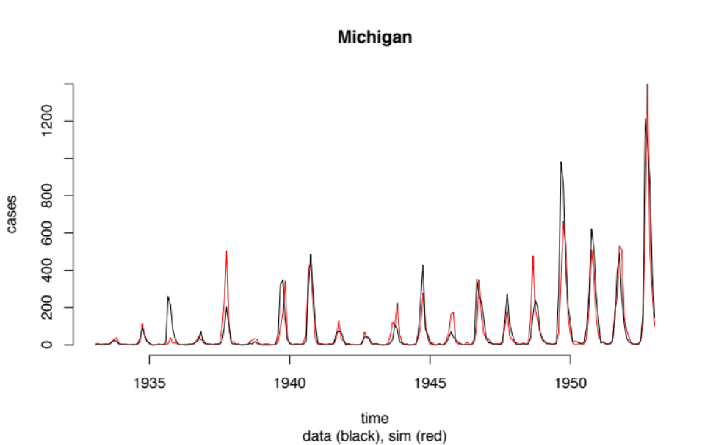

Simulating from the MLE
The data we observe is a single realization of all the possible trajectories of a stochastic process.
We can obtain the observed dynamics by simulating forward from initial conditions
simulation
data

Slide 27
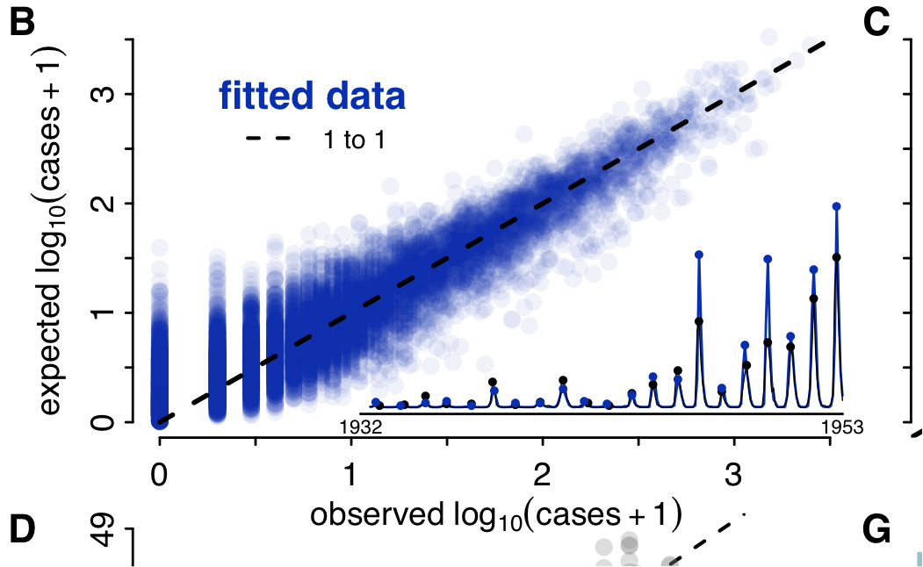
Model Validation
cases₀-cases_{n-1}
cases_{n}

Slide 28
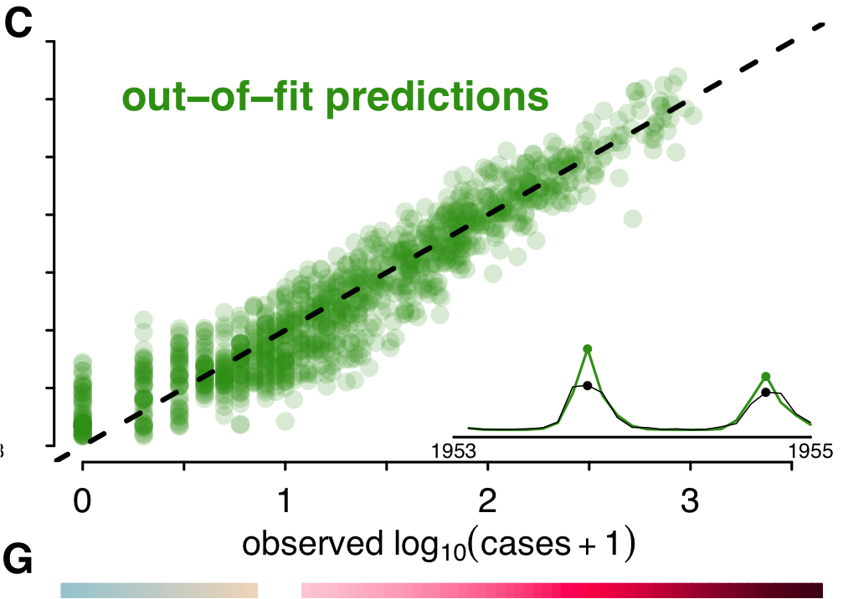
Model Validation
cases₀-cases_{n-1}
One-step-ahead predictions predict cases at time t using:
Model + MLE + cases₀+…+ cases_{t-1}
cases_{n}

Slide 29
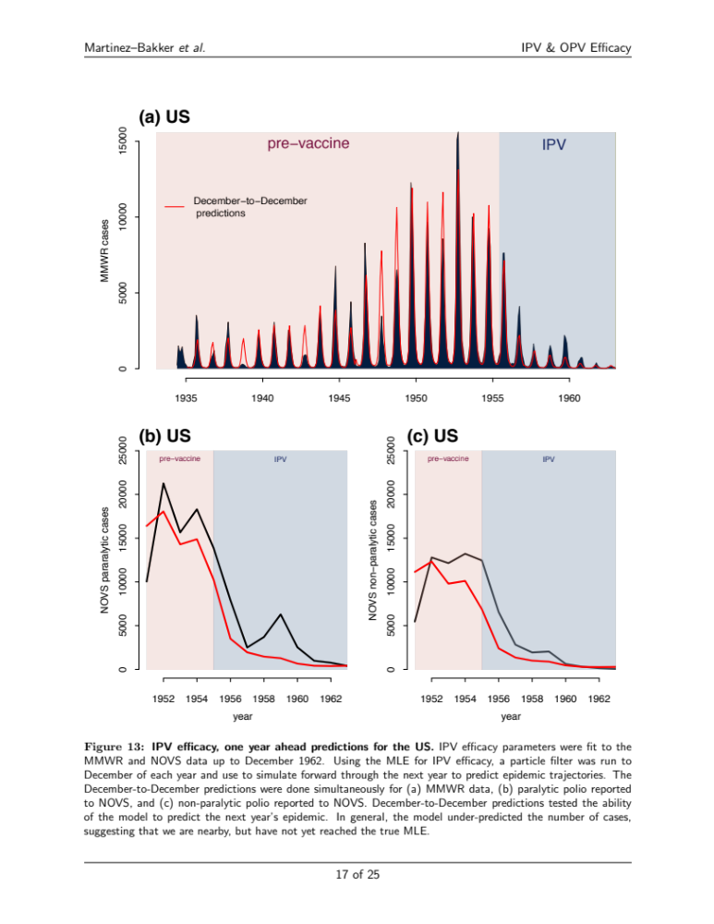
vaccination Uptake
By having high quality vaccine uptake covariate data for IPV, we were able to infer that it reduces transmission by 69%
ME Martinez (Dissertation)

Slide 30
Other covariates
Report rate (reporting system, healthcare infrastructure, etc.)
Treatment
Interventions (e.g., bed nets, social distancing, quarantine, etc.)

